Slide 1
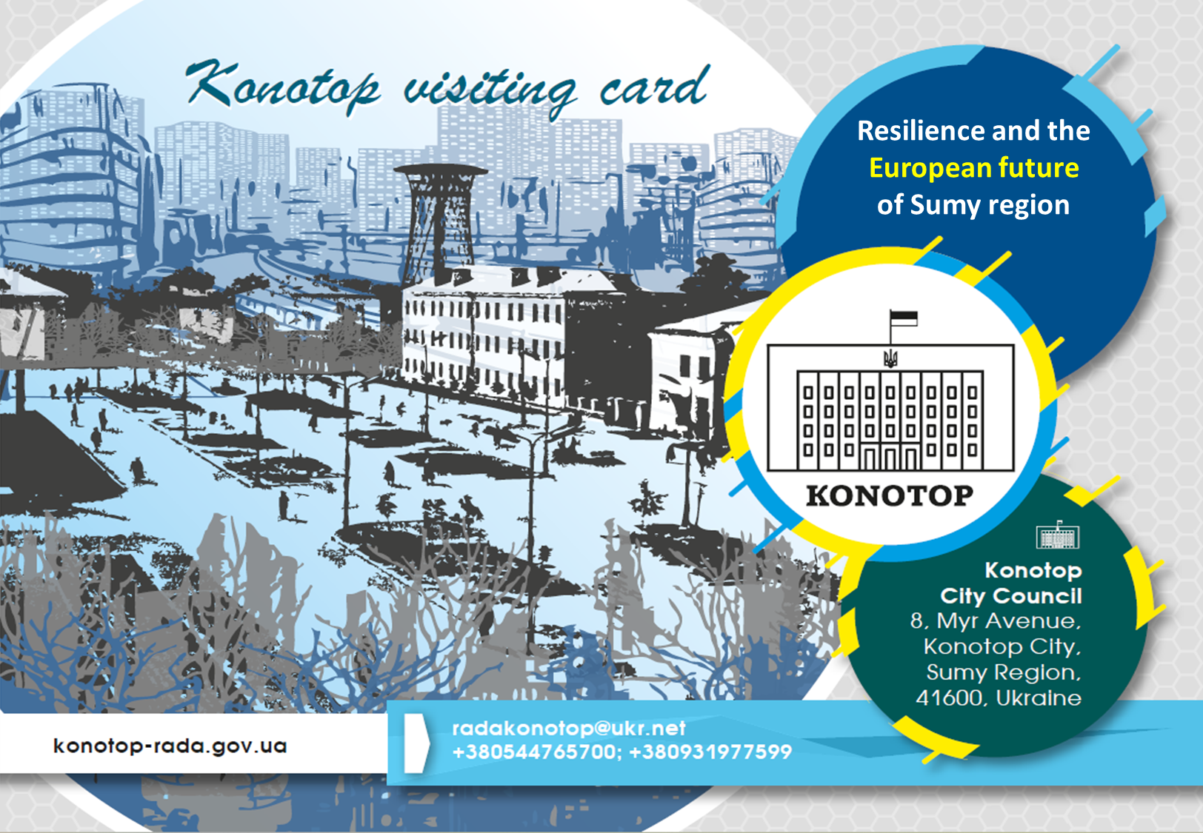

Slide 2
Contents
Reconstruction concept of Dvirtseva Ploshcha (Station square) in Konotop city (pages 3-16)
Introduction (pages 4-5)
Current state of the square (page 6)
Square layout (pages 7-8)
Project visualization (pages 9-16)
Creation of a Rehabilitation department at Konotop Hospital (pages 17-24)
Introduction (pages 18)
Building layout (page 19)
Current condition of the building (page 20)
Project visualization (pages 21-24)
Rehabilitation Centre with adaptive sports activities (pages 25-36)
Introduction (pages 26-27)
Main components of the project (pages 28-30)
Building layout (31-33)
Project visualization (34-36)
Conclusion (page 37)
Contact information (page 38)

Slide 3
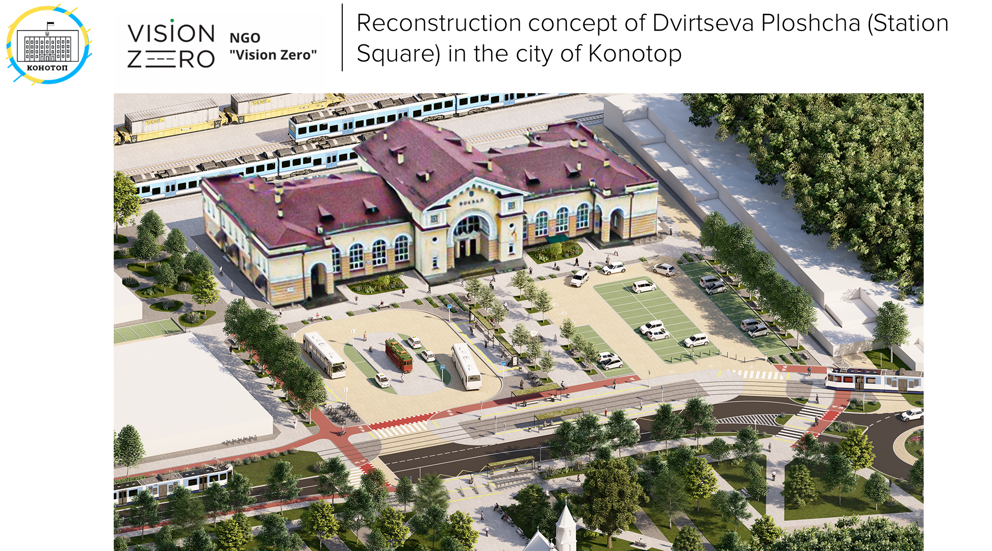

Slide 4
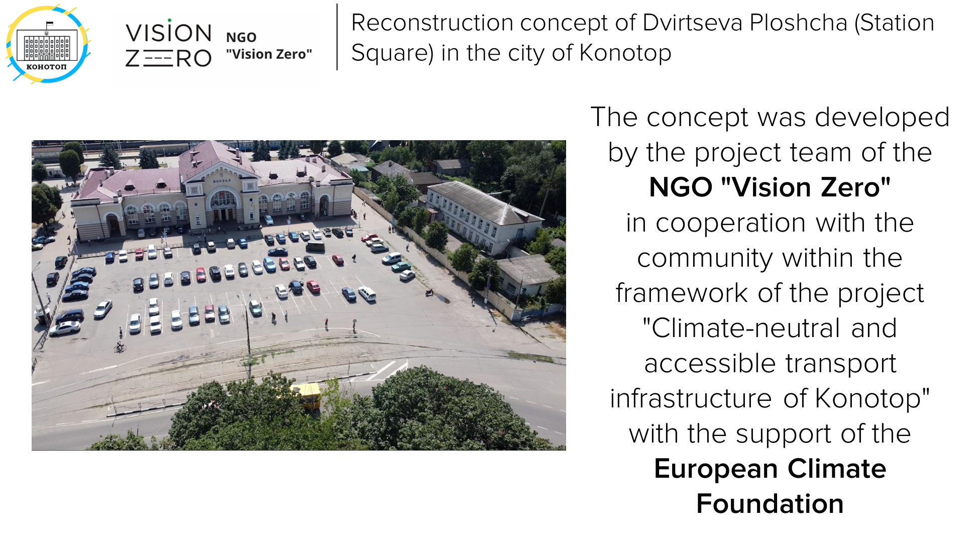

Slide 5
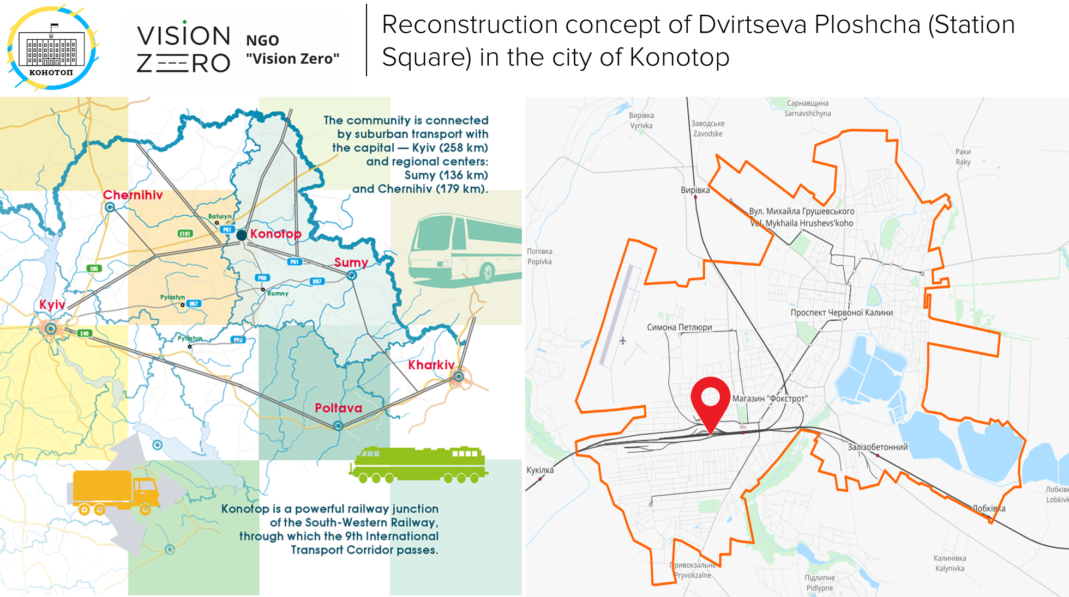

Slide 6
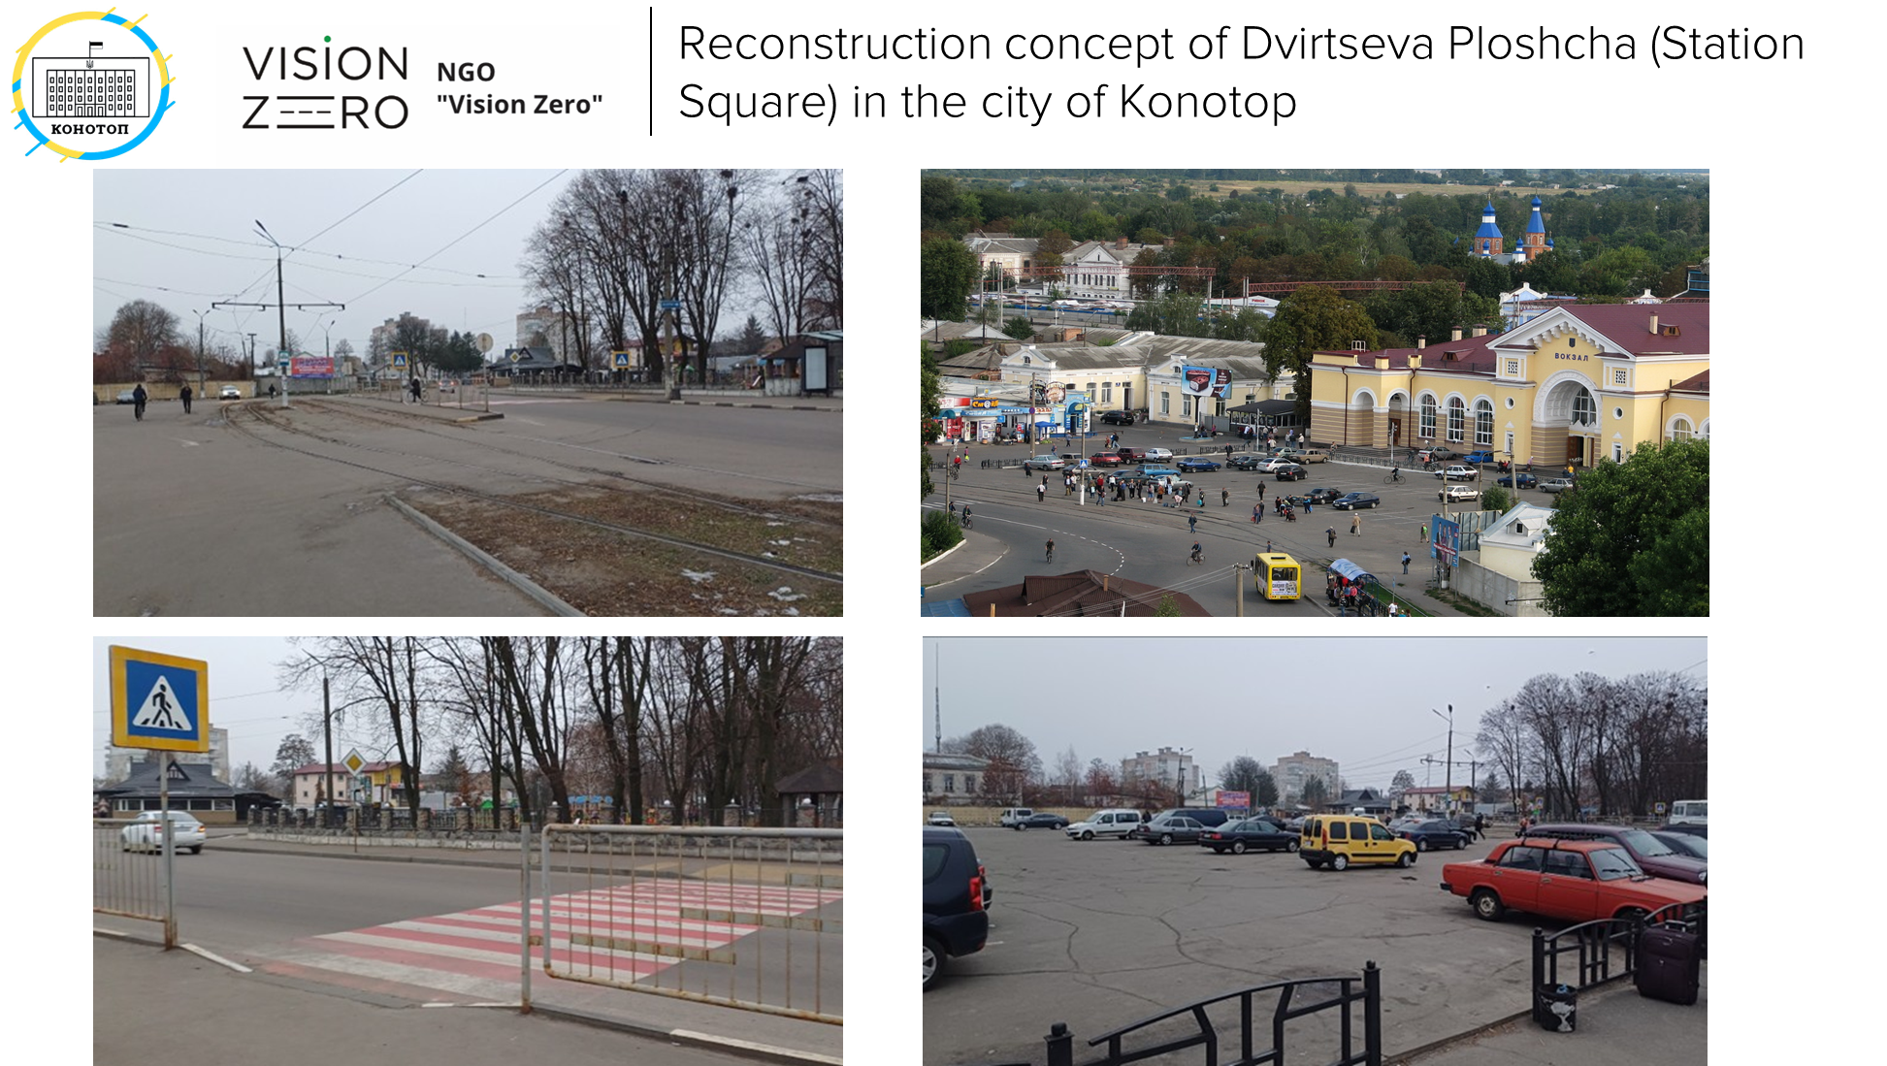

Slide 7
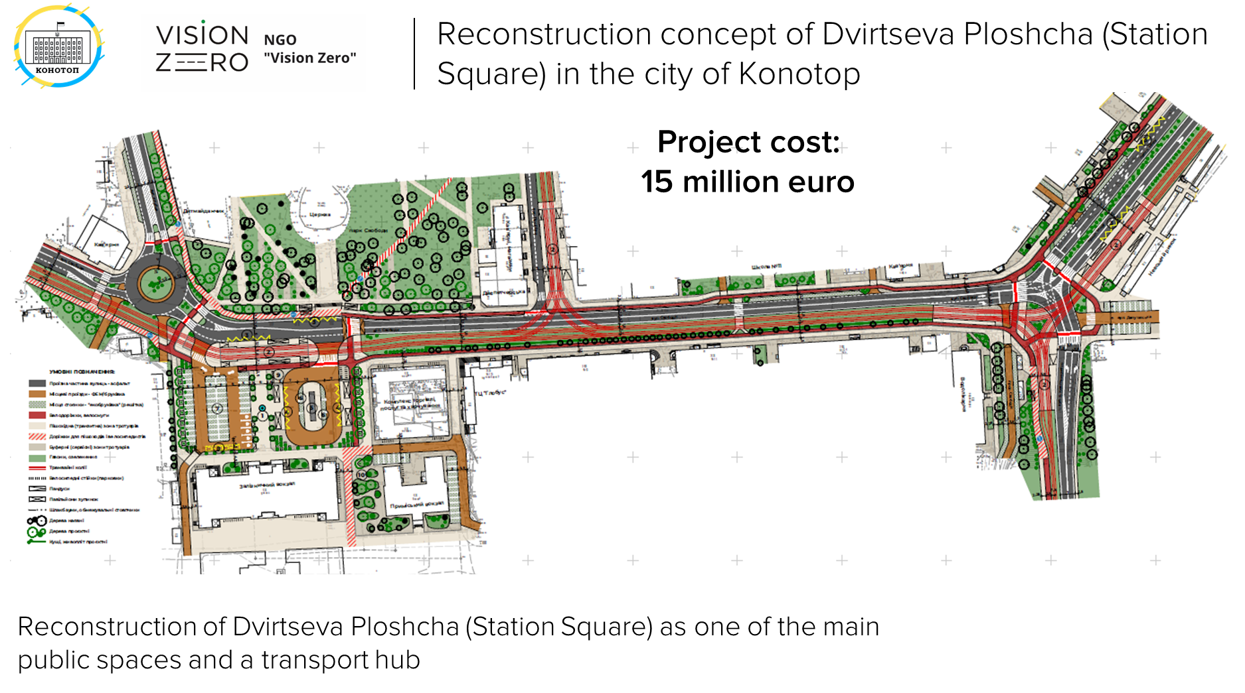

Slide 8
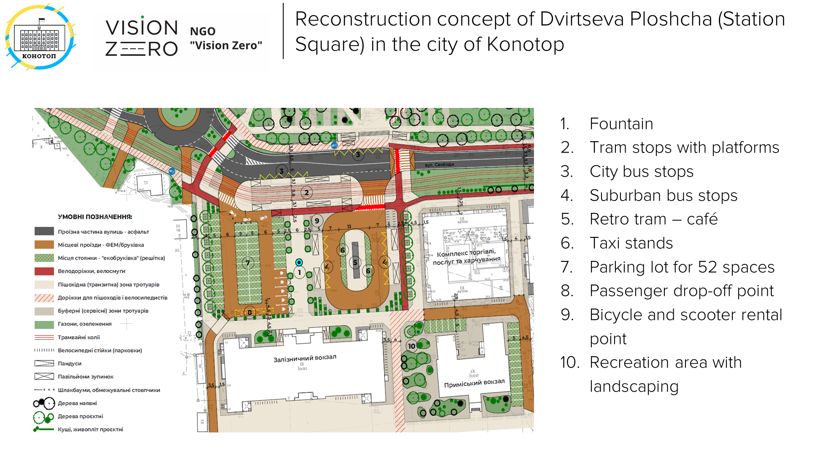

Slide 9
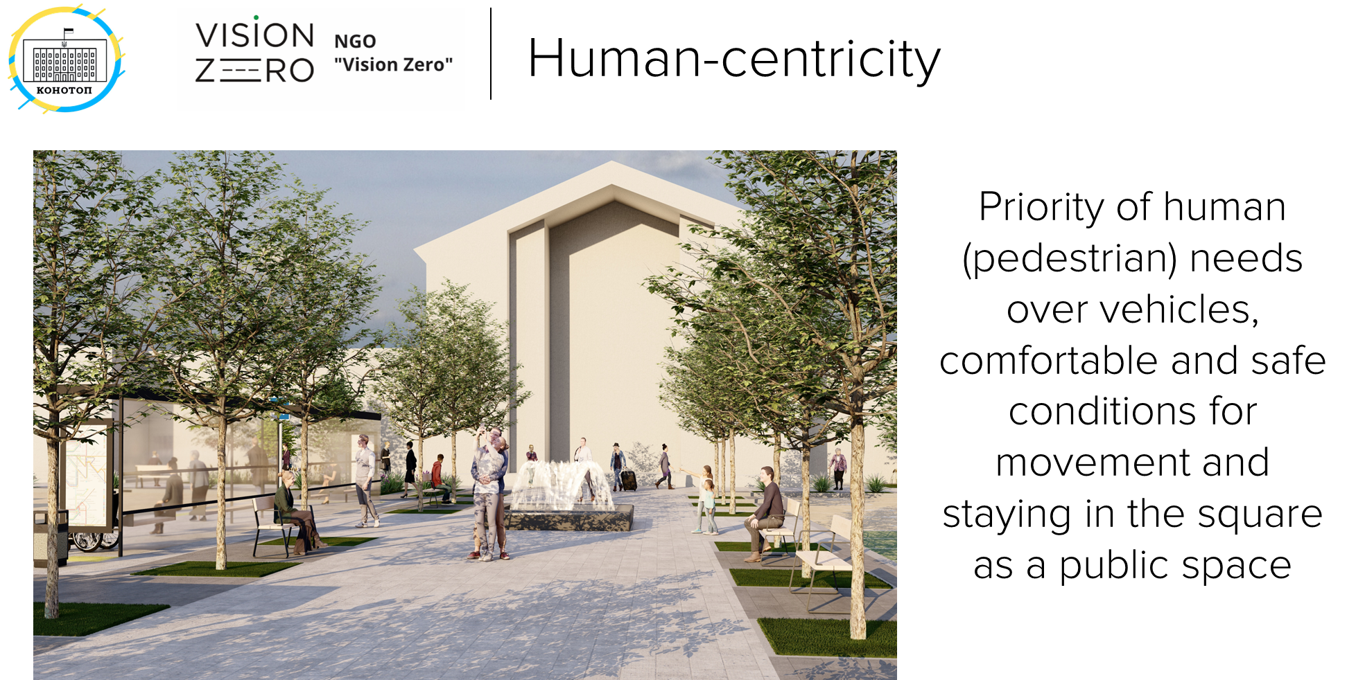

Slide 10
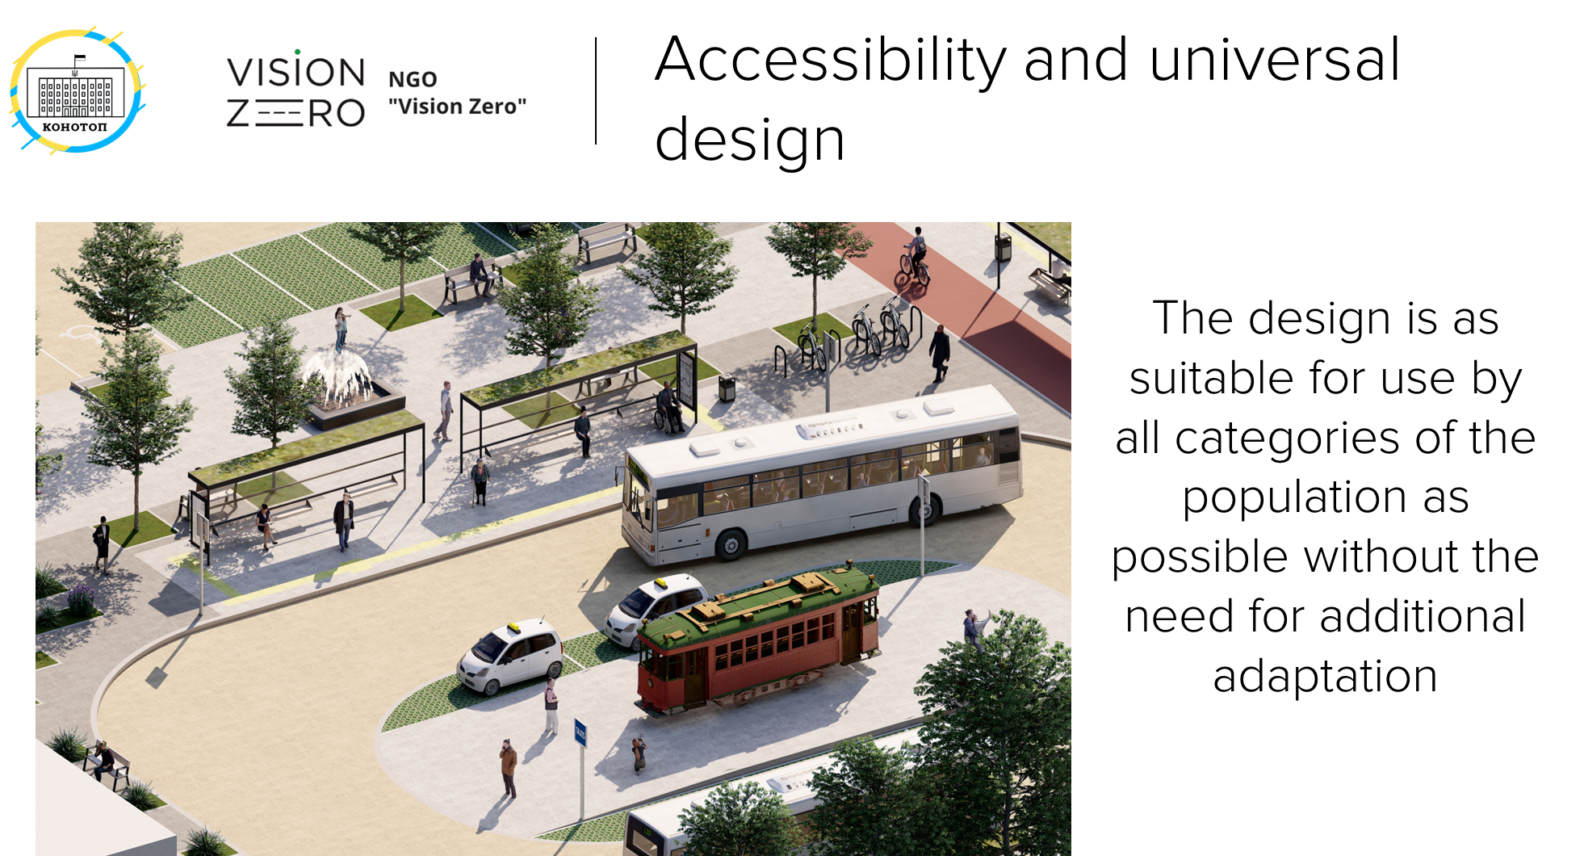

Slide 11
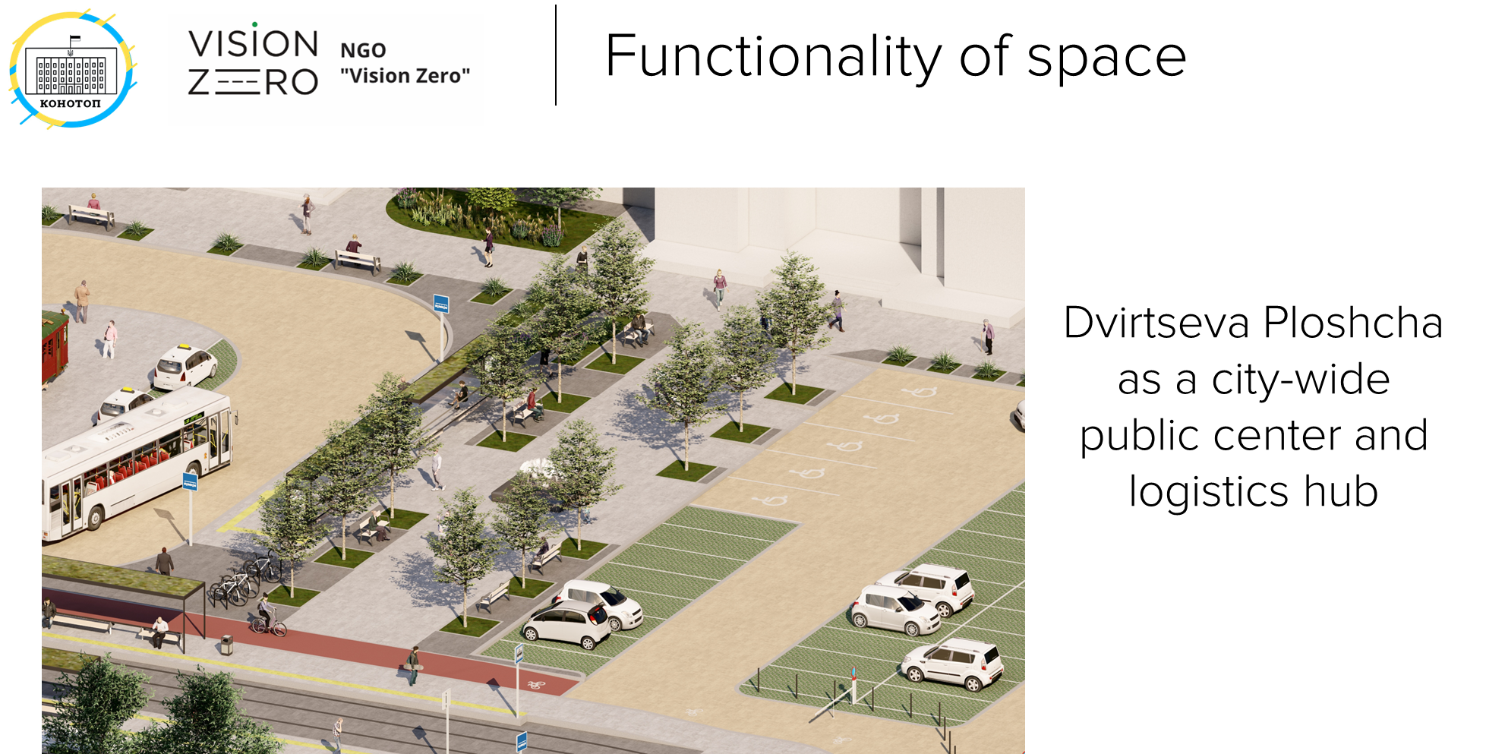

Slide 12
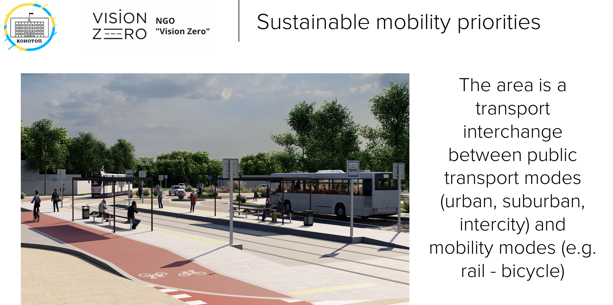

Slide 13
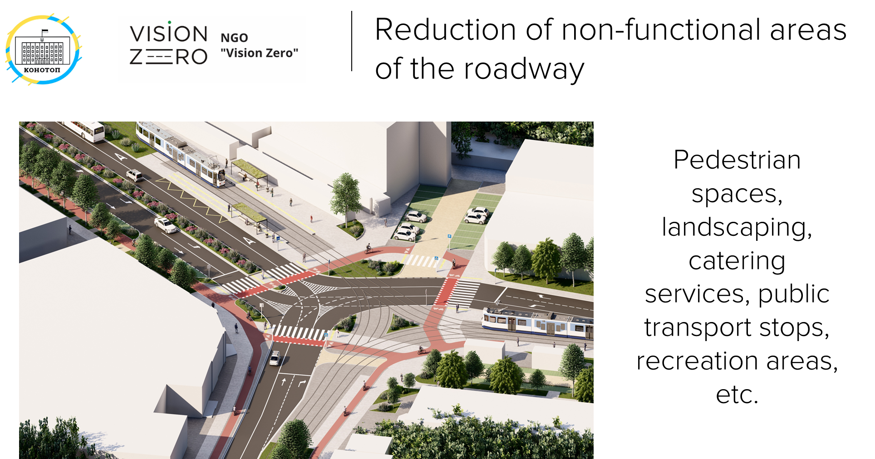

Slide 14
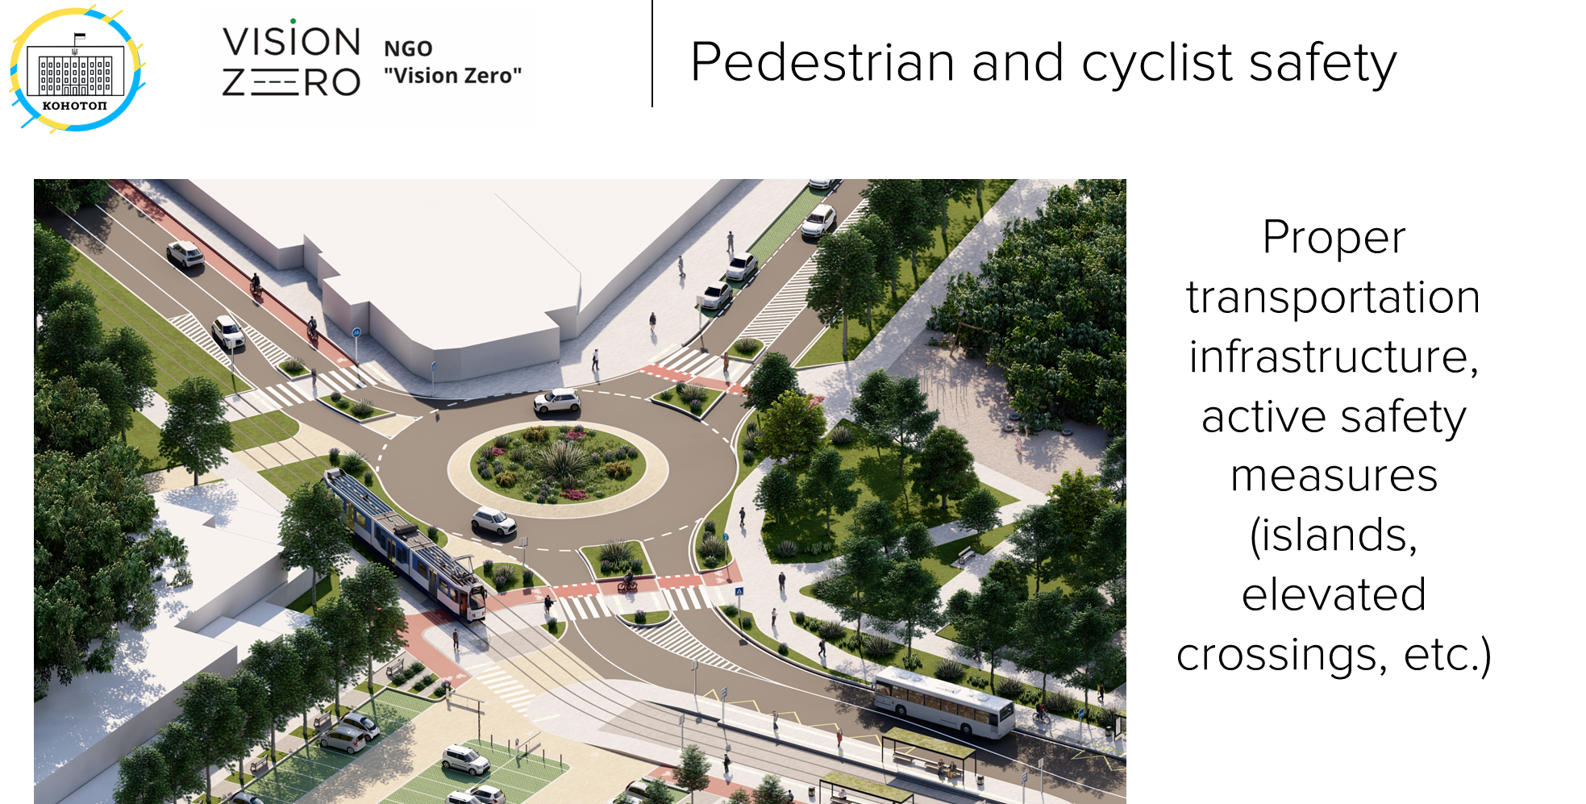

Slide 15
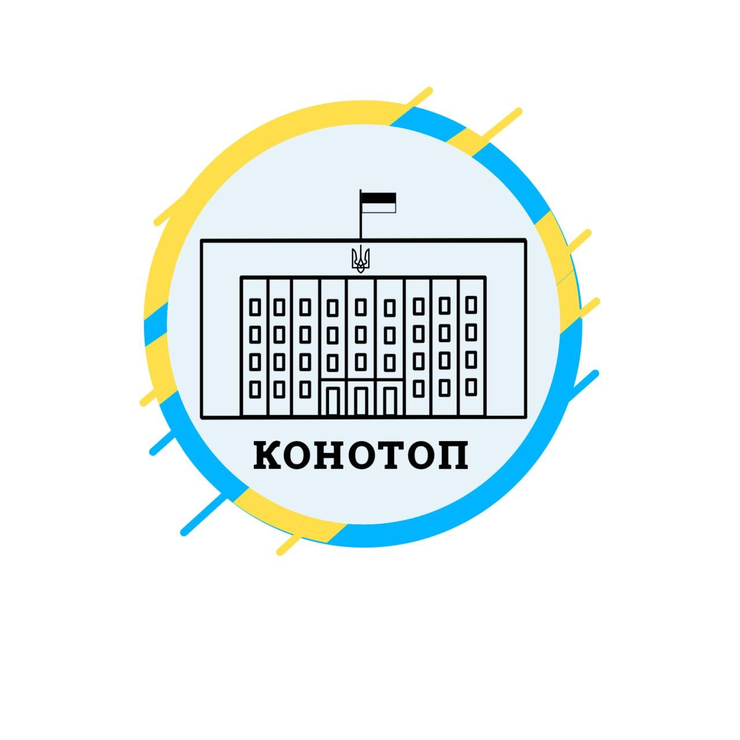

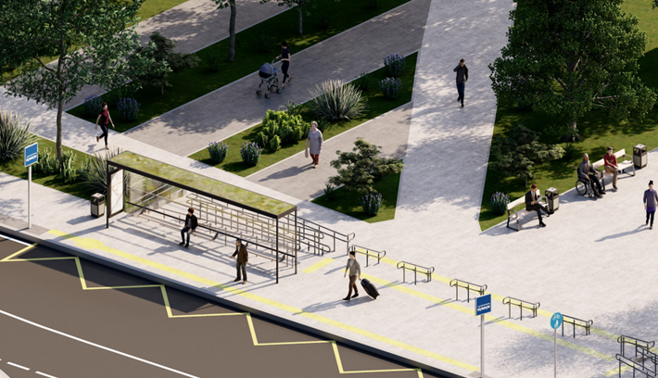
Climate resilience
Reducing the area of ​​asphalt pavementand increasing the area of ​​landscaping

Slide 16
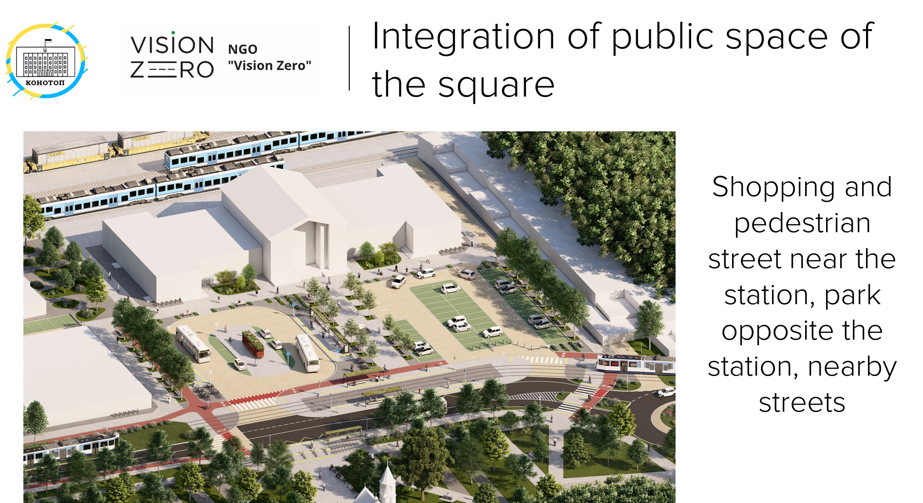

Slide 17
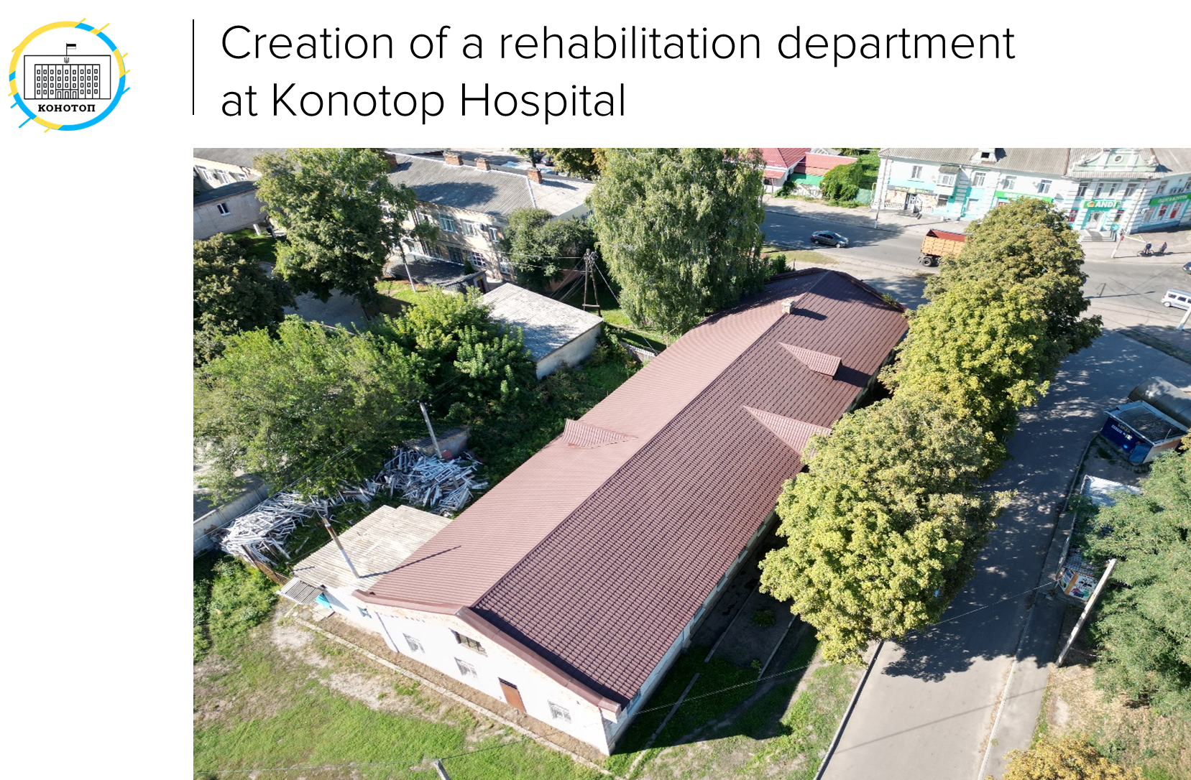

Slide 18
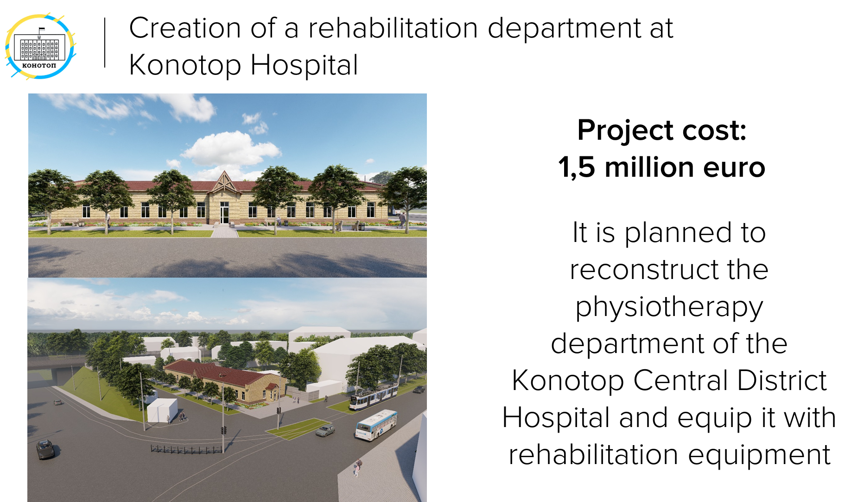

Slide 19
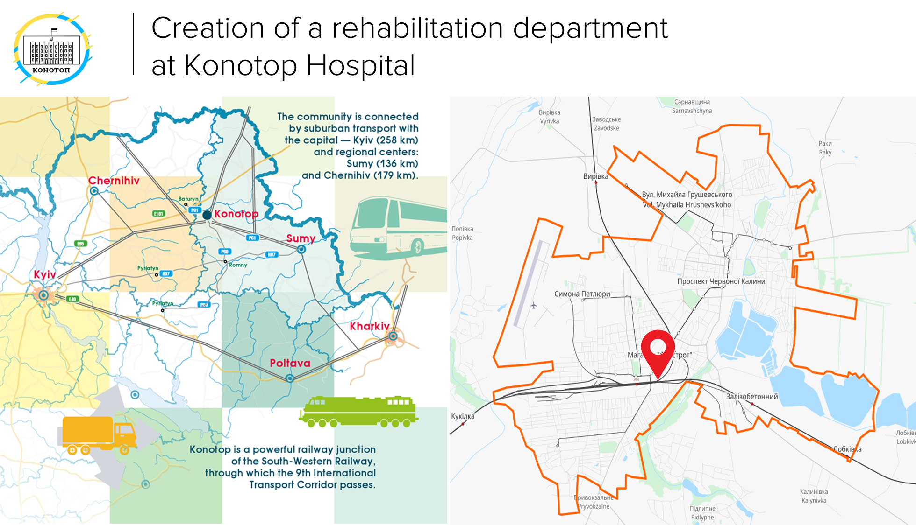

Slide 20
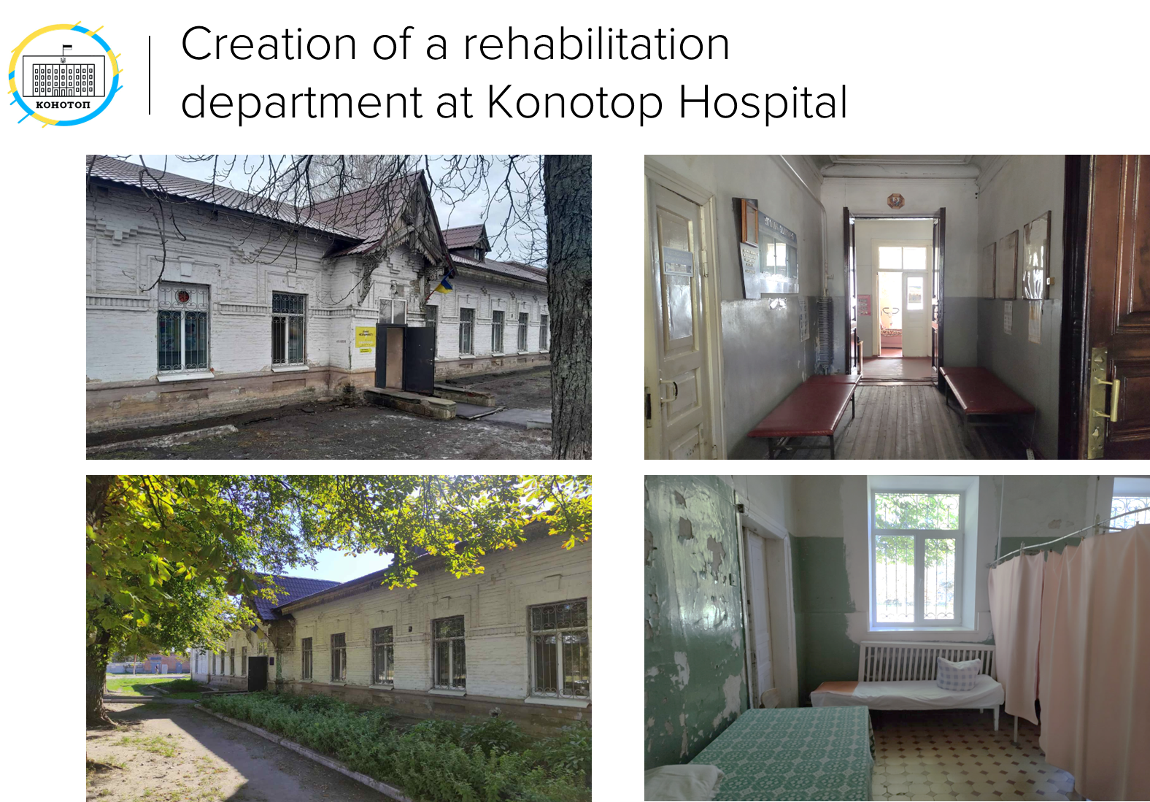

Slide 21
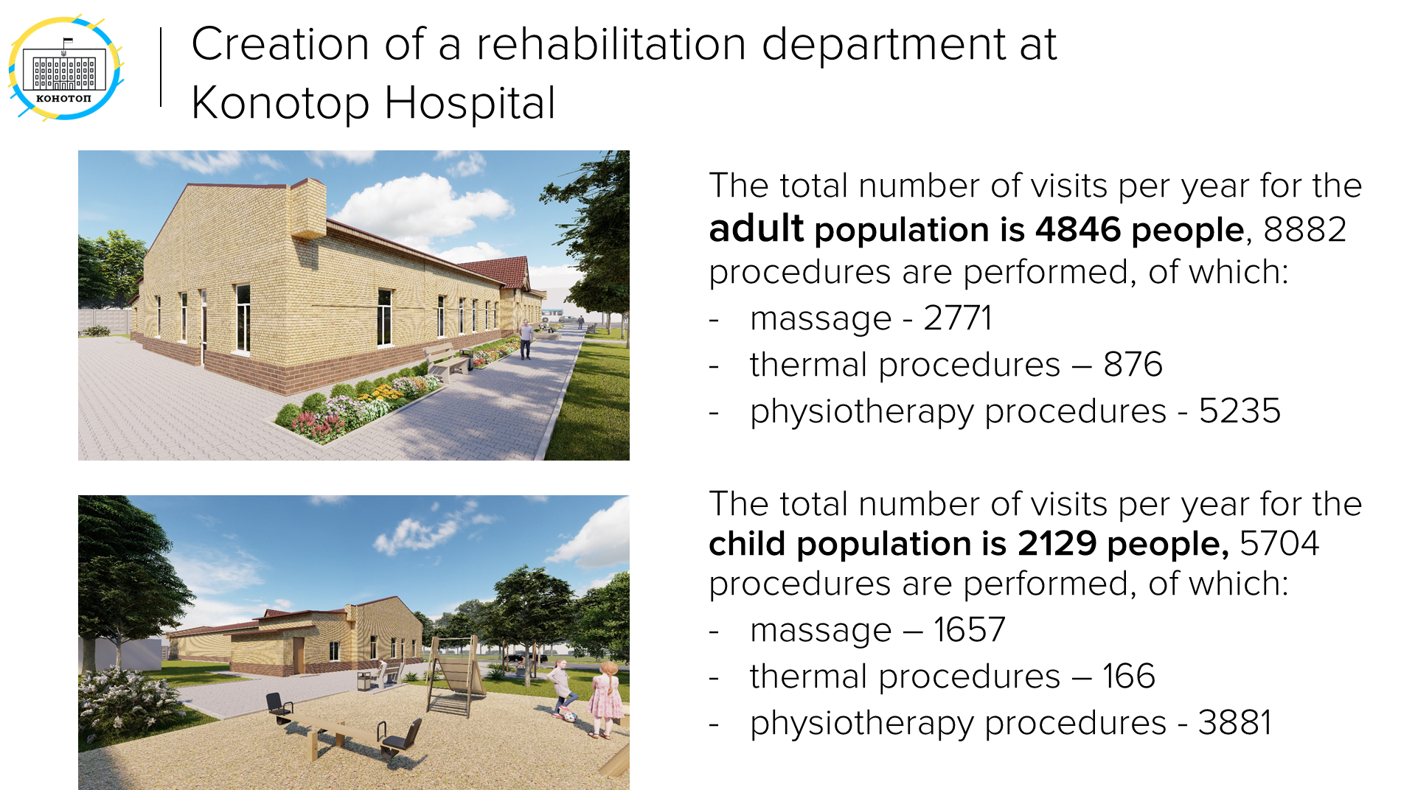

Slide 22
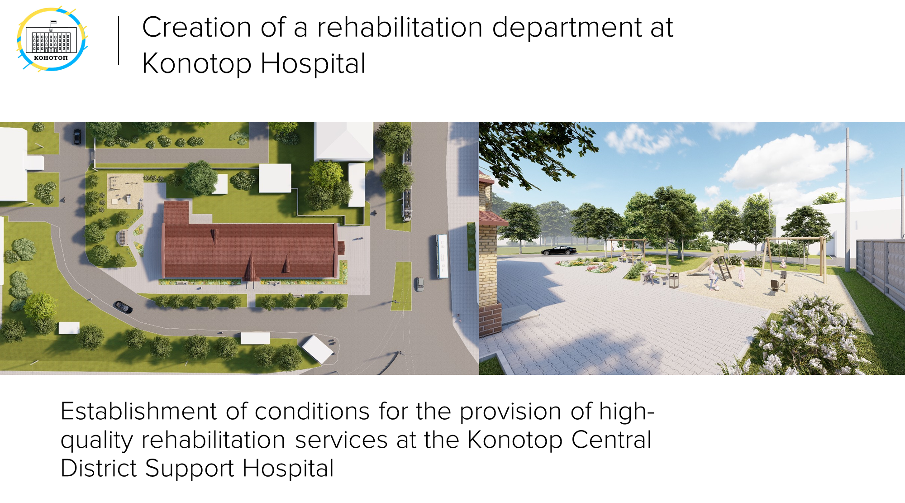

Slide 23
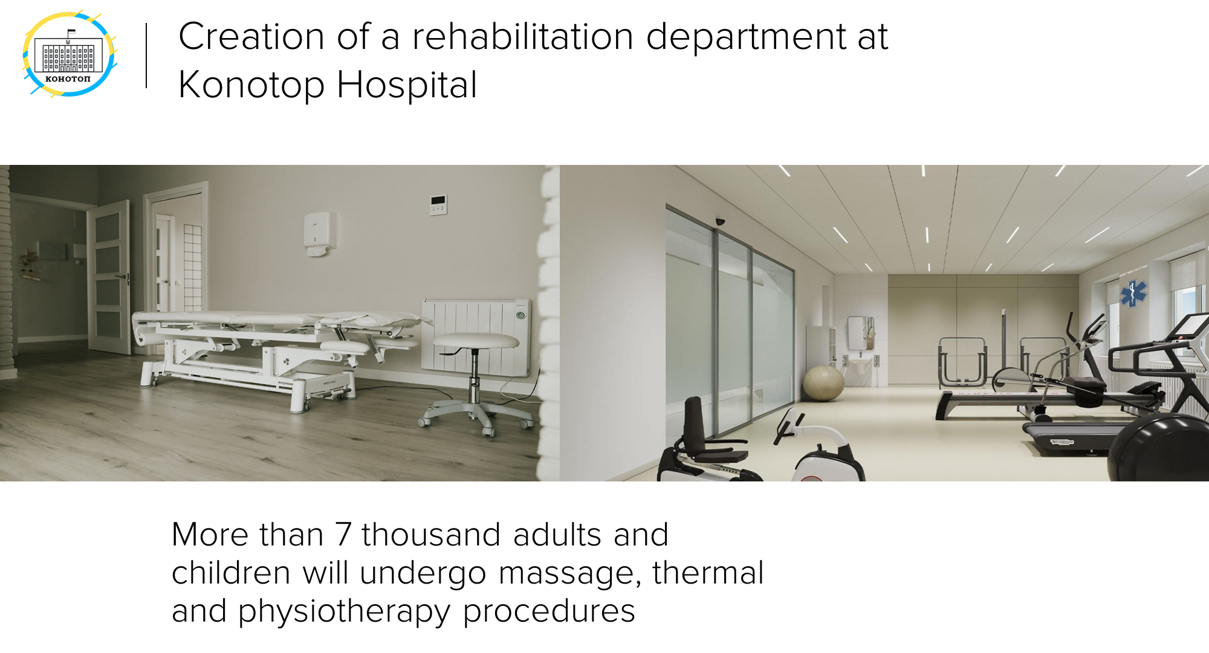

Slide 24
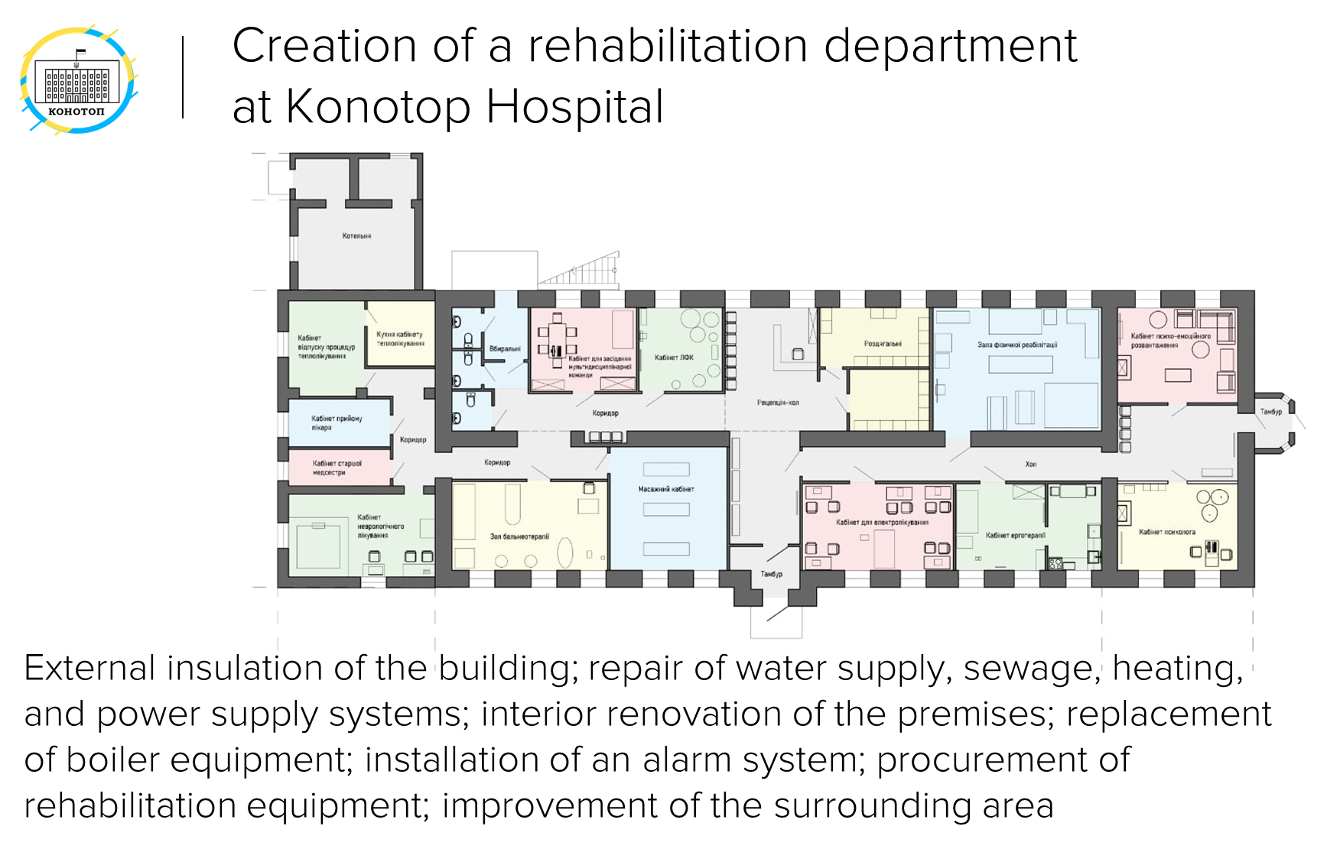

Slide 25
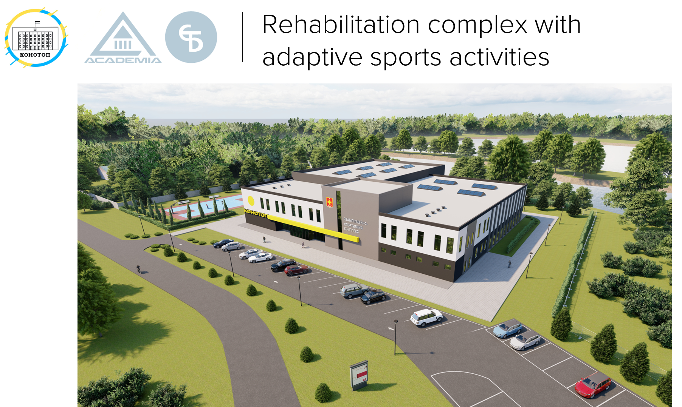

Slide 26
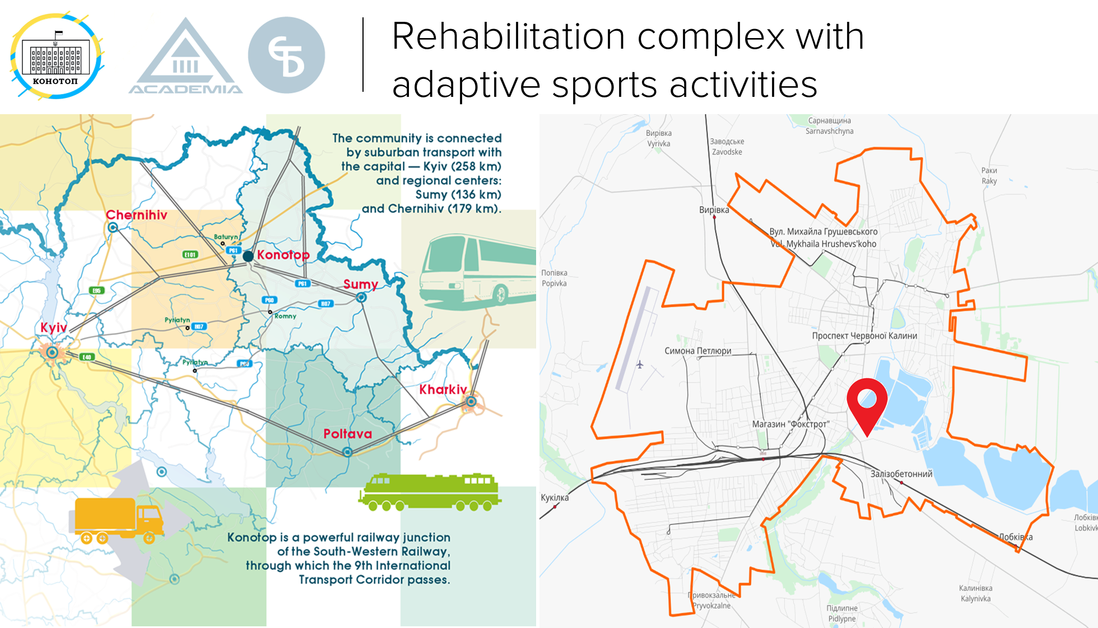

Slide 27
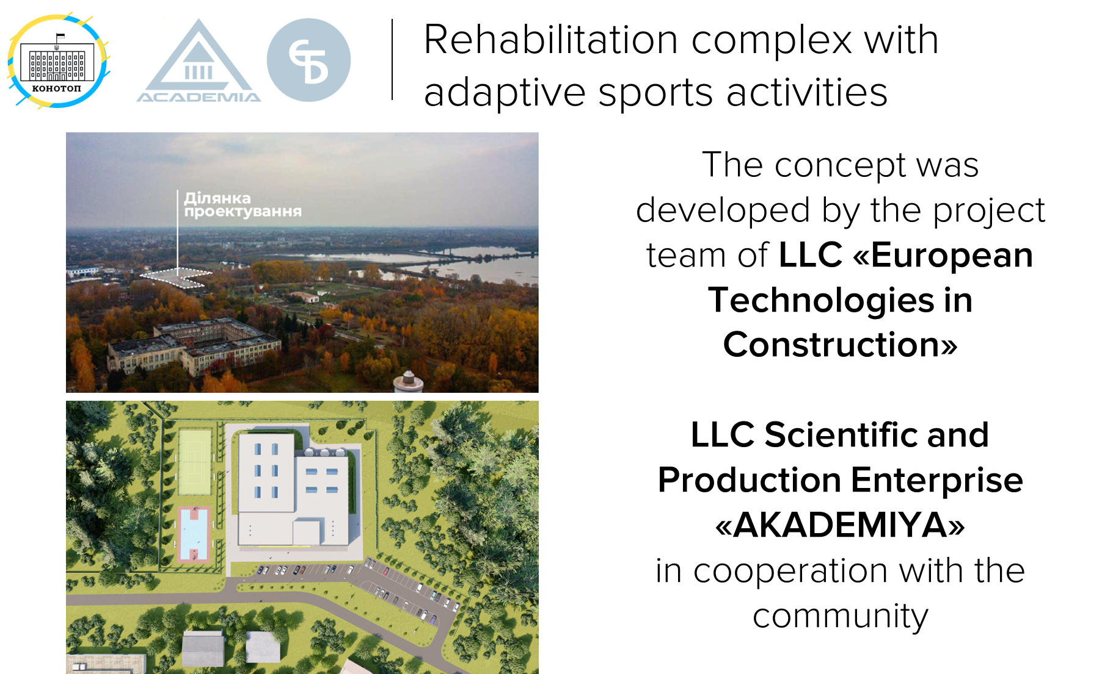

Slide 28
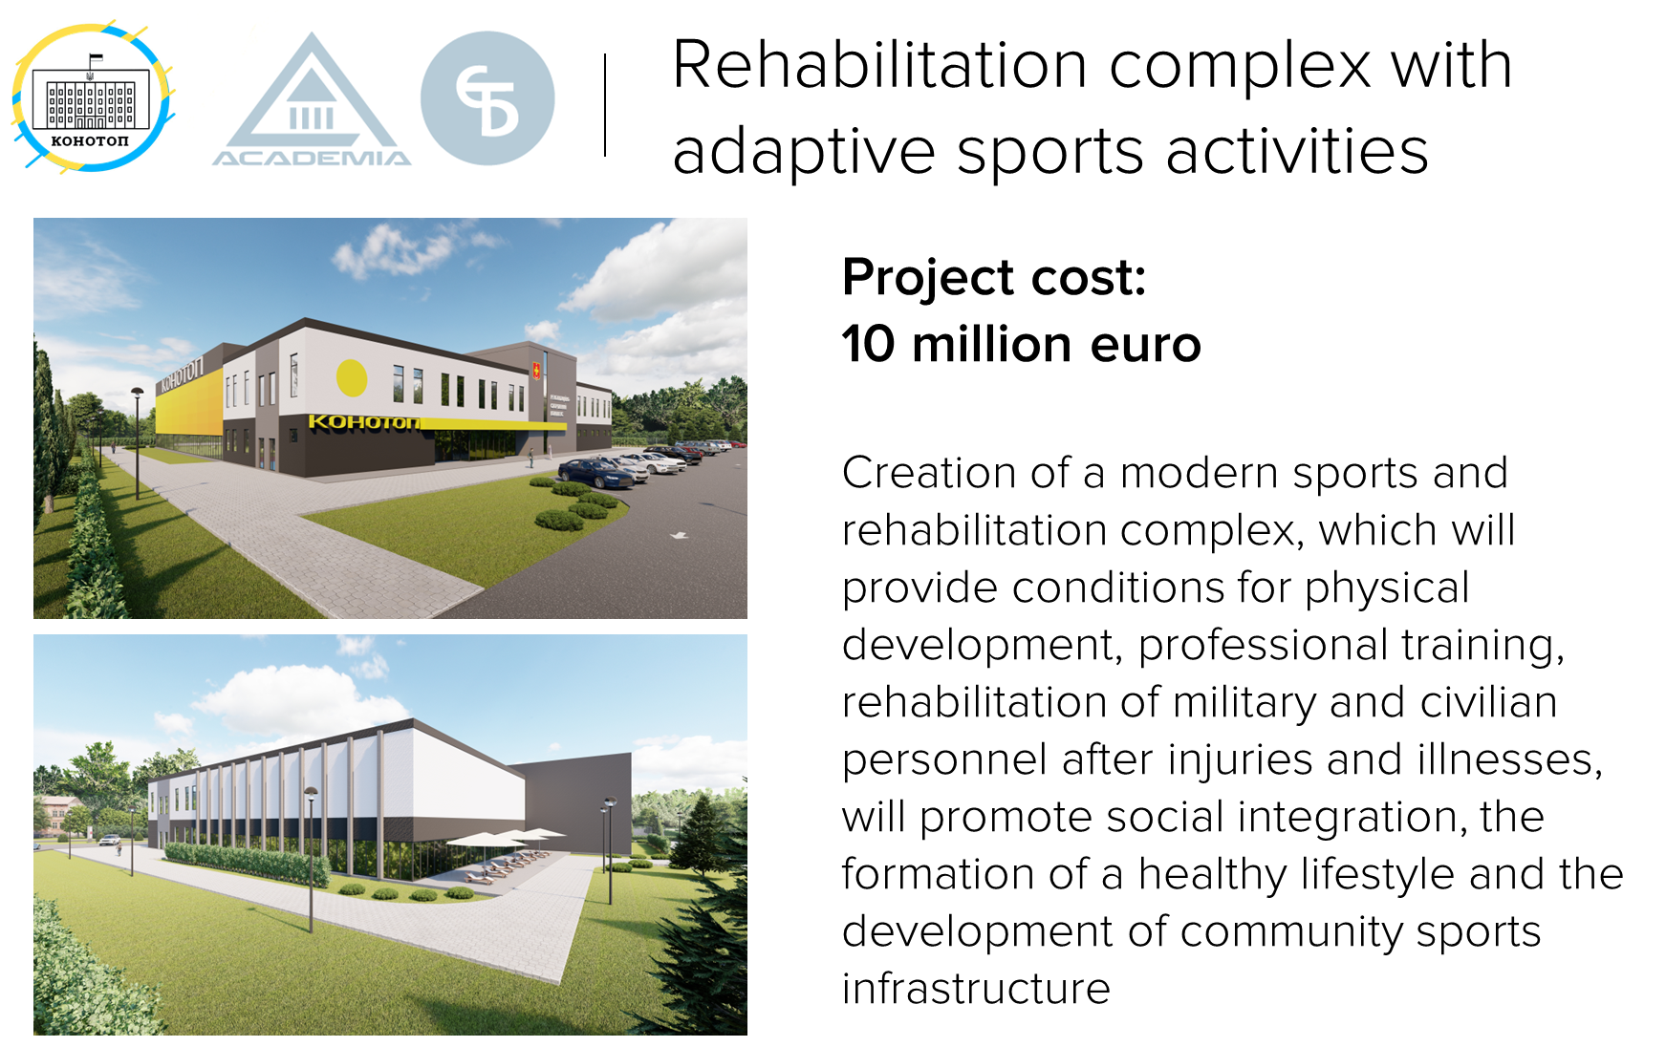

Slide 29
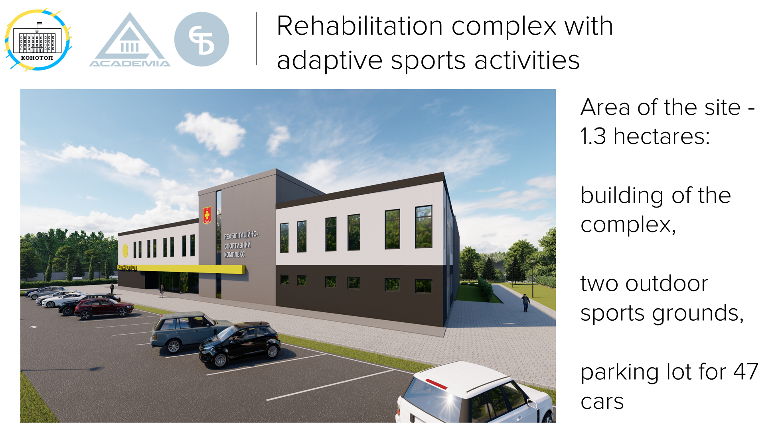

Slide 30
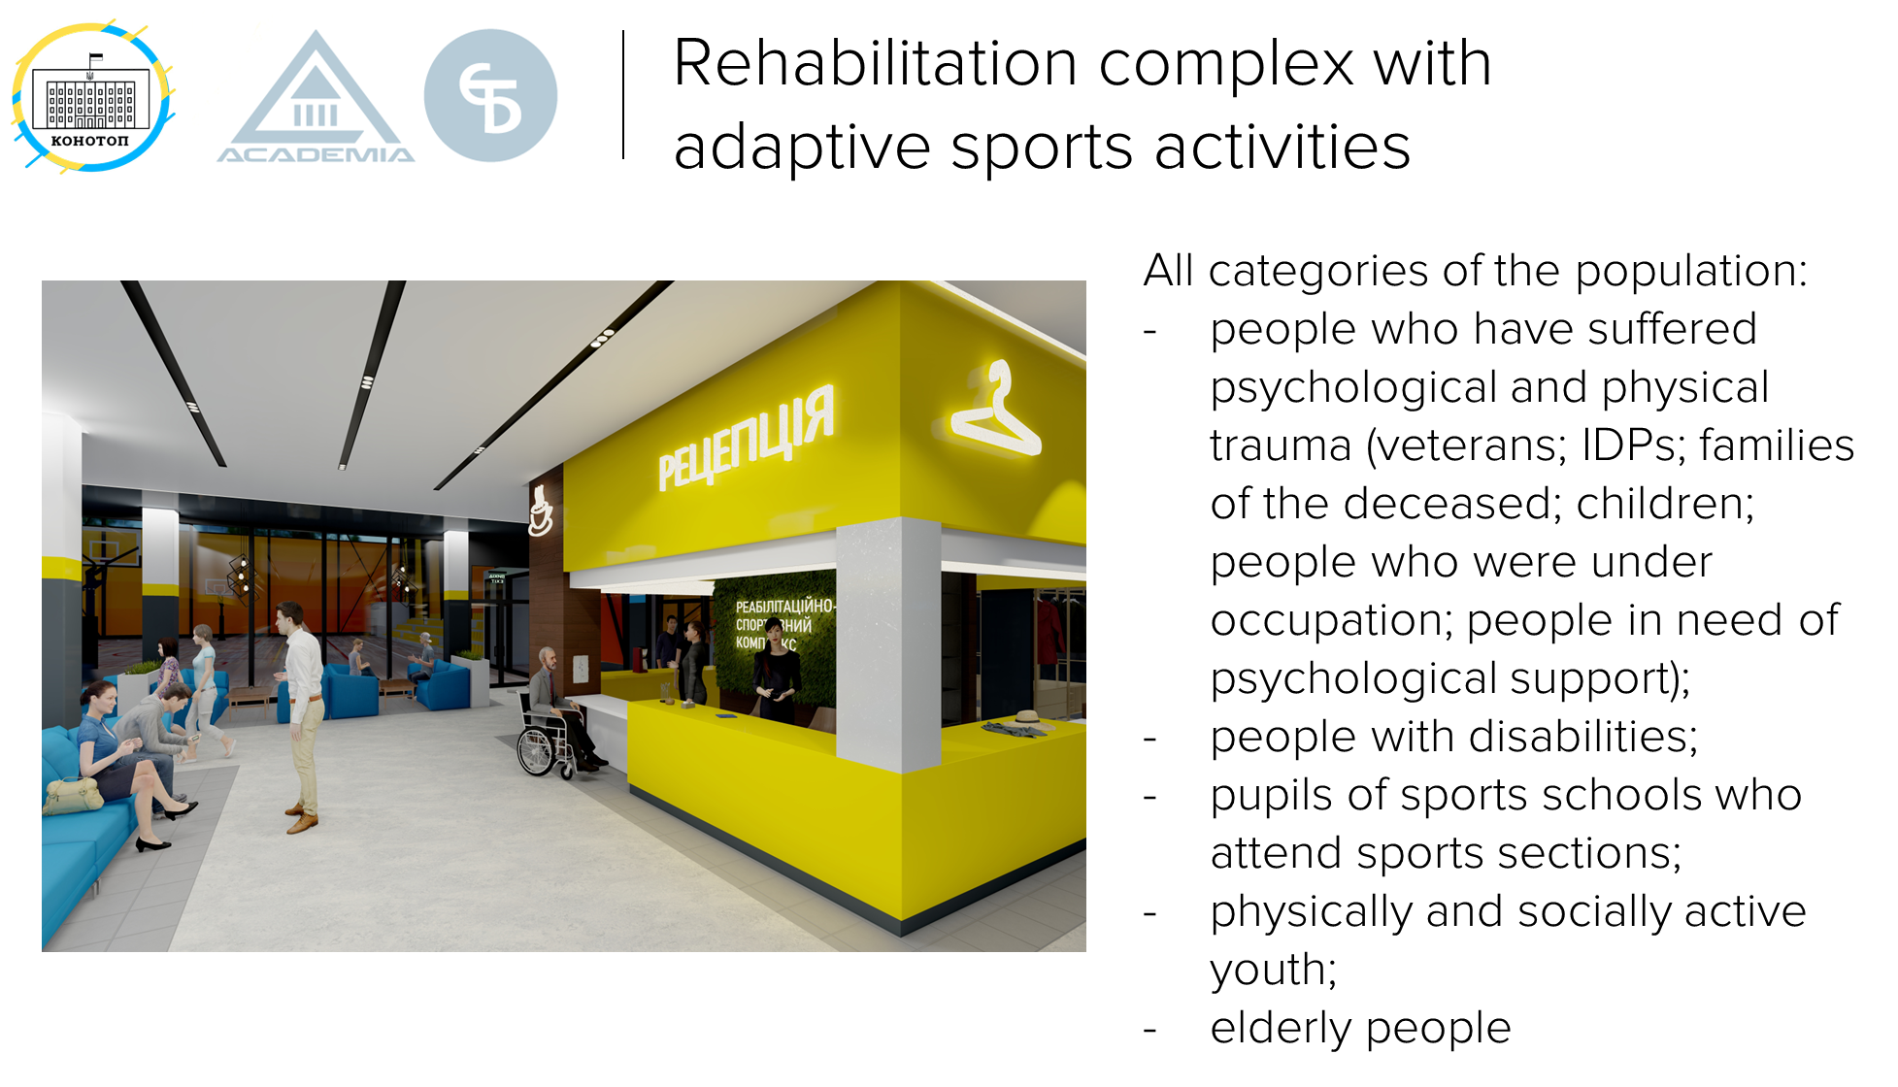

Slide 31
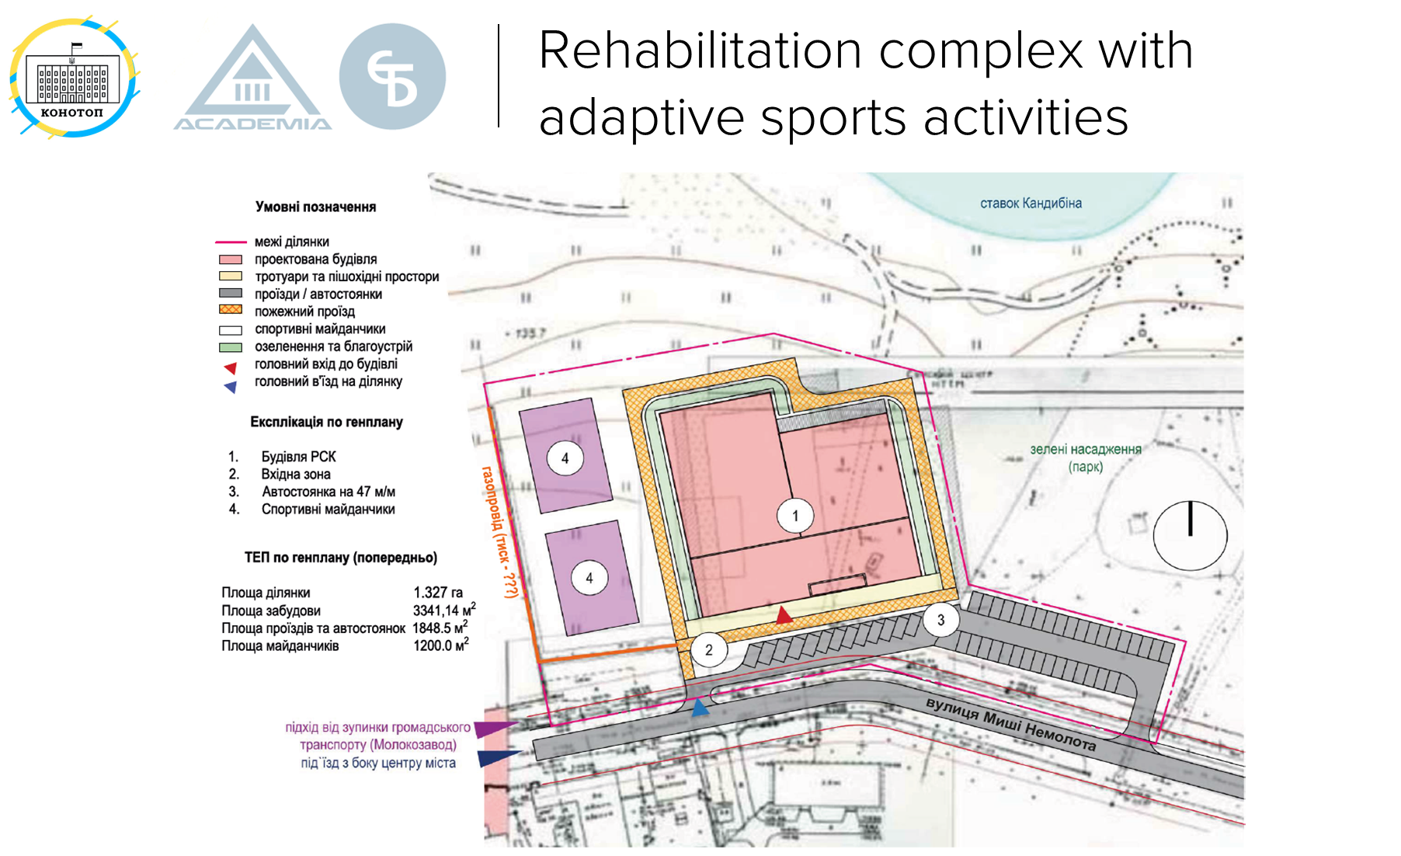

Slide 32
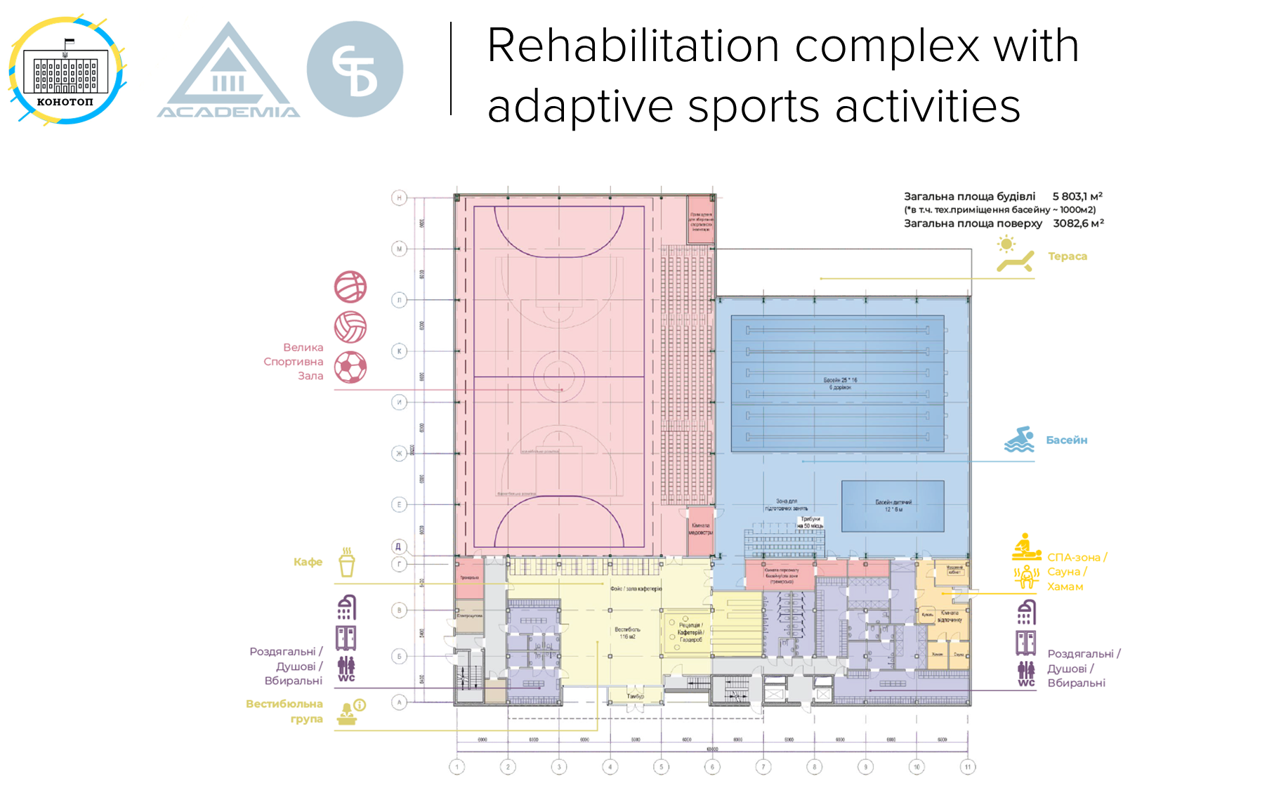

Slide 33
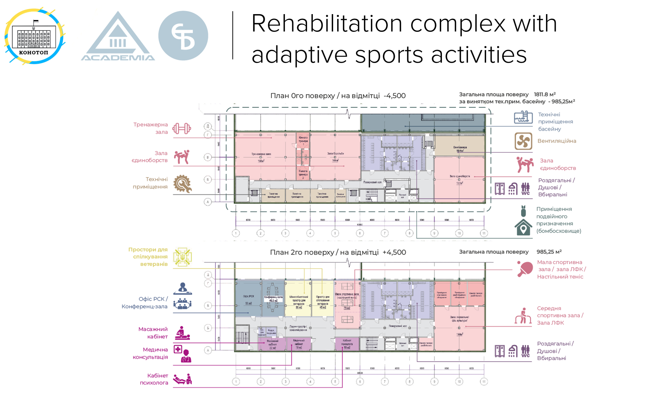

Slide 34
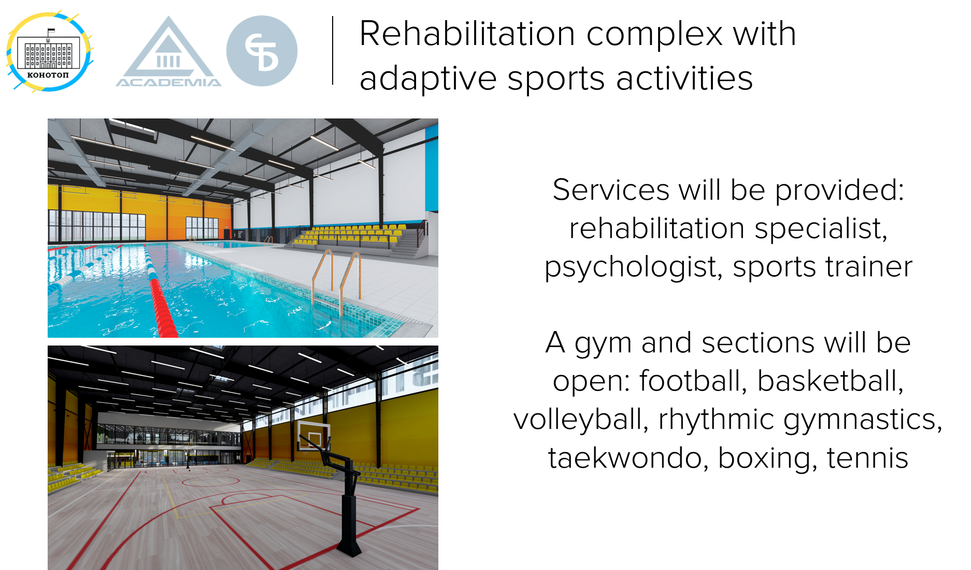

Slide 35

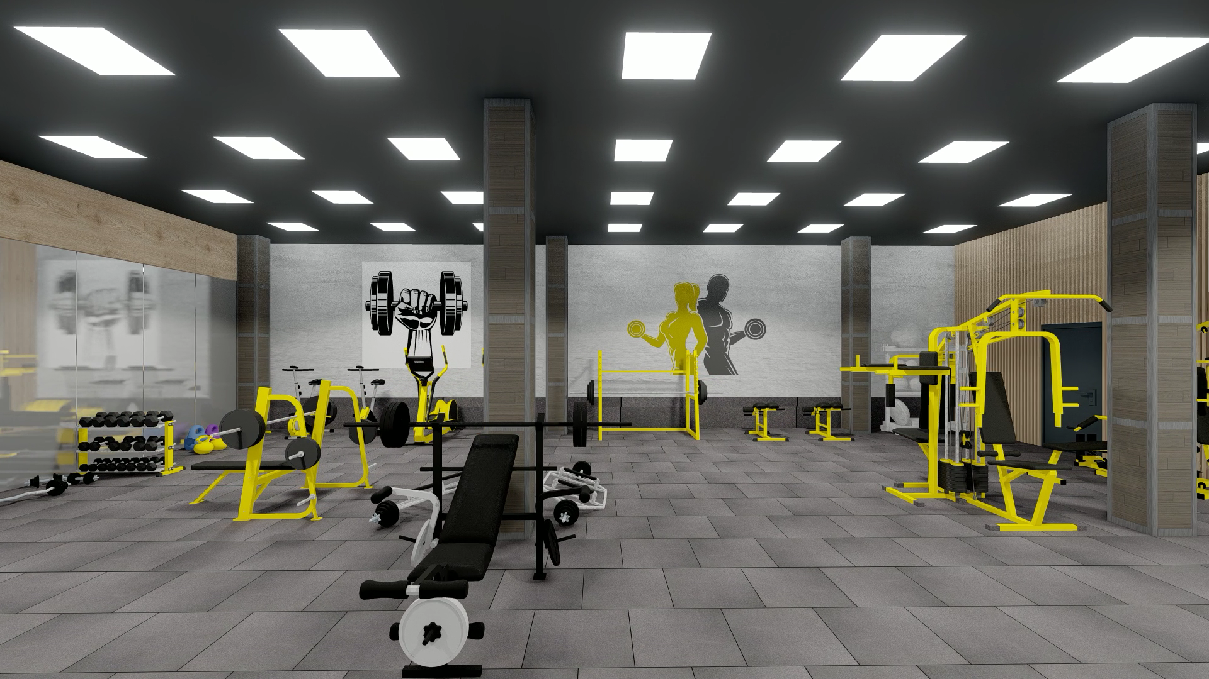
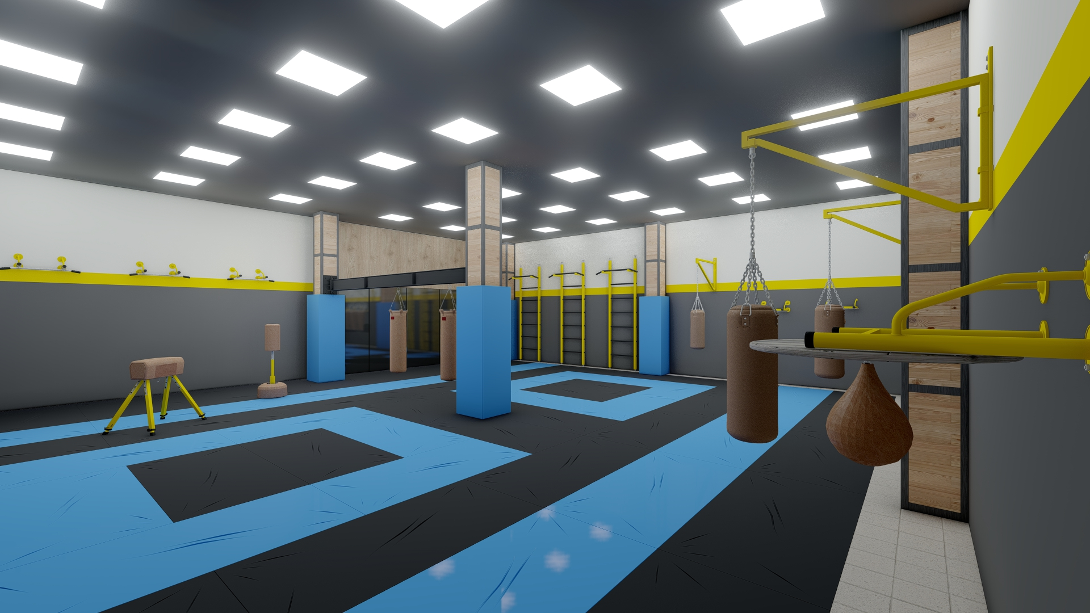
Rehabilitation complex with adaptive sports activities
Effective rehabilitation will be provided by special multidisciplinary teams.
The main task of the team is to restore the person's mental and physical functions to the maximum. After all, it is the person and his needs that are in the center of attention

Slide 36
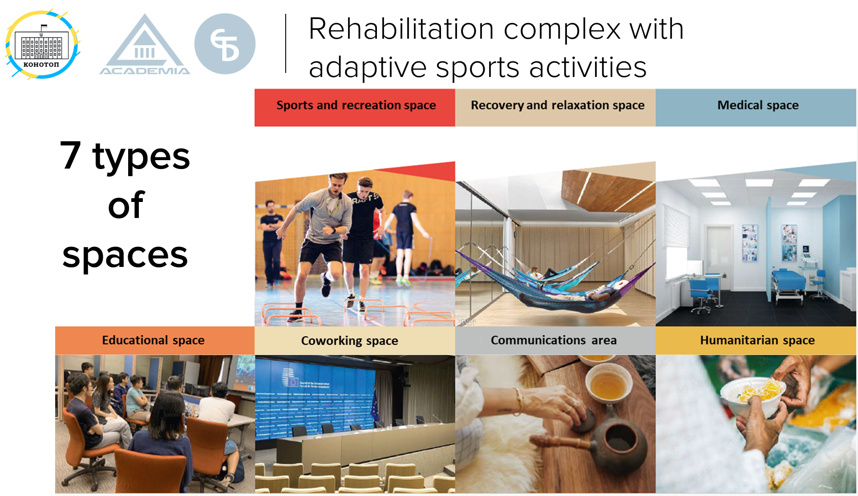

Slide 37
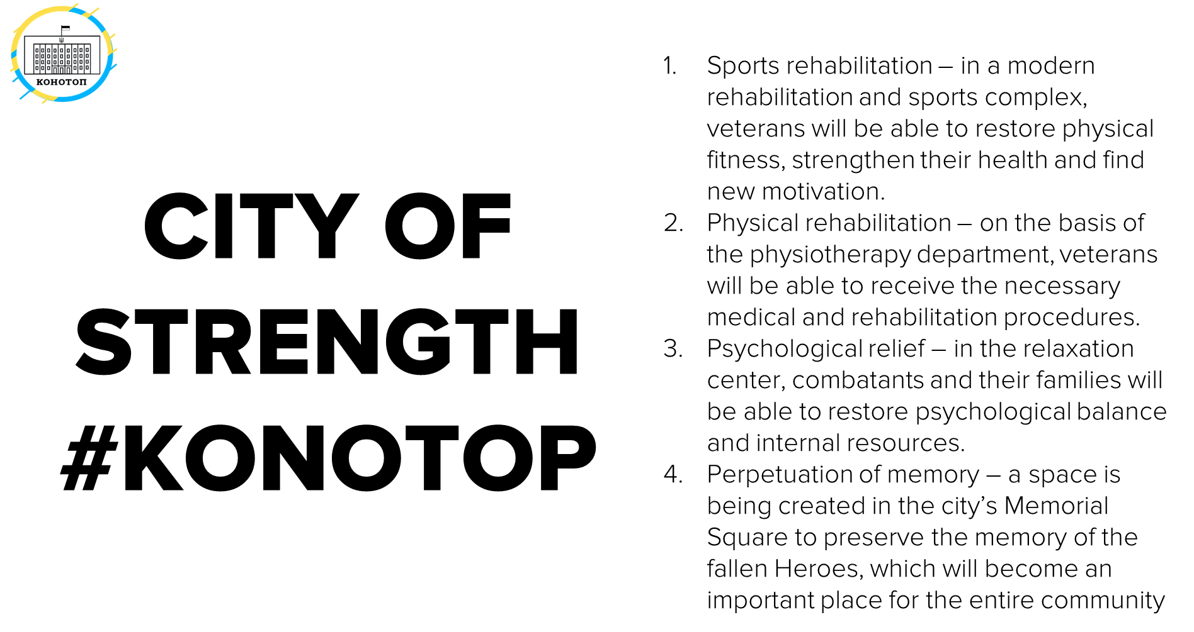

Slide 38
