Slide 1
надаватиметься
Contents
Project: SafeMed – Capsule Hospital (pages 2–13)
Experience of Cooperation with International Partners (page 3)
Critical Need (page 4)
А plan SafeMed – capsule hospital (page 5)
Hospital concept ( pages 6-9)
Target Audience of the Project (page 10)
Project components (pages 11-12)
Conclusion (page 13)
Project: ART-UNDERGROUND-CENTER (pages 14–25)
Introduction (pages 15-16)
Floor Plan – Schematic: ART - UNDERGROUND - CENTER (page 17-22)
Energy Efficiency and Autonomy (page 23)
Budget and Funding Sources (page 24)
Conclusion (page 25)
Project: "Veterans Center" in Shostka (pages 26–39)
Introduction (page 27)
Before and after the reconstruction of the building (pages 28-30)
Layout plan (pages 31-37)
Equipment (page 38-39)

Slide 2
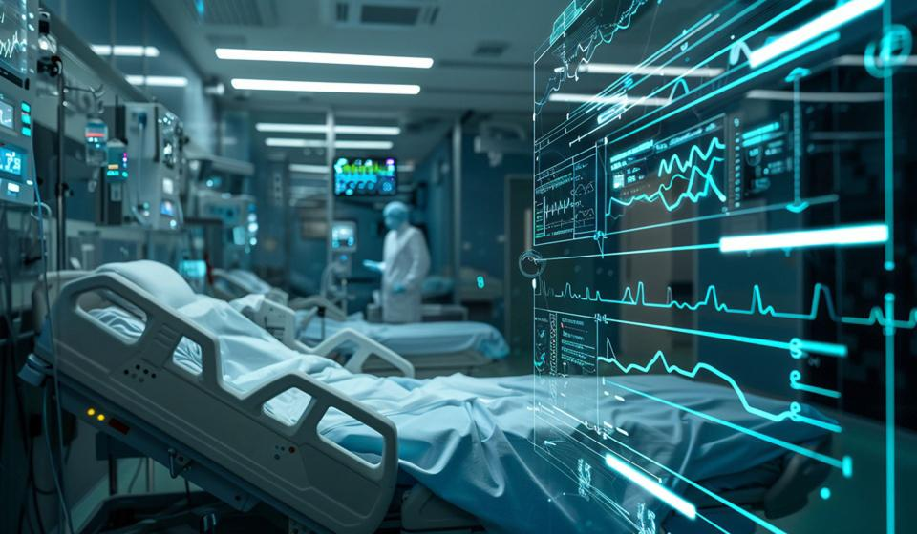

SafeMed – Capsule Hospital
Safety and Continuity of Medical Care in Crisis Conditions
2025

Slide 3


Experience of Cooperation with International Partners
Thanks to the support of international organizations, the hospital has already received significant assistance to improve energy efficiency, safety, and the quality of medical services:
EU4ResilientRegion / GIZ (ЄС)
▸ solar panels (UAH 4.6 million)
▸ major repair and equipping of the rehabilitation department and center (UAH 8.96 million)
▸ major Mobile clinic-car-IVECO DAILY 72C15 (8/9 millijn UAH)
IOM (International Organization for Migration)
▸ equipment and goods for the hospital: bedding, furniture, solar-powered lamps, etc. (UAH 0.8 million)
Security Project / Tetra Tech ES, Inc. (USA)
▸ 4 block-modular boiler houses for autonomous heating supply (UAH 9.5 million)
UNDP (United Nations Development Programme)
▸ vehicle for providing palliative care (UAH 3.6 million)
This is only a part of the international assistance implemented. We are sincerely grateful to our partners for their support in the most difficult times for Ukraine!

Slide 4

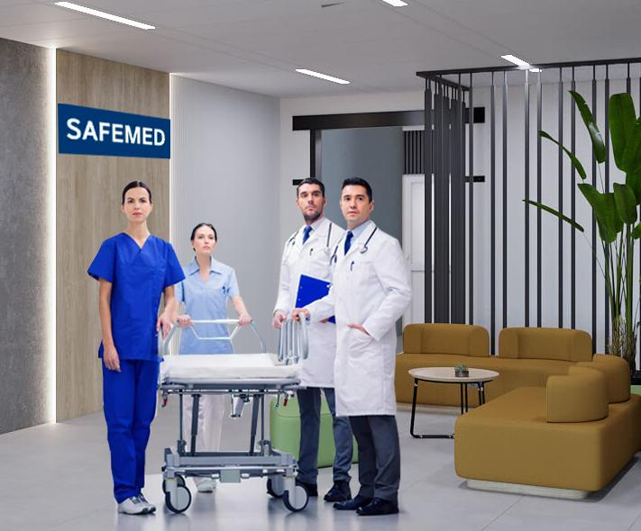



Critical Need
Crisis Context Military threats, shelling, airstrikes, and other emergencies create unprecedented challenges for healthcare facilities.
Critical Gap Traditional hospital departments lack complete autonomy and protection needed for crisis operations.
Need: Innovative solution to increase the resilience of the healthcare system.
High-Risk Scenario Hospital facility damage threatens continuity of medical care when it's needed most.

Slide 5
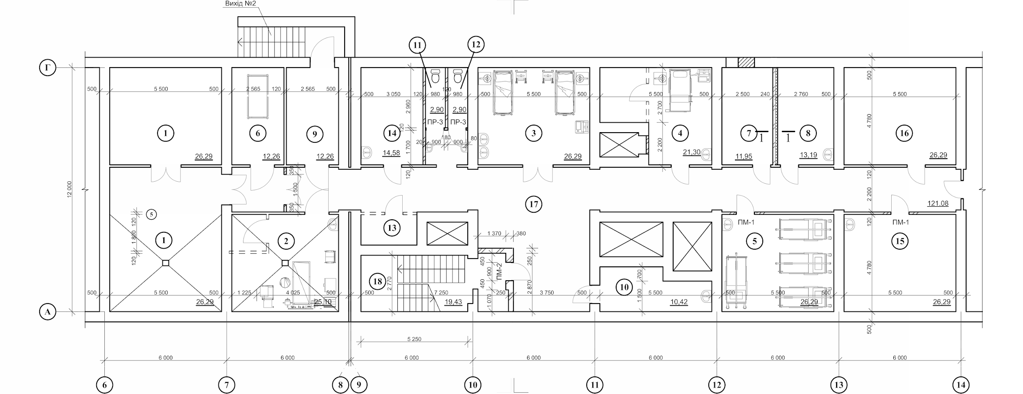
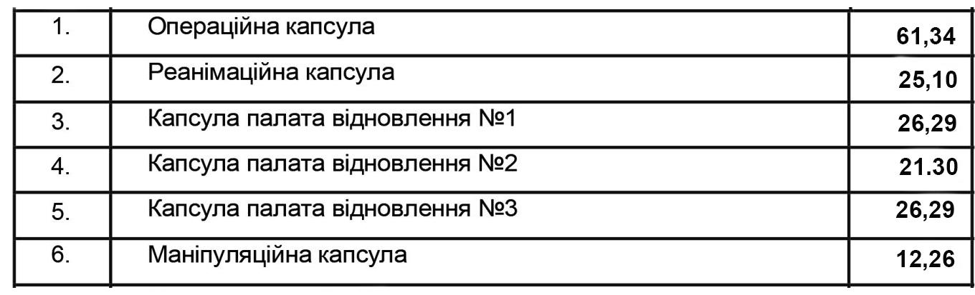
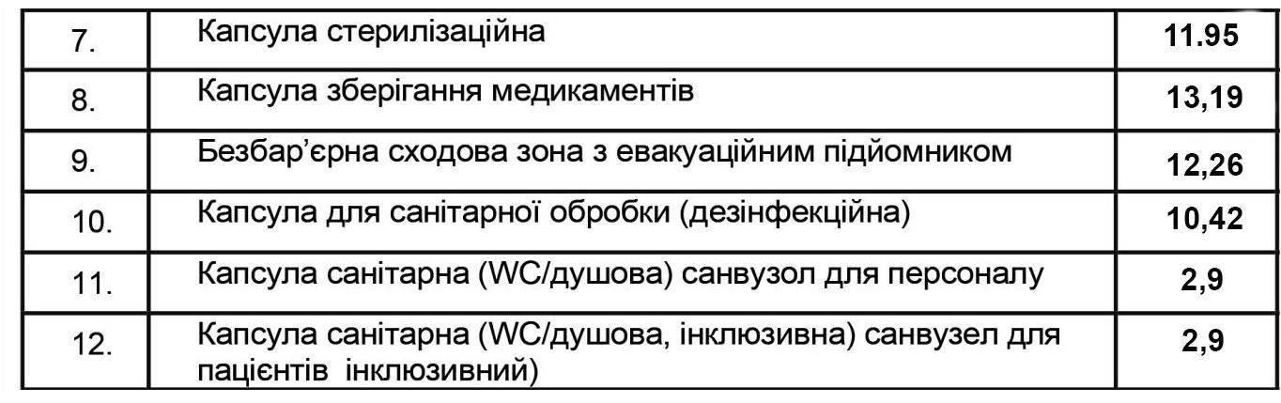
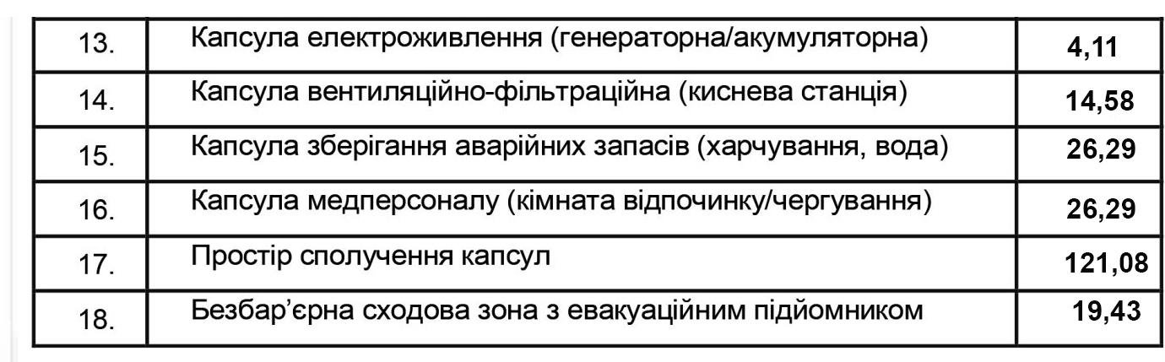
А plan SafeMed – capsule hospital

Slide 6

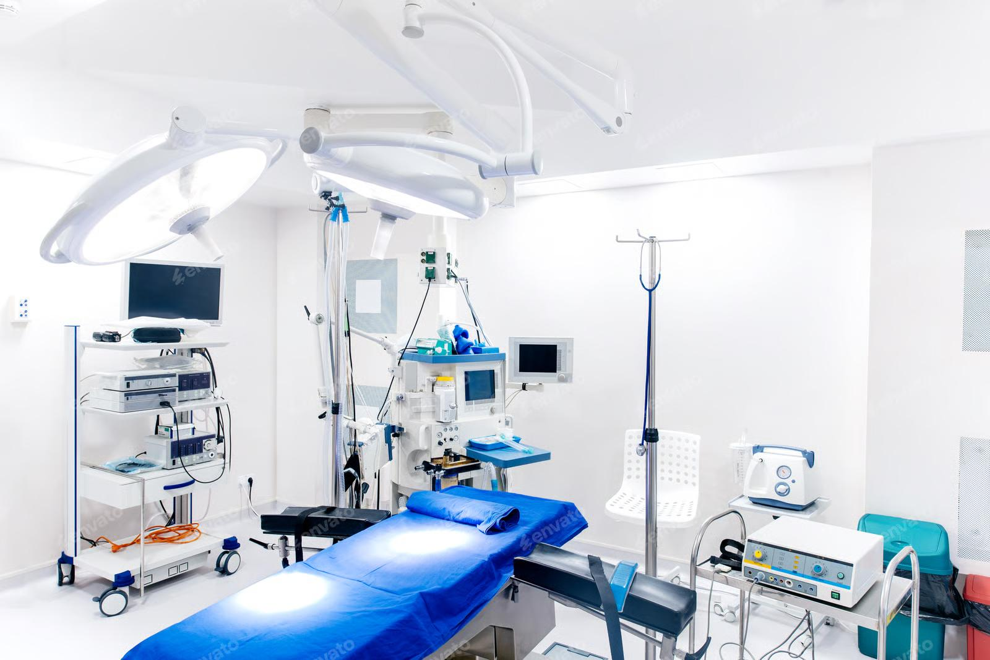









Capsule hospital concept
The main idea
Creation of sealed and autonomous modules (“capsules”) in the basement of the main building, each being an independent treatment unit.
Types of Capsules
Operating Room
Recovery Rooms
Modern surgical unit
3 separate autonomous spaces
Intensive Care
Fully equipped for critical care
Autonomy Features
Independent ventilation systems with filtration
Standalone power supply
Backup water supply systems
Complete set of medical and non-medical equipment

Slide 7
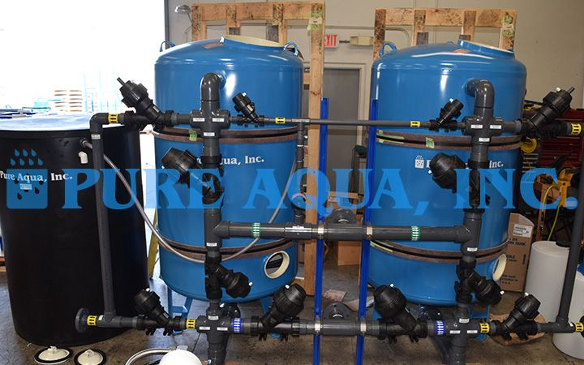


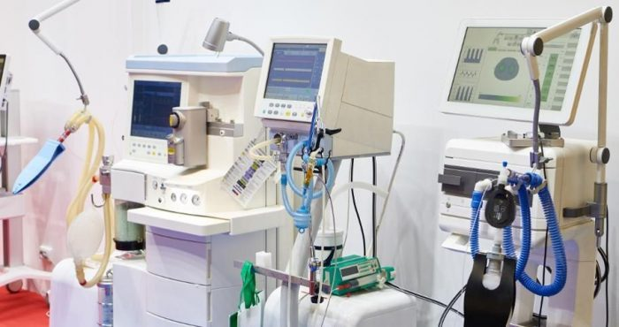


Technical Features and Autonomy
Ventilation
Independent systems with filtration, sterilization, and oxygen supply.
Power Supply
Independent sources: generators, batteries, solar panels, energy storage.
Water Supply
Backup systems
Equipment
Complete set of medical and non-medical equipment

Slide 8

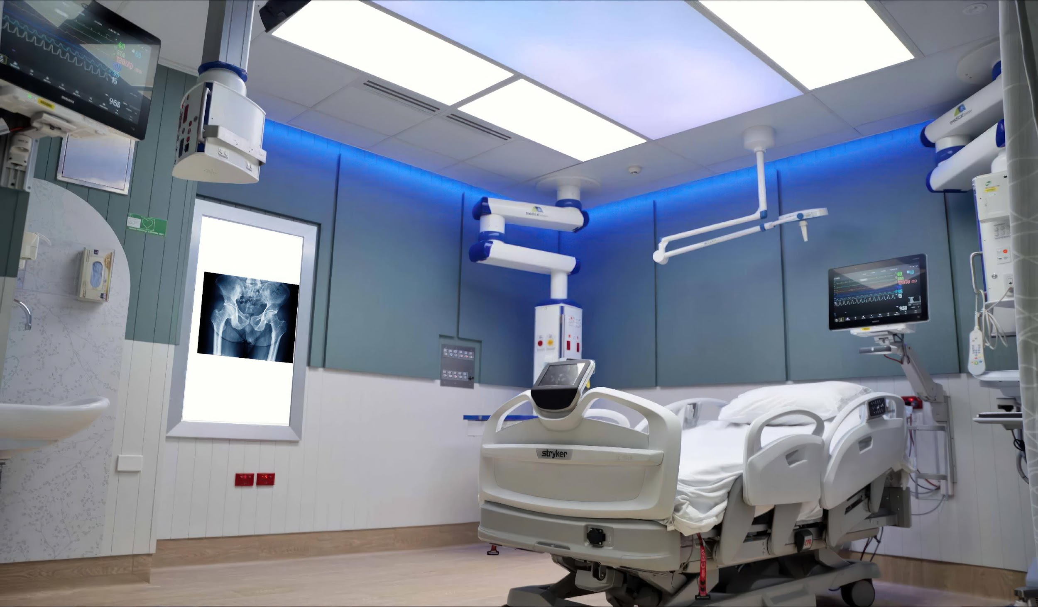


Safety and Accessibility
Compliance with Standards
Designed according to building codes and inclusivity standards
Accessibility
Spacious sanitary facilities and accessible entrances for people with disabilities
Protection
Structural solutions to maximize protection against blast waves, smoke, and fire

Slide 9
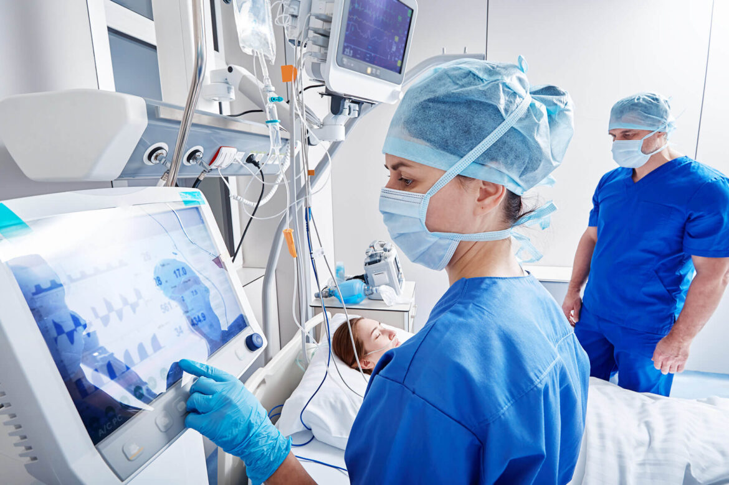




Expected Effect
Continuity
Medical care ensured even if other hospital departments are damaged
Preparedness
Increased readiness of healthcare facilities for emergencies
Scalability
Unique model of safe healthcare for other hospitals in Ukraine
Reliability in the Most Difficult Conditions
Trust
The capsule hospital guarantees continuous operation of medical staff and patient care even in critical circumstances.
Strengthening trust of communities and partners in the hospital

Slide 10
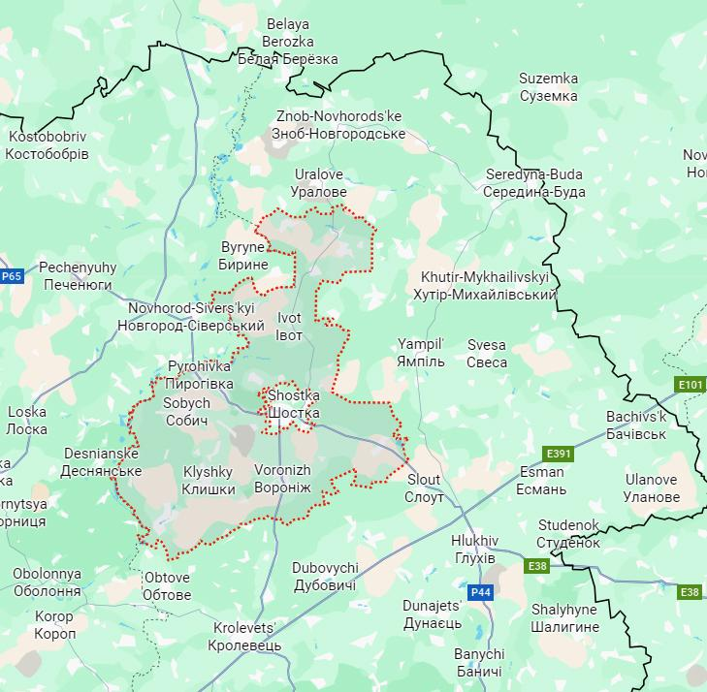


Target Audience of the Project
Community Residents and IDPs
Residents of Shostka district (190,000 people) and internally displaced persons (19,400 people)
Shostka Community (Sumy Region)
Military Personnel and Wounded
Defenders in need of medical assistance
Medical Staff
Doctors, nurses, and other hospital personnel.

Slide 11
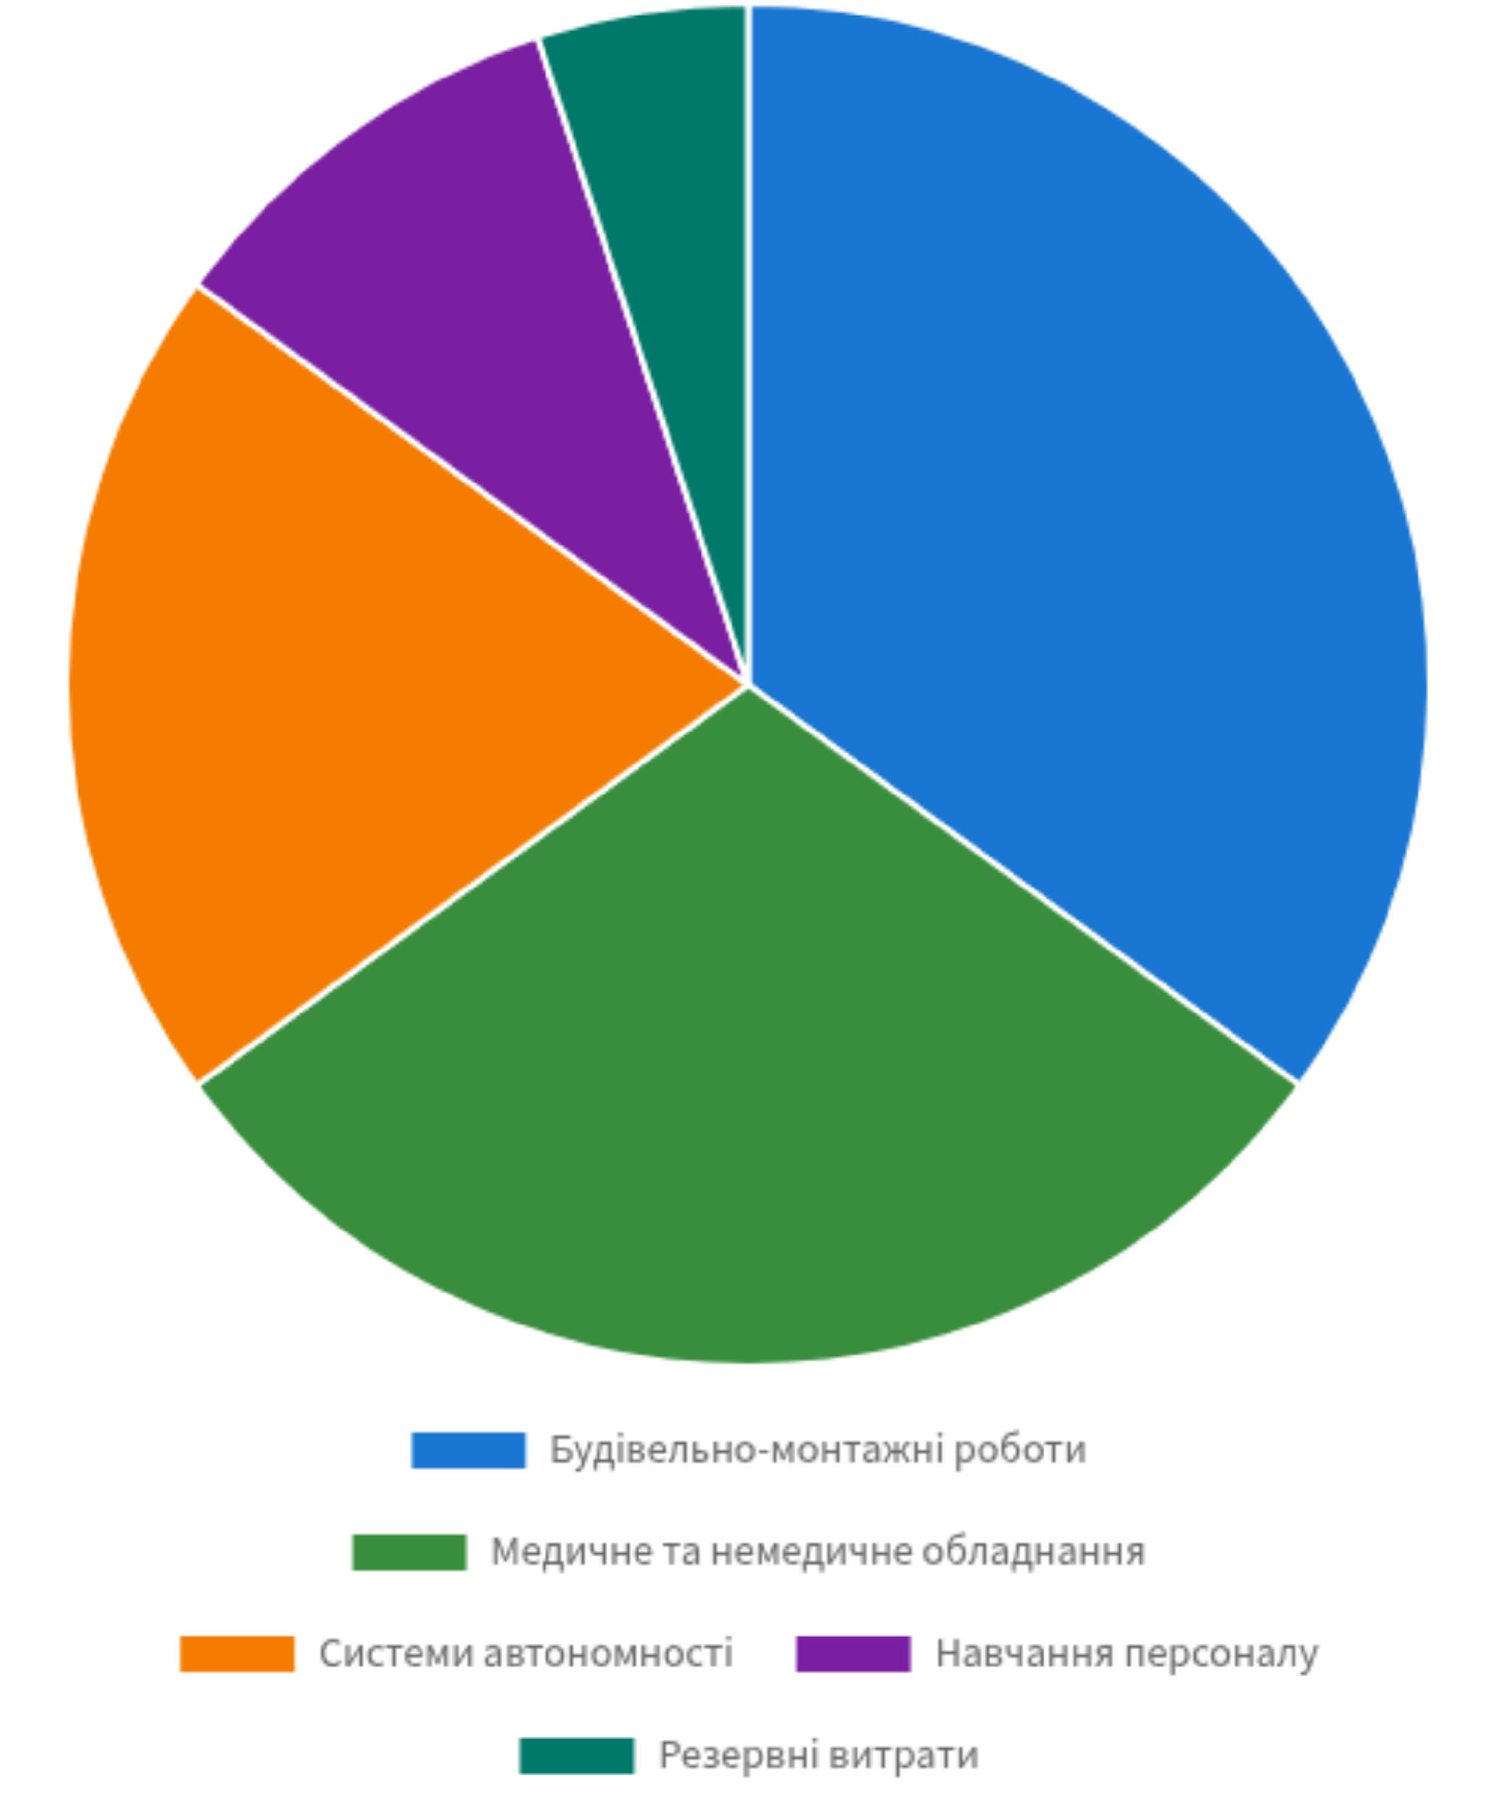





Project Budget
Total Project Cost
48,2 million UAH
995 867.7 €
Construction and installation works
Creation of capsule premises 13,68 mill UAH
Medical and non-medical equipment
Surgical unit, intensive care, recovery rooms 28,29 mill UAH
Autonomy systems
Ventilation, power, water supply 3,62 mill UAH
Staff training
Preparation for working inside capsules 1,81 mill UAH
Contingency expenses
Unforeseen costs and modernization 0,8 mill UAH

Slide 12






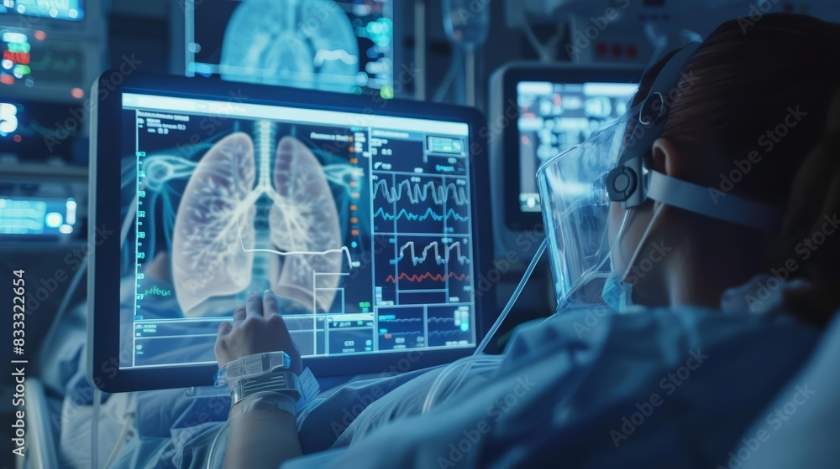
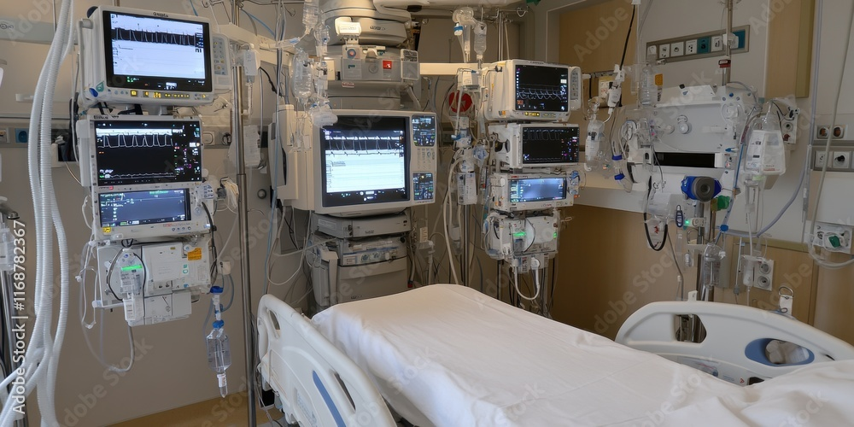

Sustainability and Multifunctionality
Use During War
Autonomy
Safety
Each capsule operates independently without external resources
Protection of staff and patients for external threats
Training Center
Use in Peacetime
The capsule hospital can be used for preparing medical staff to work in conditions that closely simulate real critical situations.
Training Center
Preparing medical staff to work in extreme conditions
Multifunctionality
The project has long-term value, ensuring safety in crises and contributing to the development of the healthcare system in peacetime.
Reserve Base
Creation of temporary specialized departments

Slide 13

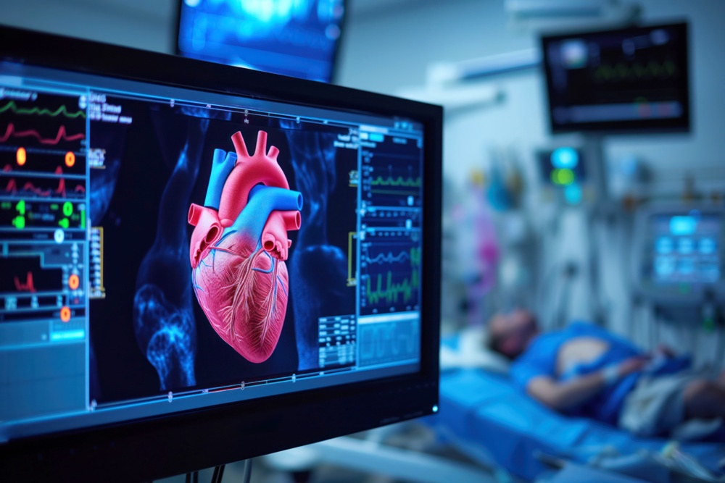





Conclusion / Call for investment
Innovation
SafeMed is a unique solution to ensure continuity of medical care
Safety and Resilience
Reliable protection of patients and medical staff in crisis conditions
Investing in the Safety of the Future
Scalability
Potential for replication in other hospitals across Ukraine
Project Team Contact Information
ispsh@ukr.net
05449-2-24-04
41100, Sumy region, Shostka city, Sadovy Bulvar st., 14;
Myroslava Lyashka st.,1
invest_shostka@ukr.net
+380977172155
shostka.crl@i.ua
80544972267

Slide 14
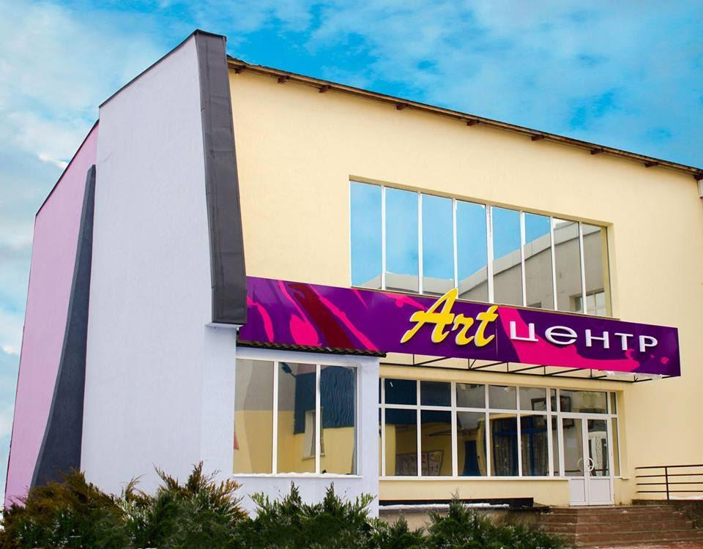
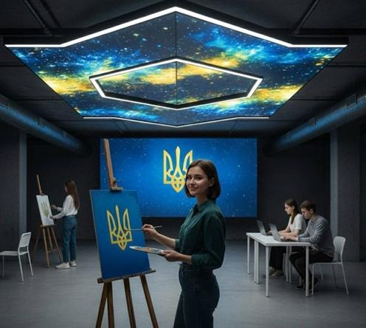
ART- UNDERGROUND- CENTER

Slide 15

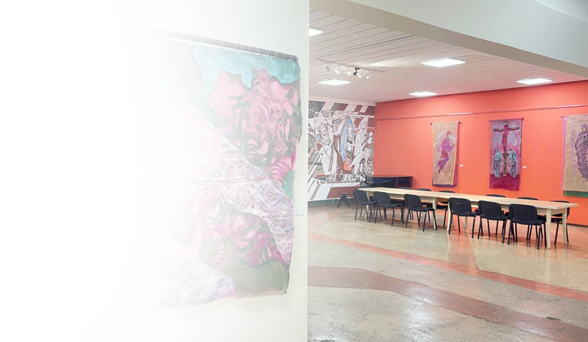
Introduction:
This project is not just a shelter, but a full-fledged cultural, economic, and creative space that functions even during the most difficult times of war. It will become an important component of our future, remaining relevant even after victory.

Slide 16
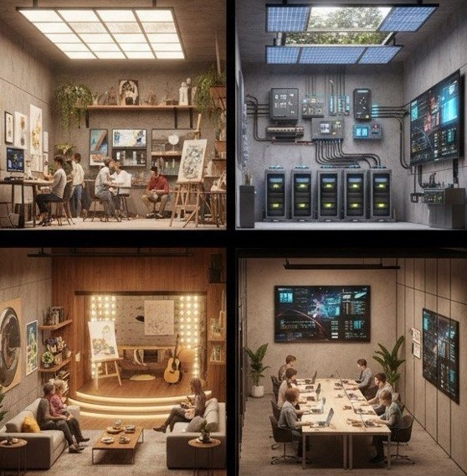

Work Zone
2
Creative Zone
Relax Zone

Slide 17
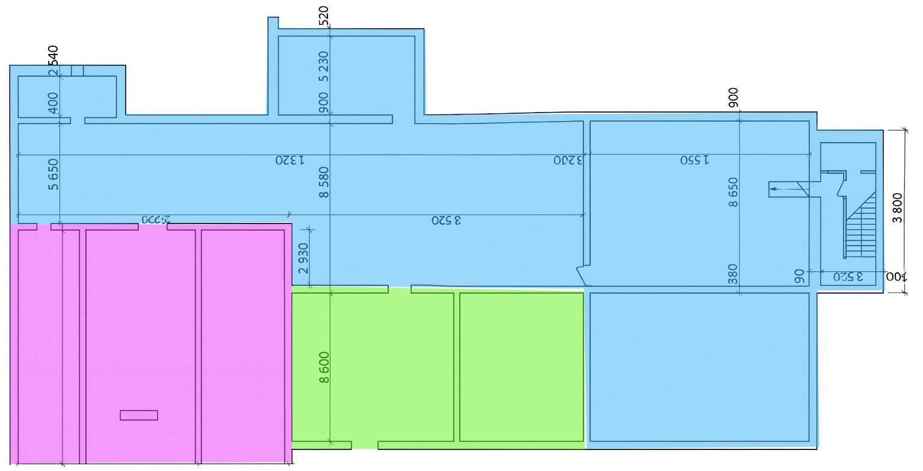
Floor Plan – Schematic: ART - UNDERGROUND - CENTER
Work Zone – Blue
Open-space
Quiet capsules/phone-booths
Transformable conference hall (18-24 seats)
Multimedia spaces for VC (2 rooms for 4-6 people each)
IT hub / communications
Creative Zone – Purple
Painting/graphics studio and Sculpture/modeling studio
Digital art / media lab
VR/AR room (min. 5x5 m open space)
Relax Zone – Green
Sensory room
Quiet library/niches
Underground greenery (biophilia)
Cafe Zone, Pantry-kitchen

Slide 18

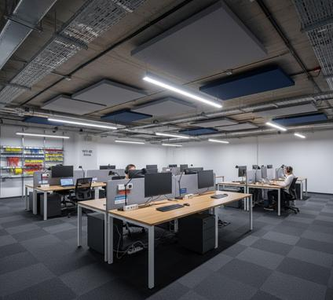
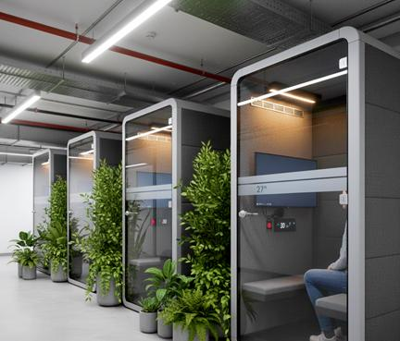
Work Zone
Quiet capsules

Slide 19
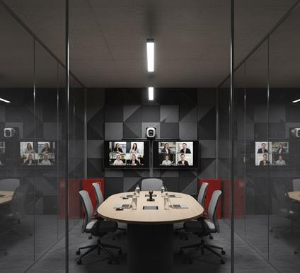
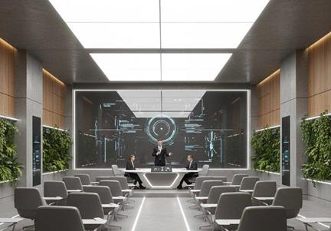
Multimedia spaces for VC
Transformable conference hall

Slide 20
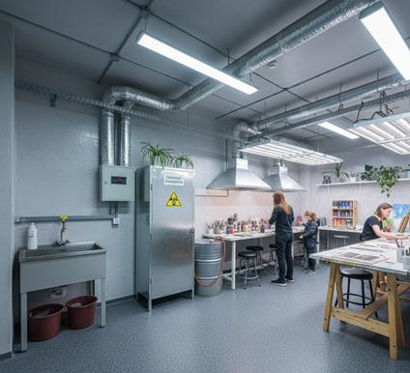
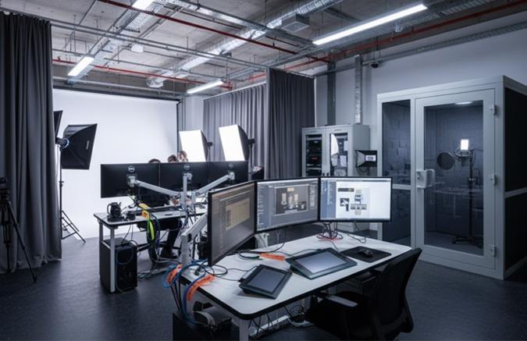
Creative Zone
Digital art

Slide 21
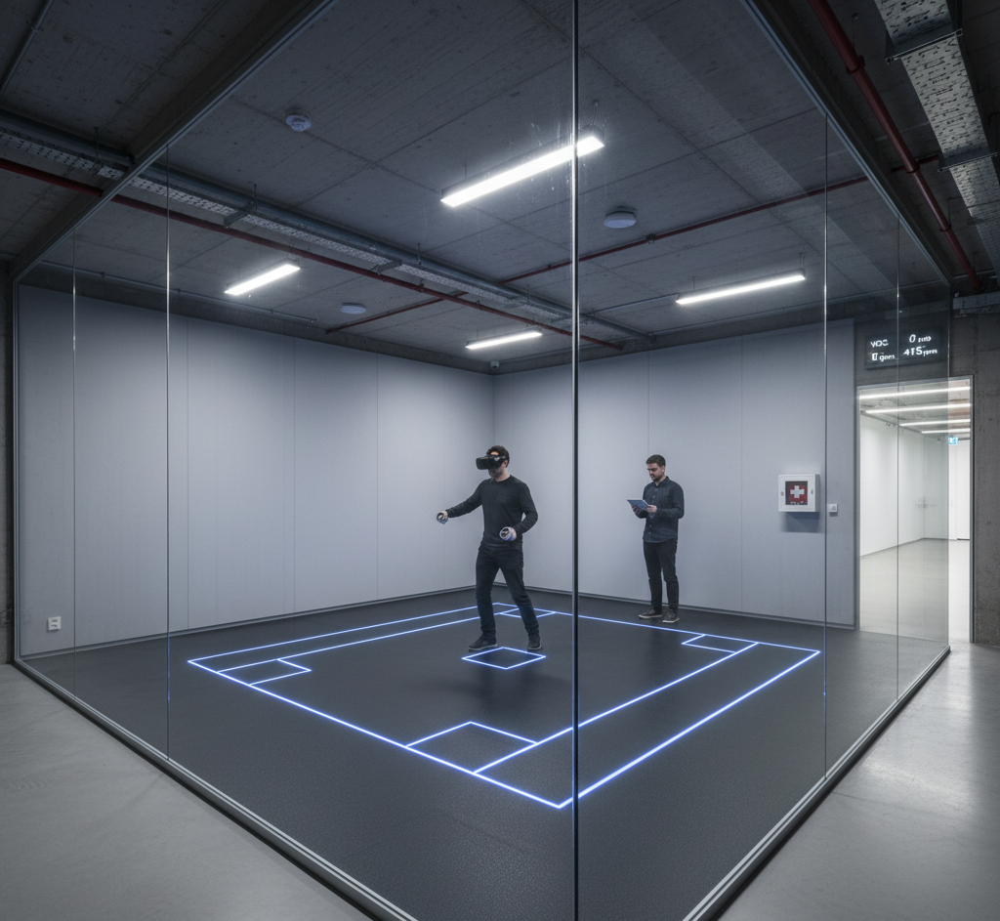
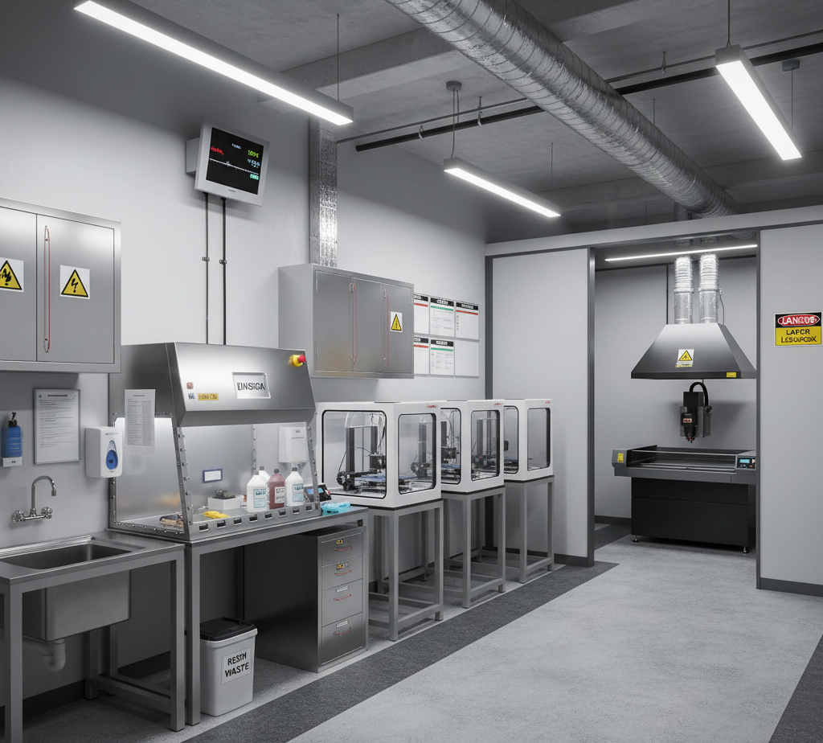
VR/AR room
Makerspace

Slide 22
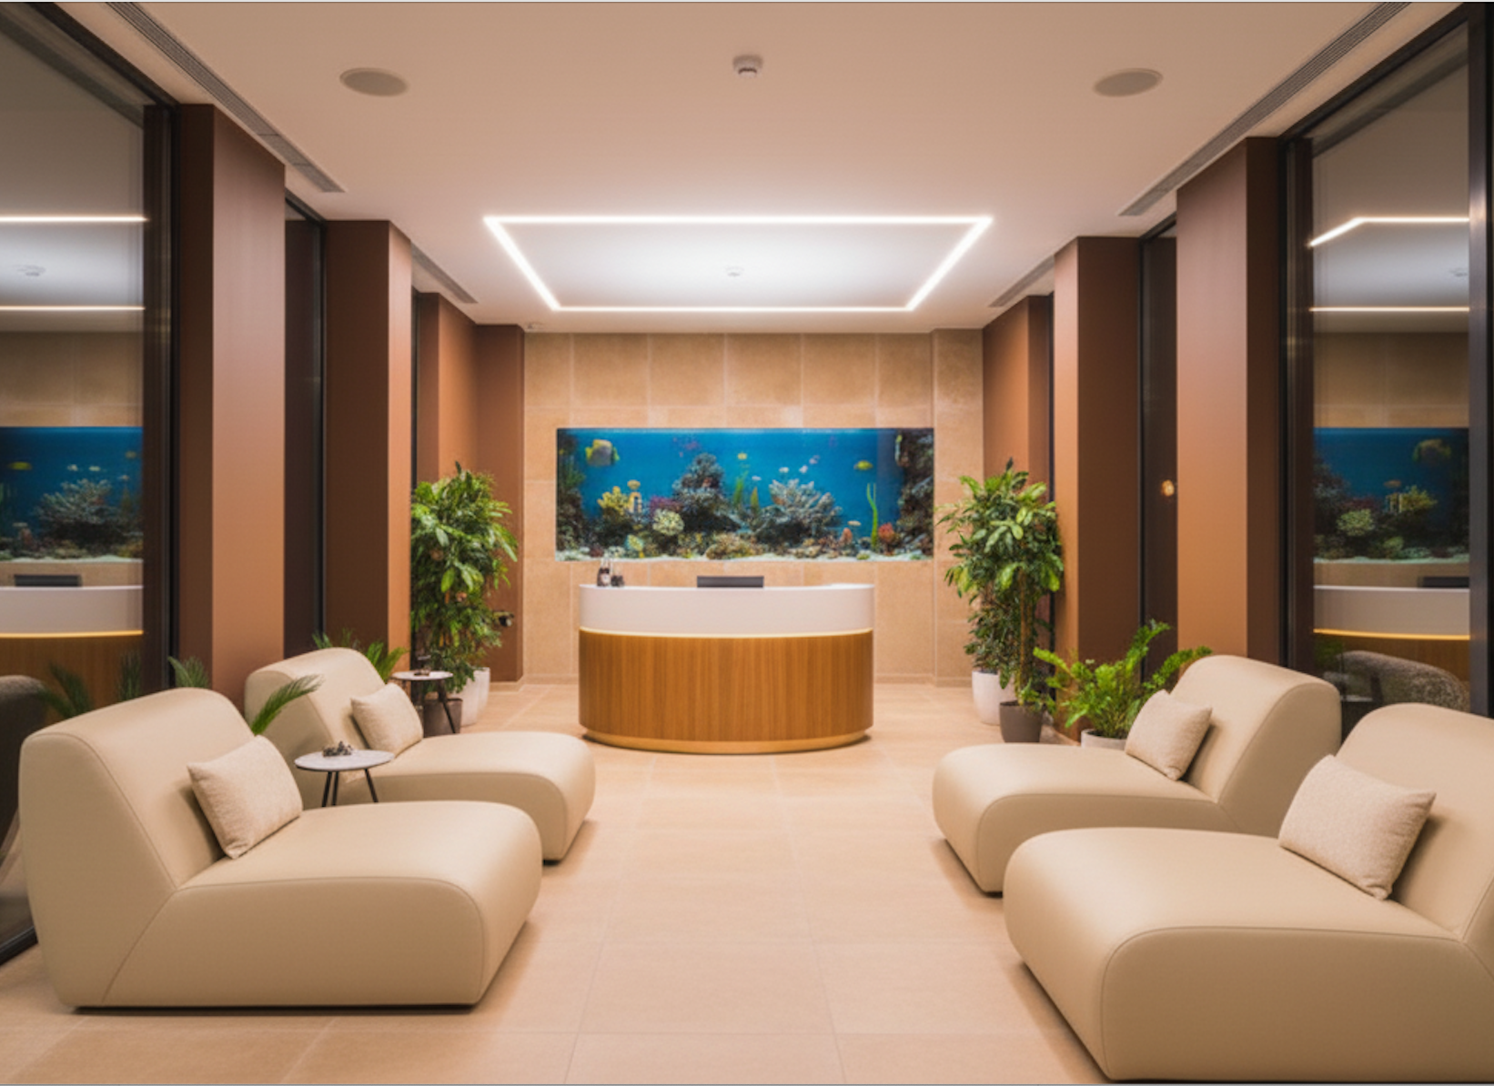
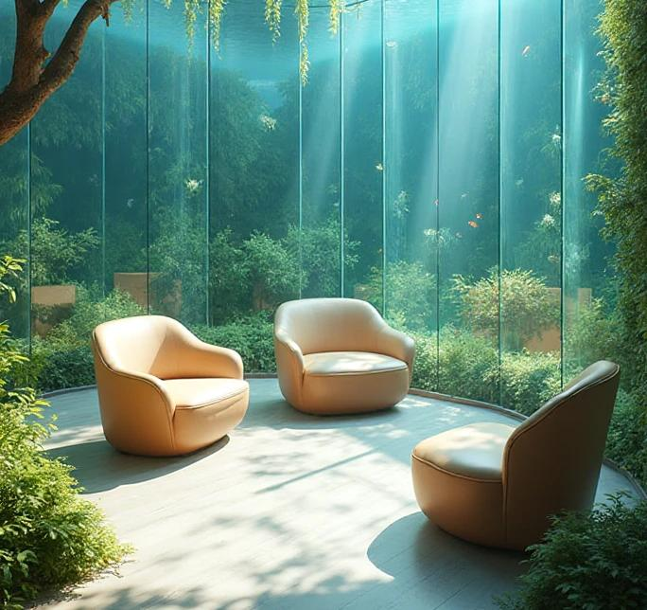
Relax Zone

Slide 23
Energy Efficiency and Autonomy
Generator in a separate room/outside with noise suppression and exhaust ventilation; ATS with safe delay.
Water: filtration (mechanical + carbon), separate drinking water line with reserve supply.
Monitoring: energy consumption panels, CO₂, RH, PM2.5; filter maintenance log.
Ventilation: local exhaust in rooms and backup mechanical ventilation unit.
Communications: fiber optics + Starlink (antenna on surface or light well); failover < 30 s; backup power for the hub.
Military resilience: 2 exits, airlock vestibule with reinforced doors, first aid kits, water 3 L/person/day (72 hours), portable radio stations, safe areas without glass.

Slide 24
Budget and Funding Sources
Transparent structure allows attracting donors, grants, and investors, demonstrating efficient use of funds.
Total Project Cost
36.2
Construction and Installation Work
14.48 million UAH
million UAH
Equipment
12.67 million UAH
Autonomy Systems
5.43 million UAH
747 933.8 €
Training and Reserve
3.62 million UAH

Slide 25
ART-UNDERGROUND-CENTER
After Victory - this center will remain a unique world-class space:
Exotic, energy-efficient, modern.
A place of power for artists, entrepreneurs, and the entire community.
A symbol that even in the darkness of war, the light of the future is born.
Creating even underground. Ukraine. Unbreakable. Free.
Project Team Contact Information
ispsh@ukr.net
05449-2-24-04
41100, Sumy region, Shostka city, Sadovy Bulvar st., 14;
invest_shostka@ukr.ne
+380977172155
fim62@ukr.net
0663413676

Slide 26
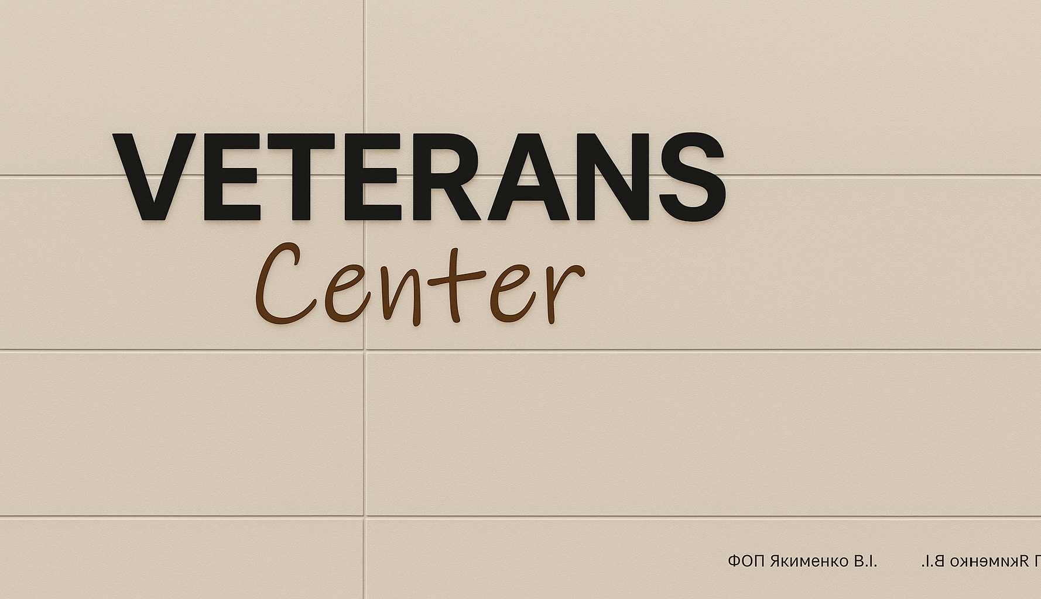

Vairhroekt

Slide 27
"Veterans Center" in Shostka
PREREQUESITES. PROBLEMS.
One of the important aspects of the psychological consequences of war is the problem of adaptation of military personnel returning from the front to peaceful life. Combat veterans often encounter difficulties in returning to everyday social activity due to physical and psychological trauma.
These problems necessitate the creation of a space for the rehabilitation and social integration of veterans. Successful rehabilitation requires the creation of comprehensive services, including psychological assistance, job search support, and social adaptation through participation in community or educational programs.
Creation of a municipal institution
GOAL. OBJECTIVES.
The Veterans Center is a municipal facility created to provide service recipients, namely war veterans and their family members, with information and counseling support; legal assistance; psychological assistance; physical and sports rehabilitation; social adaptation; professional adaptation, including the development of digital literacy skills; and the organization of leisure and active recreation.
The project aims to achieve the following goals:
raising awareness of opportunities and state guarantees for veterans;
improving the level of support for veterans;
physical and psychological resilience, socialization of veterans;
reducing tension and social problems in the community;
increasing trust in local government and authorities.
EXPECTED RESULT.
The work of the veterans' center will help reduce tension and social problems and is crucial to ensuring long-term security and stability in the Shostka community.
The Veterans Center will also be able to provide services online.
Overall, the creation of the Veterans Center in the Shostka community will increase trust in local government and authorities, raise awareness of opportunities for veterans, promote their physical and psychological resilience and socialization, and increase the level of support and national cohesion.
In the future, the Veterans Center will be able to scale up its activities not only in the region but also throughout Ukraine.

Slide 28
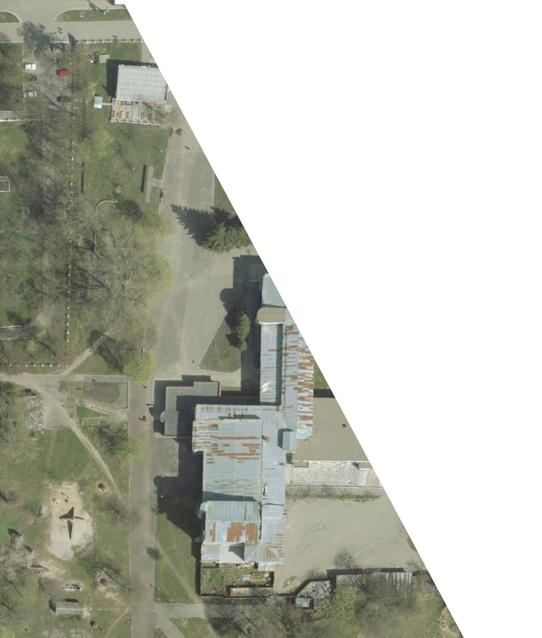
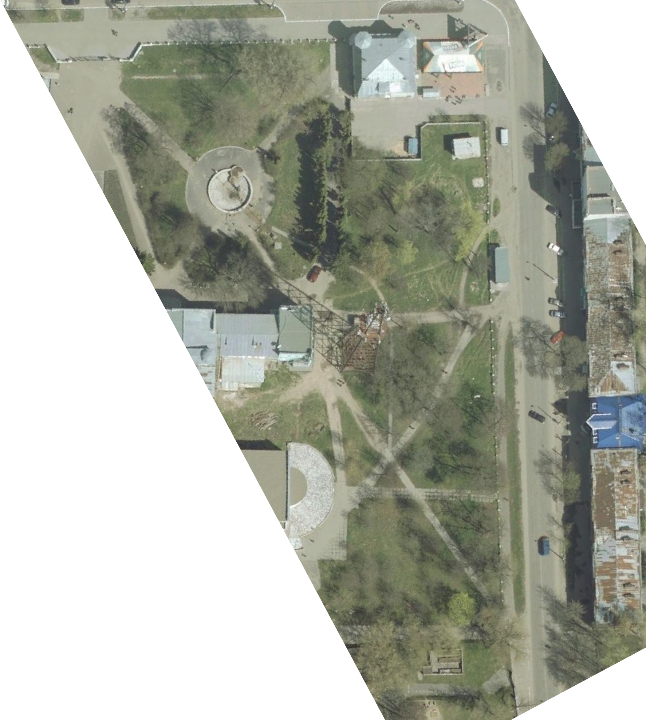
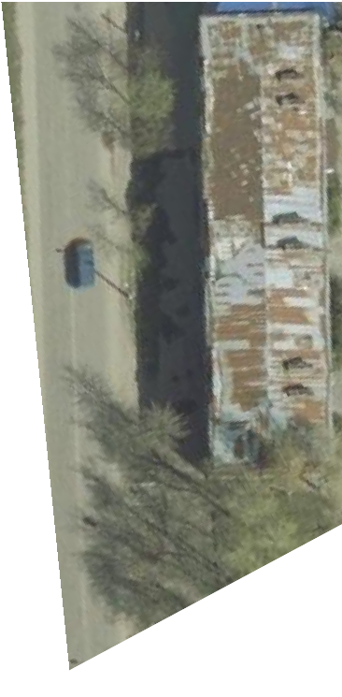
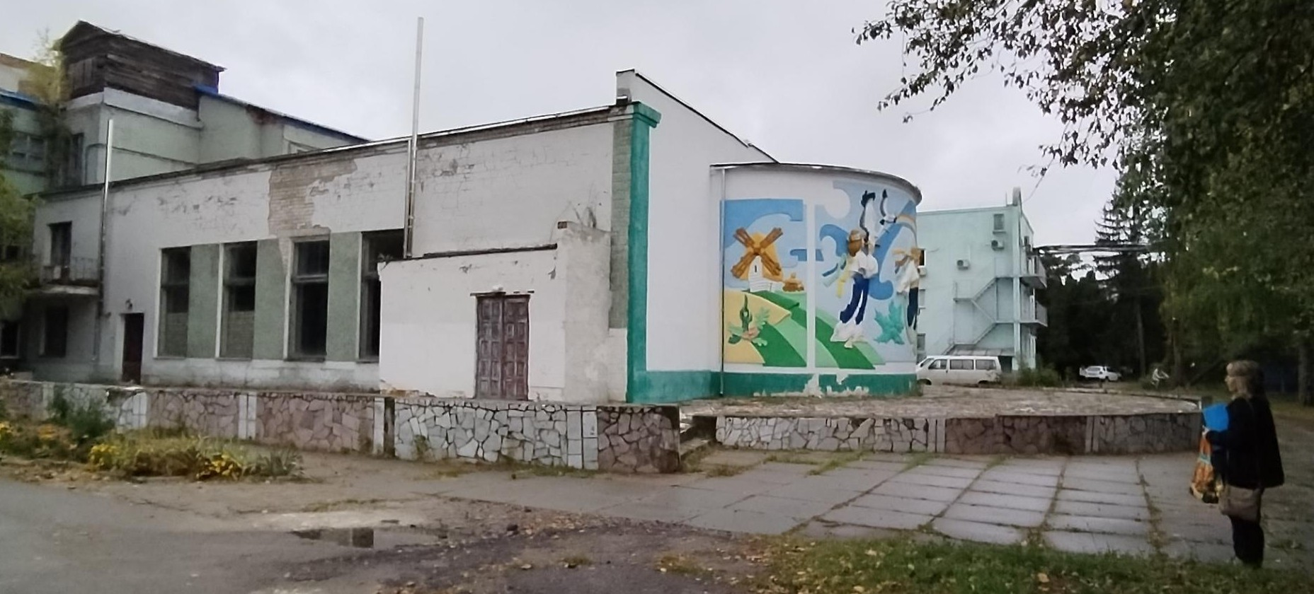
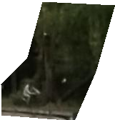




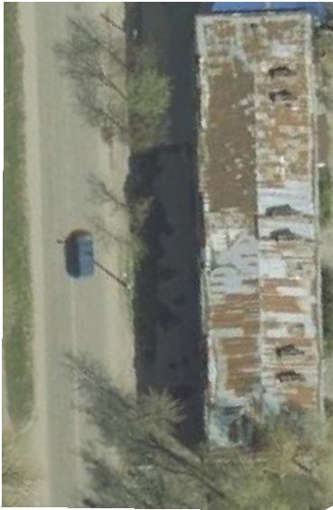
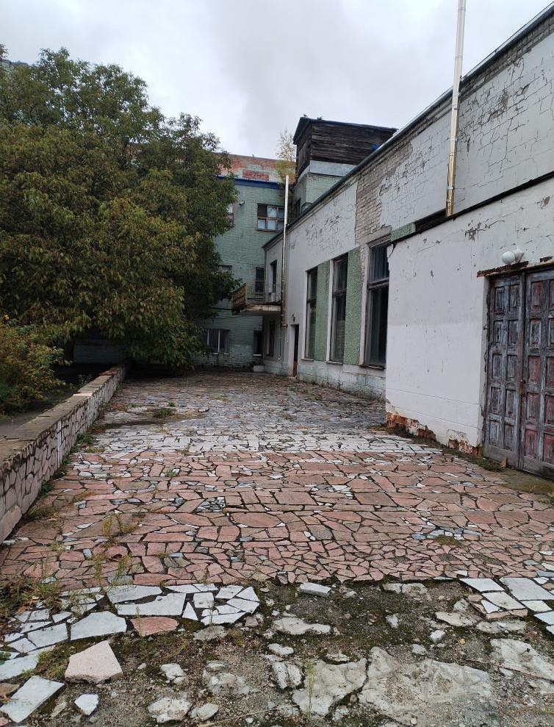
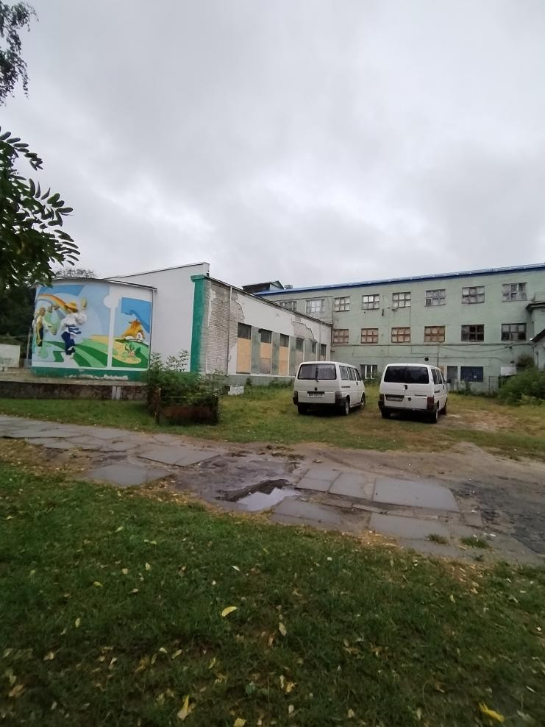
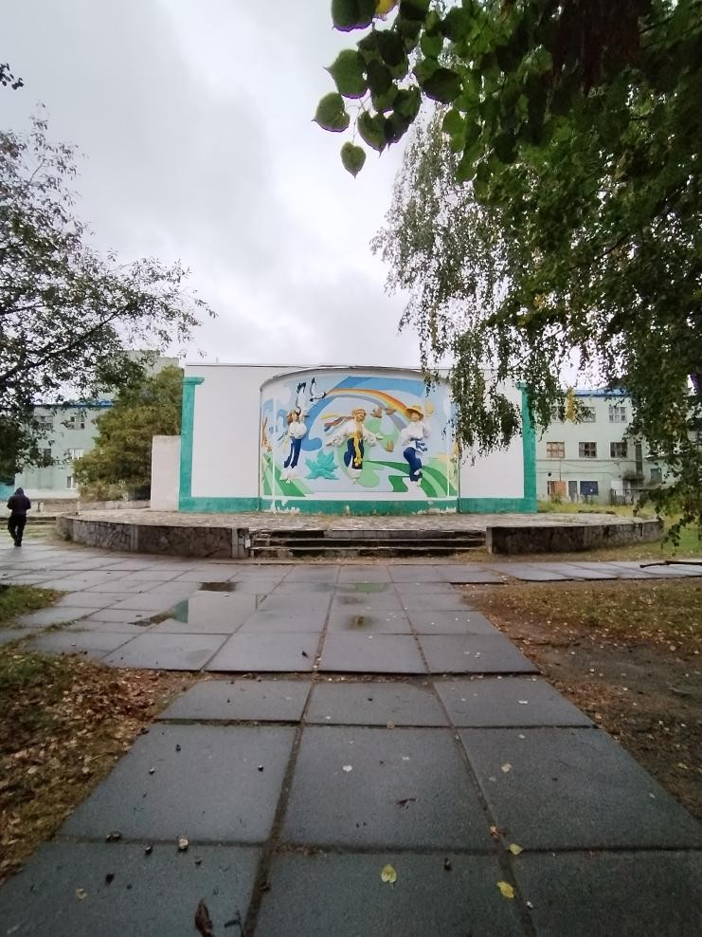
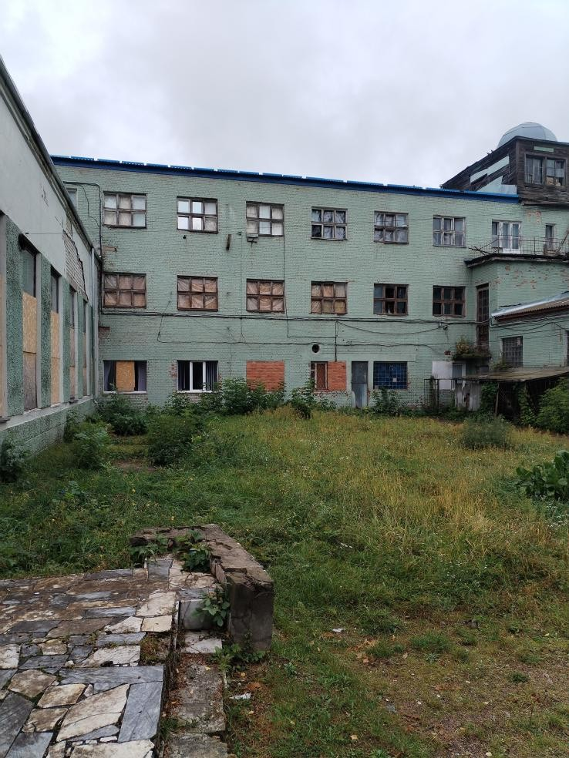
Existing condition. Photofixation

Slide 29
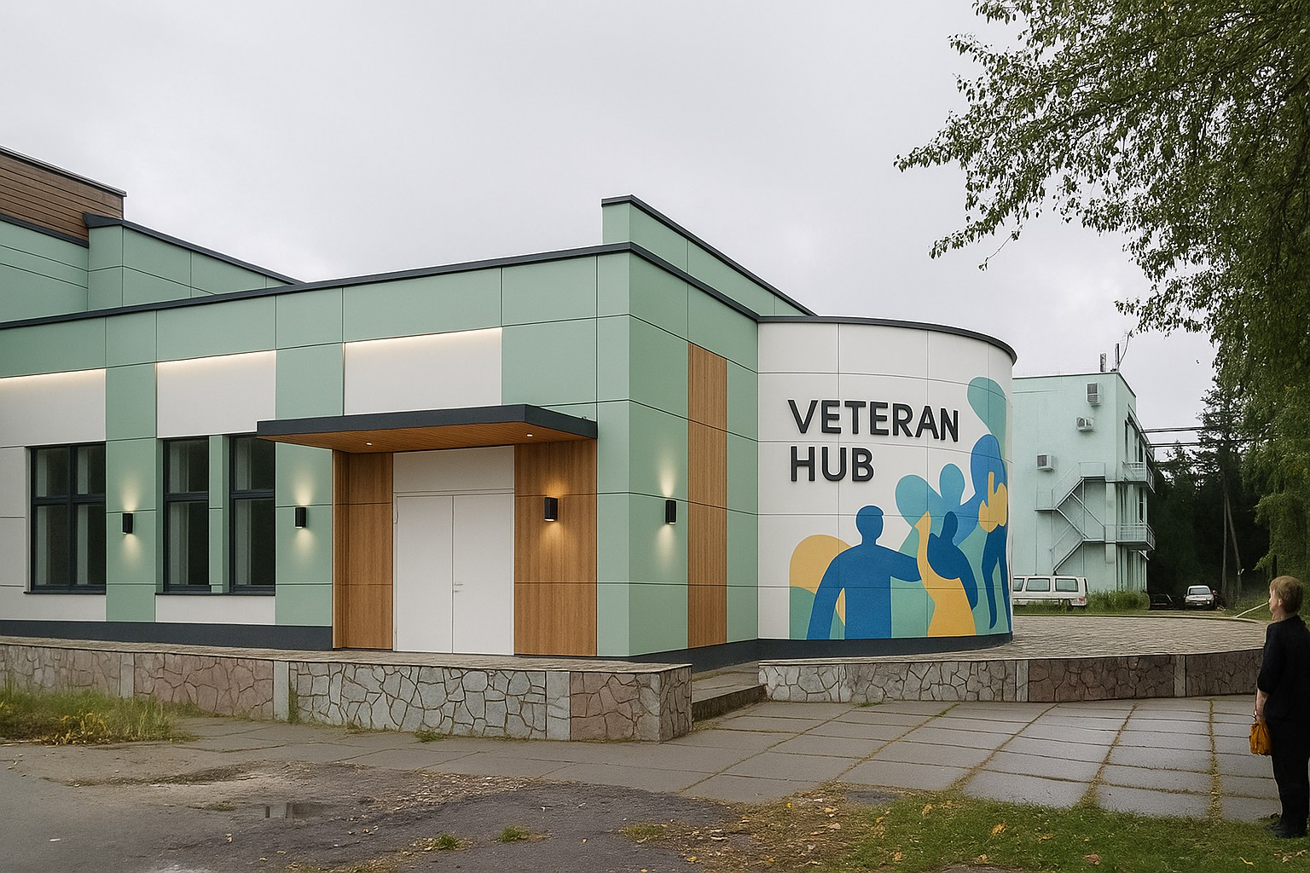
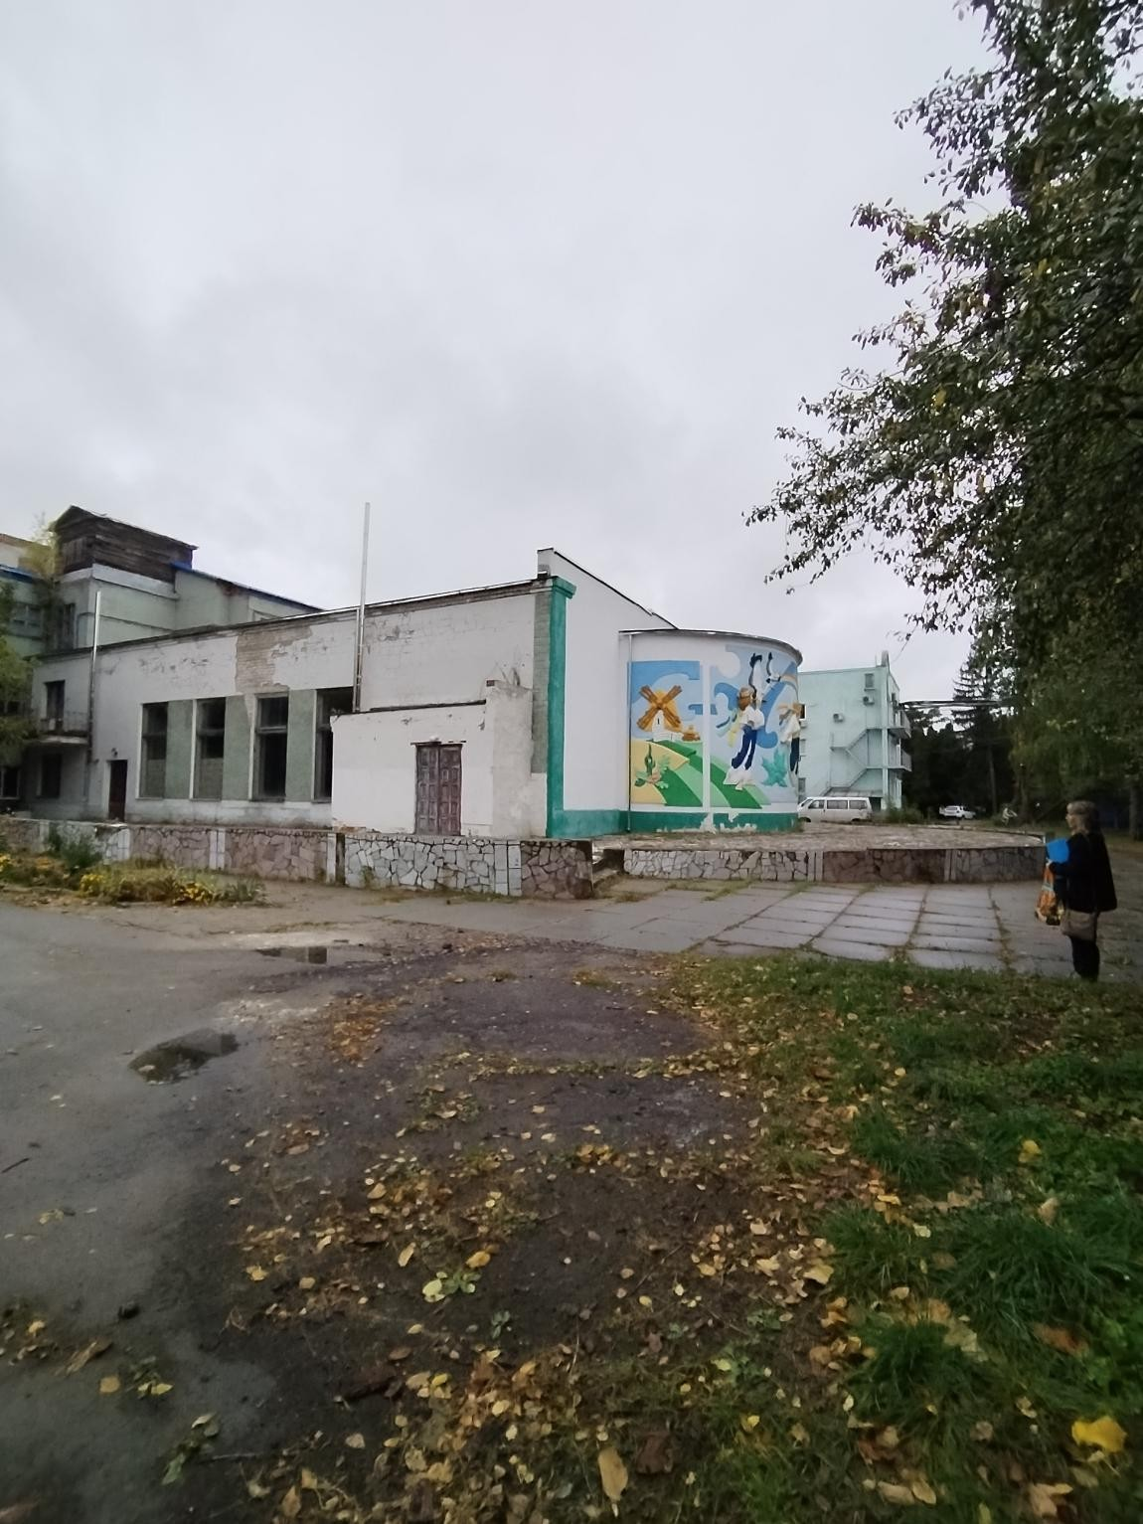
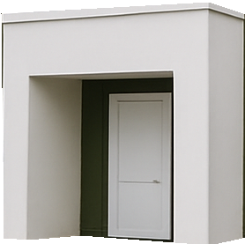
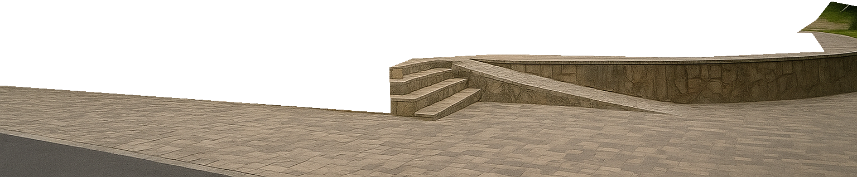
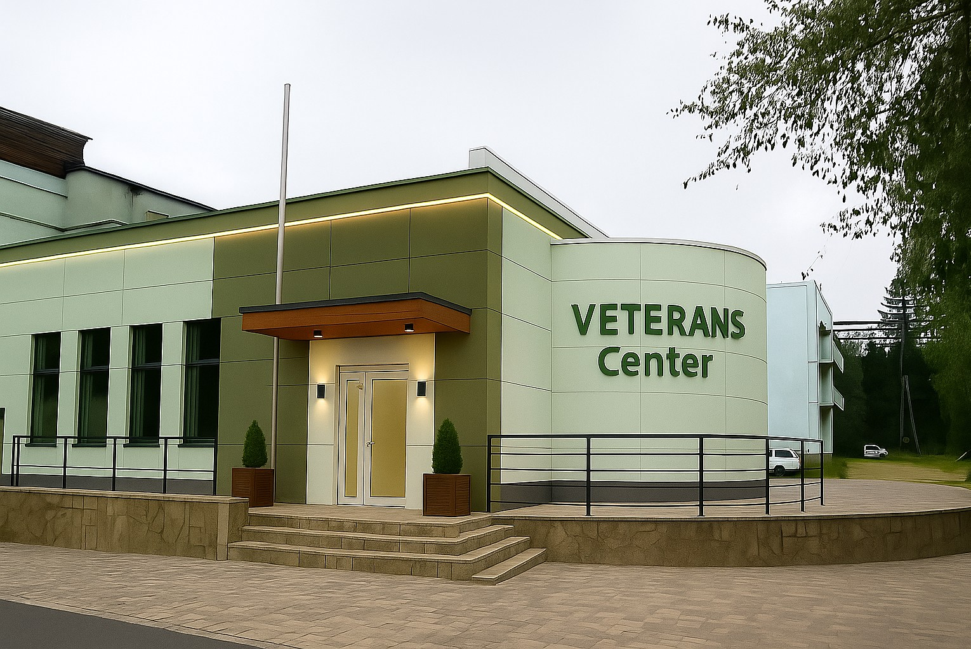
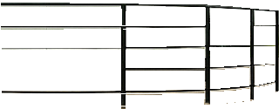
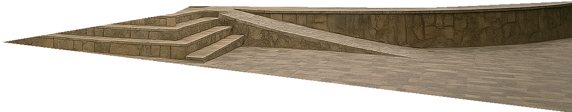
Veteran Center Facade Variations
before reconstruction
after reconstruction

Slide 30
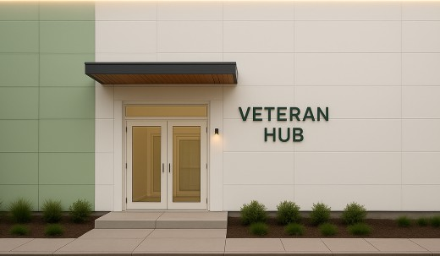








after reconstruction
Veteran Center Facade Variations
before reconstruction

Slide 31
























Master plan scheme
Sports ground area
with exercise equipment
Places to relax
playgrounds
Terrace for summer
Parking spaces
relaxation

Slide 32


Placement of the Veteran Center in the structure of the Center for Aesthetic
Education
Санітарний блок
30,00
душова
роздягальня
First floor layout plan
(total area 565,0м²)
638,95 м2
Зона для реабілітації
40,00
Кімнати для індивідуальних консультацій
17,00
Кімнати для
індив.конс.
Кімнати для
індив.конс.
зона для дітей
17,00
Zoning:
Reception with waiting area
Кімната для групових занять / психотерапії
22,70
Зона коворкінг/ робоча
зона
80,00
Coworking and consulting area
перегородка-трансформер висотою 2,0м
Багатофункціональна зала
75,00
Service area
Службові приміщення
Кабінет юриста
сцена
Lounge area
барна стійка
перегородка висотою 2,0м
Multifunctional hall
Службові приміщення
Children's area
кава-зона
60,00
ресепшн із зоною очікування
Rehabilitation / sports area
Кухня
33,00
Sanitary and hygienic premises
Administrative Facilities

Slide 33








Balcony layout
(total area 125,0м²)
Індивідуальна
робоча зона
35,00
Individual work area with PC
Службове приміщення
Зона для відпочинку
55,00
13,00
The reading area on the balcony is the perfect place for peace, reflection and leisure. It allows veterans to retreat with a book, work or simply relax, observing the activity below, but remaining in silence.
Interior proposals
Адмін. приміщення
Reading and board game area
15,00
before reconstruction after reconstruction

Slide 34









Sanitary and hygienic premises
Санітарний блок
30,00
The Placement of the Reception and Waiting Area within the Planning Structure of the Veteran Center
17,00
22,70
сцена
перегородка висотою 2,0м
ресепшн із зоною очікування
33,00
Interior proposals
Reception
VETERANS
Meeting
Center
Coordination
сцена
Initial Information
перегородка висотою 2,0м
ресепшн із зоною очікування
33,00

Slide 35




Interior proposals
Placement of the multifunctional hall area in the planning structure of the Veterans Center
after reconstruction
to create a cozy, warm space for the comfortable stay of veterans and their
Multifunctional hall (75,0м²)
families
зона для дітей
preservation (restoration) of elements of the existing interior and their improvement
trainings presentations
public meetings
Багатофункціональний зал
75,00
exhibitions
сцена
film screenings
перегородка висотою 2,0м
Celebrations
mobile furniture for various formats (chair+table+modular armchairs, transforming partition, etc.)
before reconstruction
modern equipment

Slide 36







Placement of the coworking area in the planning structure of the Veterans Center
Interior proposals
Coworking / work area
Коворкінг / робоча зона
after reconstruction
та первинна консультація
before reconstruction
80,00
Coworking creates access to a comfortable space with internet, technology, and office amenities
Багатофункціональна зала
The shared space promotes networking between veterans, their families, and local activists
перегородка висото
кава-зона
ресепшн зона із зоною очікування

Slide 37






Rehabilitation/physical activity room (optional)
Placement of the rehabilitation zone, individual and group consultations in the planning structure of the Veterans Center
Small gym or yoga
Can be equipped with rehabilitation equipment
Locker room with shower
Rooms for individual consultations
Interior proposals
after reconstruction
Separate offices for psychologists, lawyers, social workers
before reconstruction
Cozy, with good soundproofing
after reconstruction
before reconstruction

Slide 38






Rehabilitation space
gamified training virtual reality occupational therapy
increasing motivation for recovery
providing feedback to the patient
using virtual (VR) or augmented (AR) reality devices
Equipment
A virtual reality helmet for veterans is used in rehabilitation to overcome phantom pain, treat , improve psycho- emotional state, and motor rehabilitation
interacts with training objects, relearns how to move his own body correctly so as not to harm himself

Slide 39


VRRS system/ Система VRRS
Upper limb rehabilitation device/
Апарат для реабілітації верхніх кінцівок
VRRS Virtual Reality System for Intensive Clinical Use
for motor, static and dynamic postural and cardiorespiratory rehabilitation
The device is designed to test the range of motion of the upper extremities, active training of joint movements and cognitive training after injuries
Equipment
The game approach makes the training process more attractive and interesting, which helps maintain a high level of motivation

