Slide 1
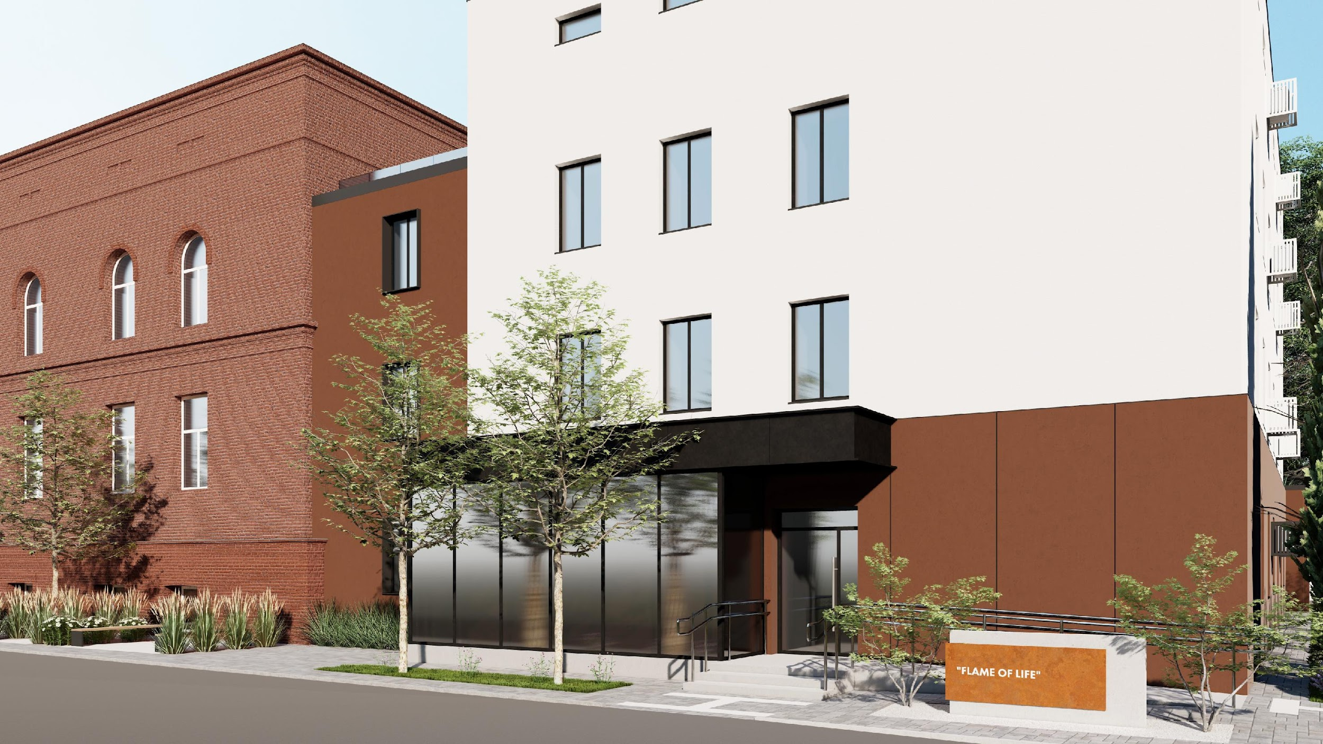
Sumy | Flame of Life
Sumy. Flame of Life
as part of non-profit enterprise
«Sumy Regional Clinical Hospital»
of the Sumy Regional Council

Slide 2
Contents
Introduction (Pages 3)
Description (Pages 4–7)
Burn Injury Statistics (Pages 8–10)
Why “Flame of Life” is Important (Pages 11)
Planning and Premises (Pages 12–13)
Building Design Proposal (Pages 14–19)
Equipment (Pages 20–22)
Building Design (Pages 23–24)
Letter of Support (Pages 25–26)
Project Team (Pages 27)

Slide 3
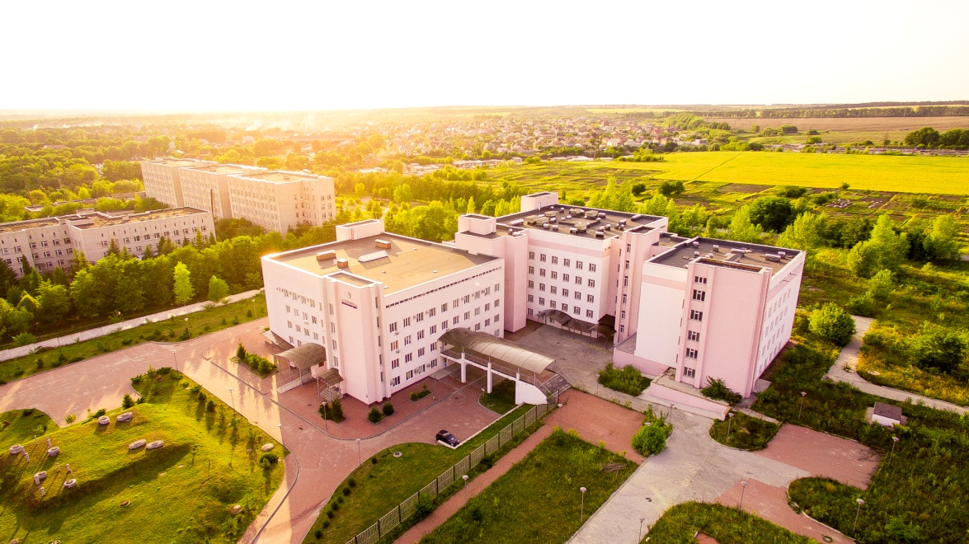

Sumy Regional Clinical Hospital is a leading medical institution with the highest accreditation category, providing care to one-fifth of the region’s population.
The hospital includes highly specialized centers such as the Interventional Radiology Center with an X-ray Surgery Unit, the Joint Endoprosthetics Center, the Nephrology and Hemodialysis Center, and the Endocrinology Center.
The treatment and diagnostic process is supported by paraclinical services, including the Clinical Diagnostic Laboratory, the Department of Functional Diagnostics, the Department of Radiology, the Endoscopy Department, and the Physiotherapy Department.

Slide 4
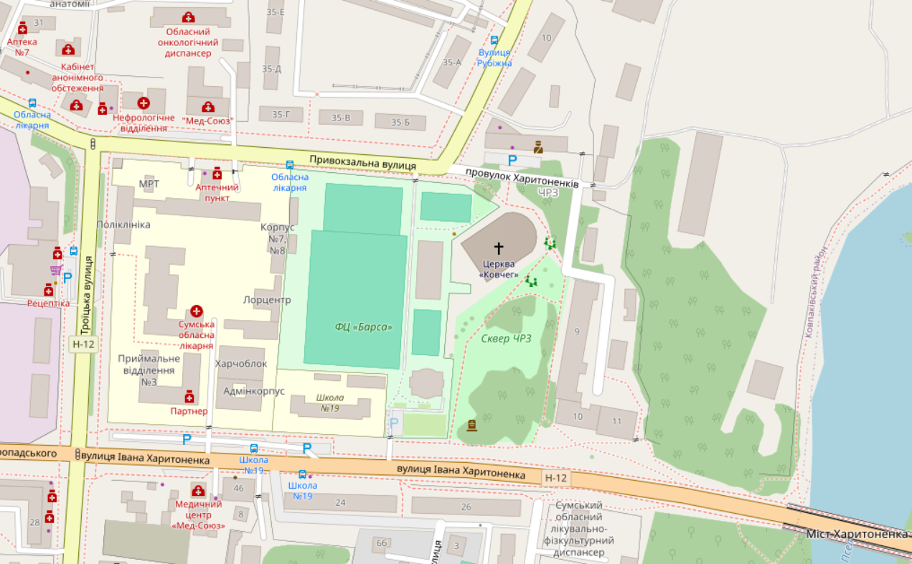
The Burn Center of the Non-Profit Enterprise of Sumy Regional Council “Sumy Regional Clinical Hospital” is the unical center in the Sumy region providing treatment for patients with thermal injuries using modern European methods of diagnosis, treatment, and rehabilitation.
The department applies early surgical treatment of burns, especially in children: early necrectomy and dermabrasion with simultaneous xenodermoplasty and autodermoplasty.
Patients with almost all types of skin loss receive surgical care. The department also treats patients with frostbite, trophic ulcers, and bedsores.
Currently, the Burn Center has 8 wards with 2 to 6 beds each, three dressing rooms, one manipulation room, and an operating theater with one surgical table.
Each bed is allocated 5.75 m².
The department staff includes 2 full-time burn surgeons and 2 part-time specialists, 10 nurses, and 9 nurse assistants.

Slide 5
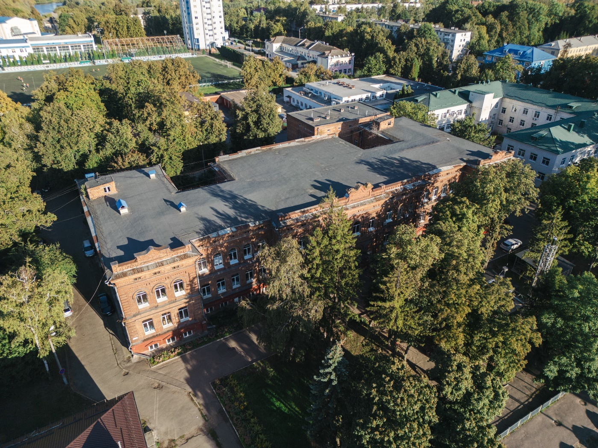
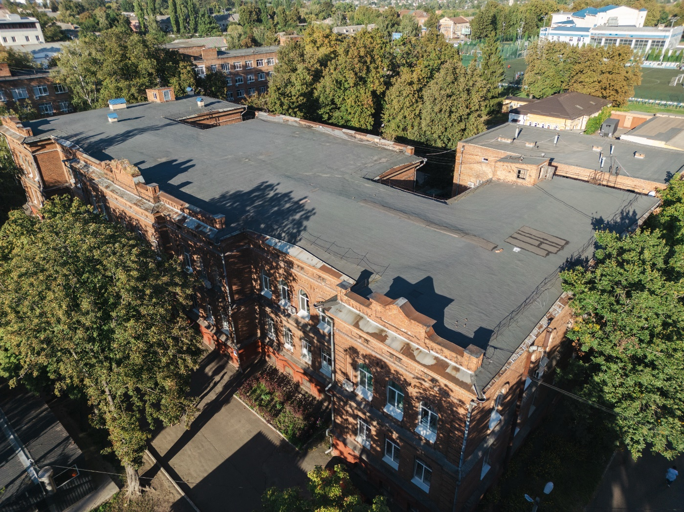

Slide 6
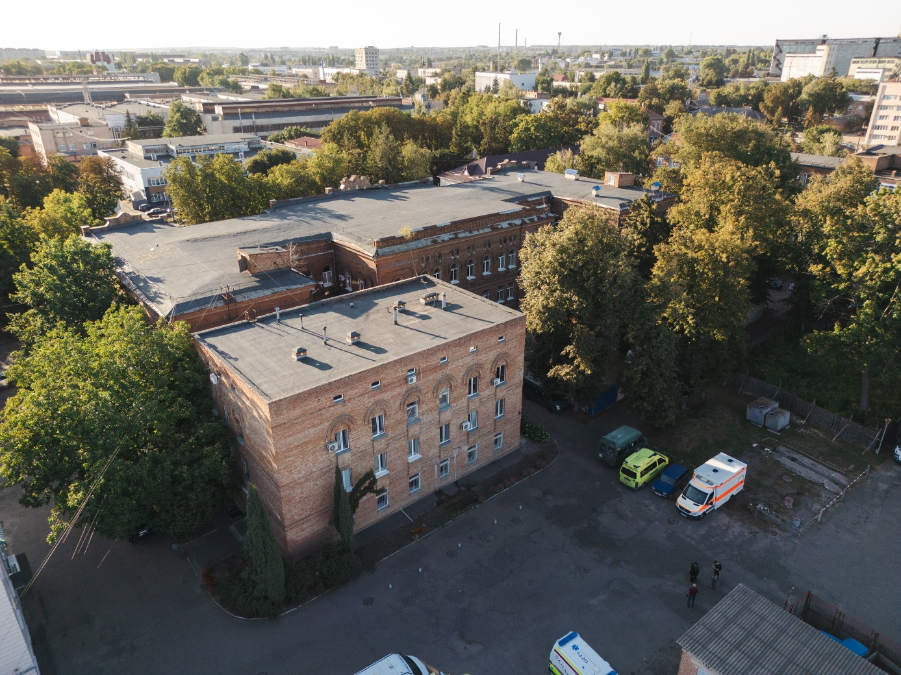
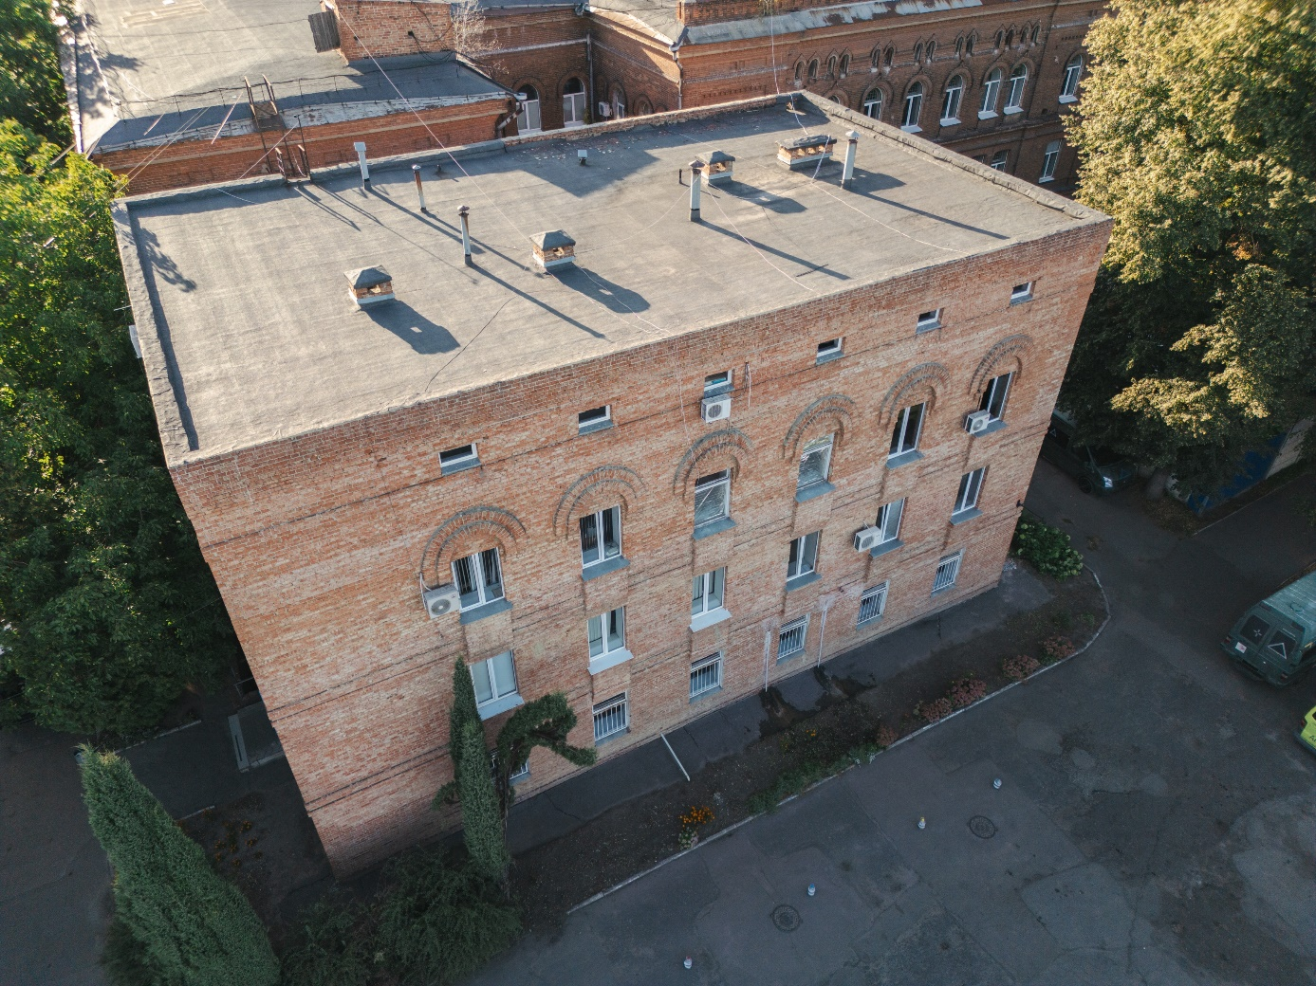
The physical deterioration of the building: brick wall damage, destroyed porches, damaged roof joints, corroded drainage system, deformed window frames, lack of glazing, partial destruction of reinforced concrete staircases.
Worn-out utility systems (sewage, water supply, electrical networks, ventilation and air conditioning.
Non-compliance with thermal insulation requirements under DBN V.2.6-31:2021 “Thermal insulation and energy efficiency of buildings”: the thermal conductivity of a 680 mm brick wall does not meet modern standards.
Lack of major repairs since time of building construction: aging and damage of floor coverings, deterioration of wall finishes, partitions, and ceilings.
Absence of a ramp and elevator for barrier-free access to the Burn Center.

Slide 7
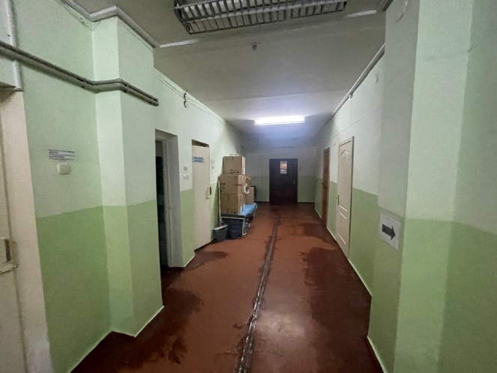
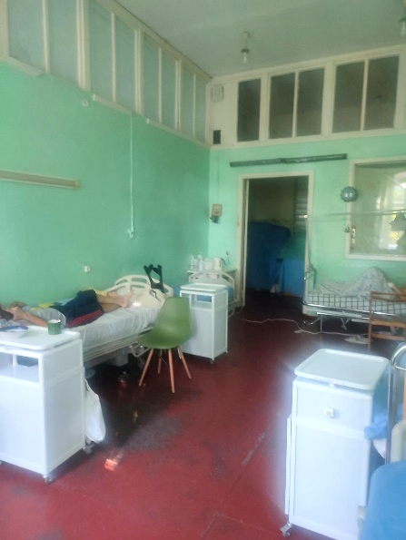
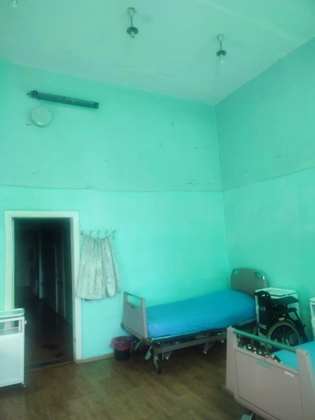
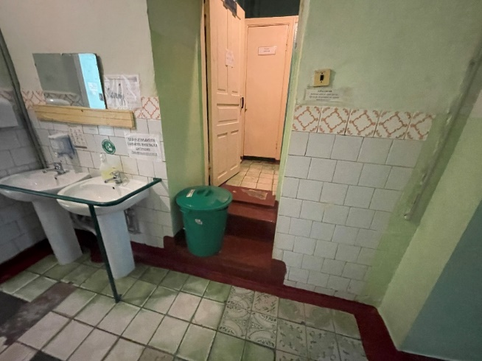
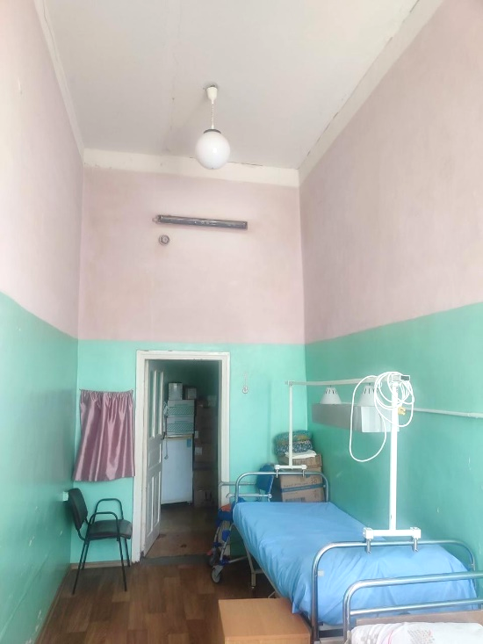
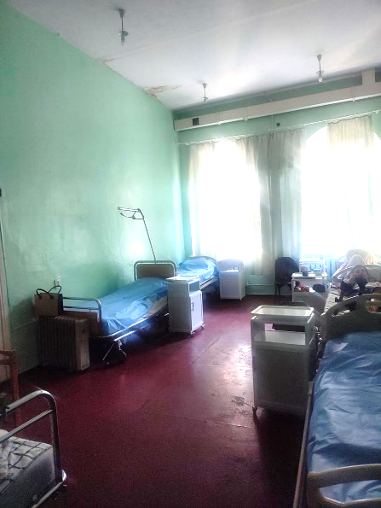

Slide 8
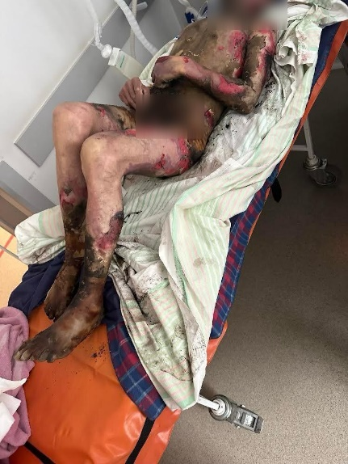
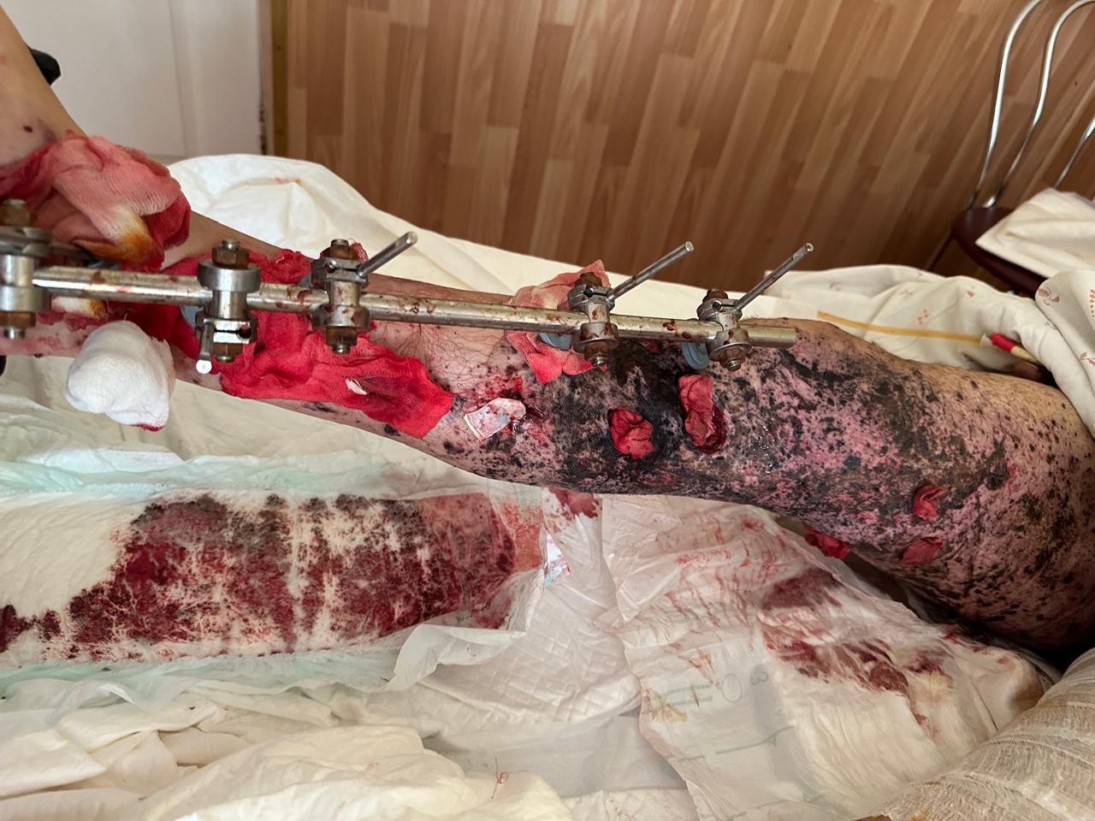
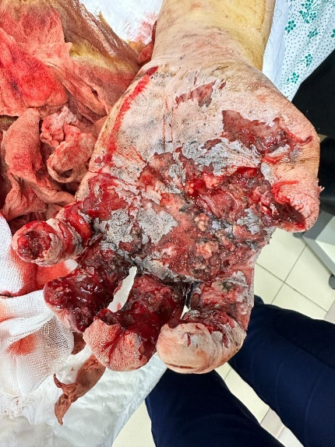
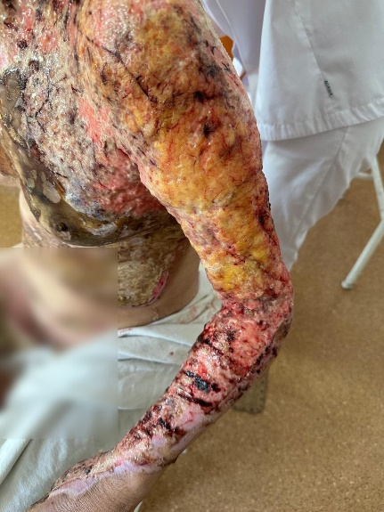
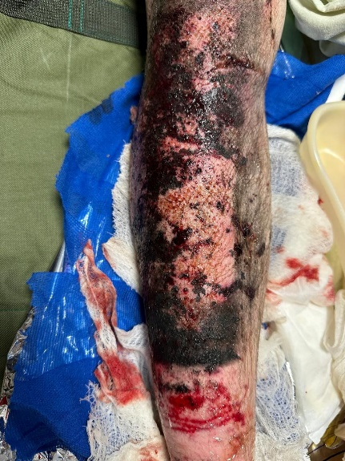
Burn injuries are considered among the most severe traumas in global medical practice. In Ukraine, due to the war, the number of people with burn injuries is constantly increasing. Before the war, most burn cases were related to domestic accidents. The war has radically changed this statistic.
In 2024-2025, more than 35% of patients sustained injuries during attacks. Mine-explosion injuries require highly qualified care, urgent surgical interventions, and long-term rehabilitation. In 2024, up to 270 patients, including 10 children, receive inpatient care in the department.
The department performs up to 450 surgical interventions annually, of which more than 50% are autodermoplasty and combined skin grafting, 5% are amputations and total osteonecrotomies, and 3% are reconstructive surgeries. The surgical activity of burn surgeons reached 66.8%.
In 2025, high-complexity procedures (level III–IV) accounted for 60%.
In 2025, the average length of hospital stay decreased to 21.8 days due to the implementation of early rehabilitation and evacuation of patients to safer medical facilities outside the region.

Slide 9
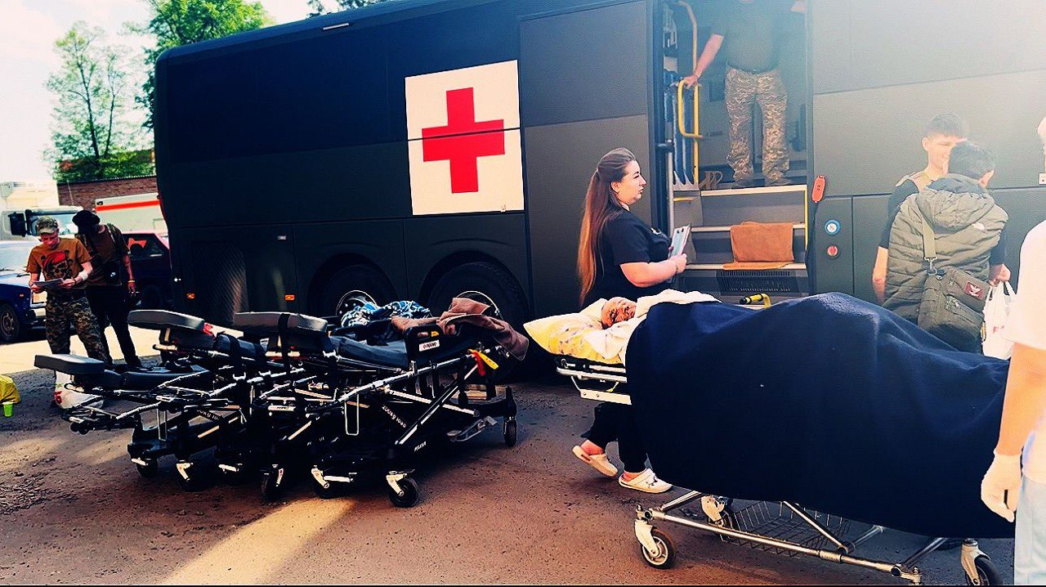
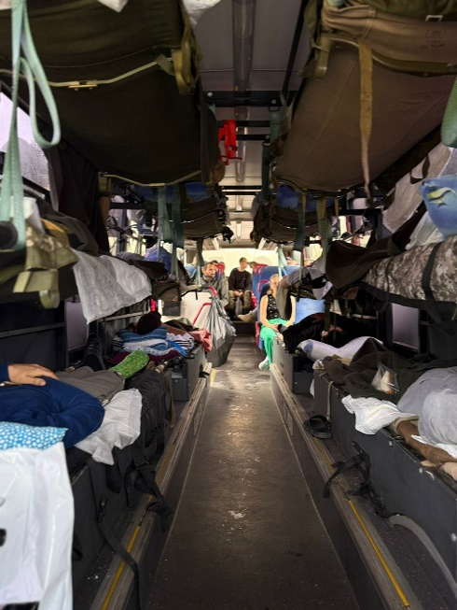
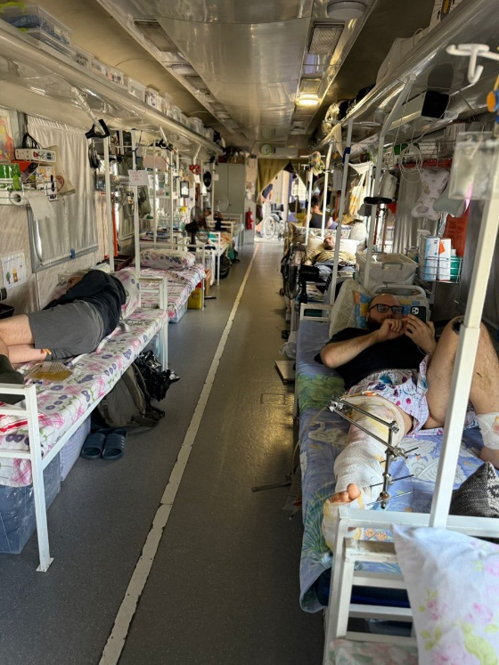
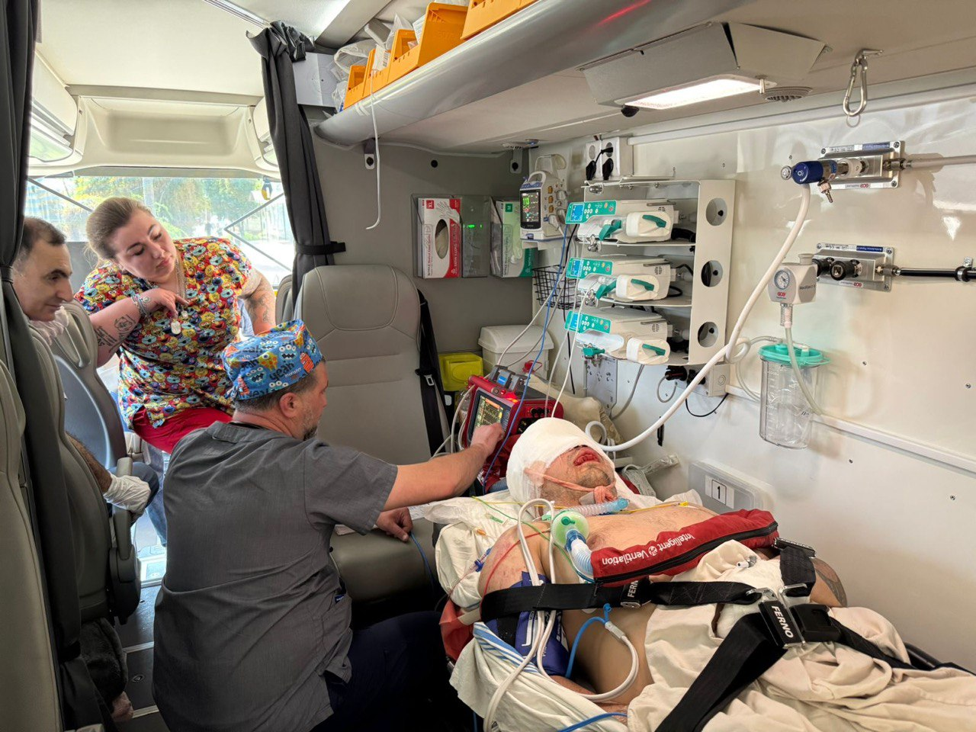
Due to the limited equipment capacity of the burn department and the tense military situation, up to 20% of patients, including military personnel with severe injuries, are evacuated to the Kyiv city clinical hospital №2, and St. Panteleimon’s hospital in Lviv (10 patients in 2023, 51 patients in 2024).
Today, the fundamental principles remain unchanged: the first 48 hours are “golden” for ensuring proper conditions of stay, adequate pain management, and restoration of the function of organs and systems affected by damaging factors.
The accuracy of patient management strategies at all stages of treatment directly affects survival, recovery quality, and subsequent reintegration into society.
The continuity of all stages of treatment in one place will help reduce mortality and restore quality of life.
Modern equipment and a multidisciplinary team will ensure the highest standards of care.
The accumulation of additional facilities will allow the separation of patient flows between children and adults, creating comfortable conditions both for patients and for medical staff.

Slide 10

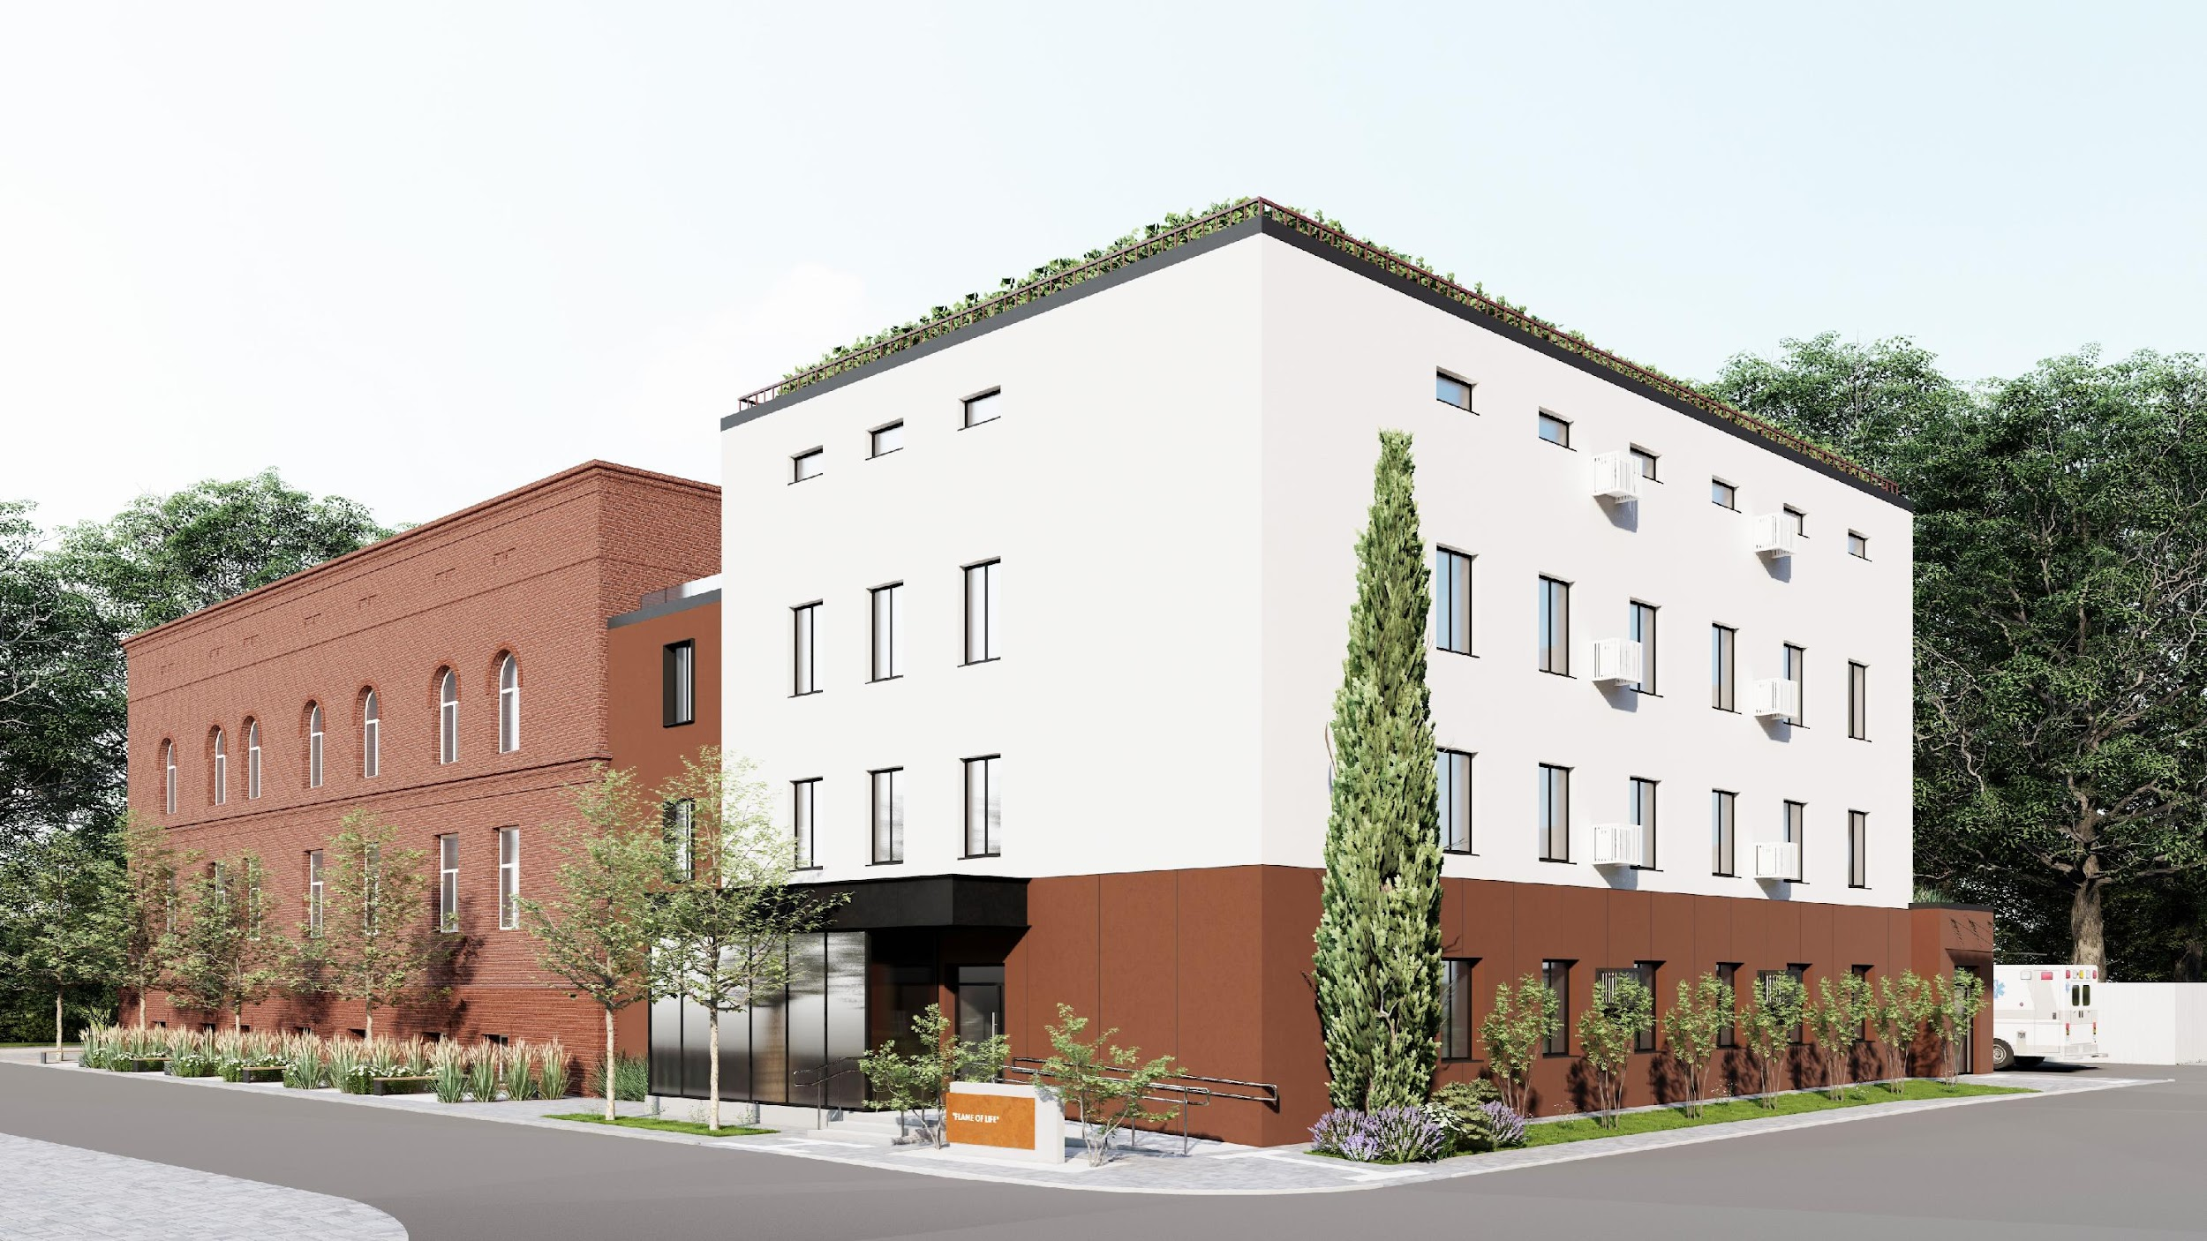
The establishment of a modern Burn Center in Sumy Region will significantly improve access to specialized care by:
doubling the number of treated patients and corresponding surgical interventions (500 patients; 900 surgical procedures)
expand the scope of surgical operations, with up to 20% (180 cases) being reconstructive surgeries
In case of modernization, the Burn Center “Sumy. Flame of Life“ will provide higher-quality treatment for patients with thermal injuries — including civilians, military personnel, workers in hazardous industries, and children — using advanced methods of diagnosis, treatment, and rehabilitation, and applying the achievements of modern science and technology as well as the best practices of leading medical institutions.

Slide 11
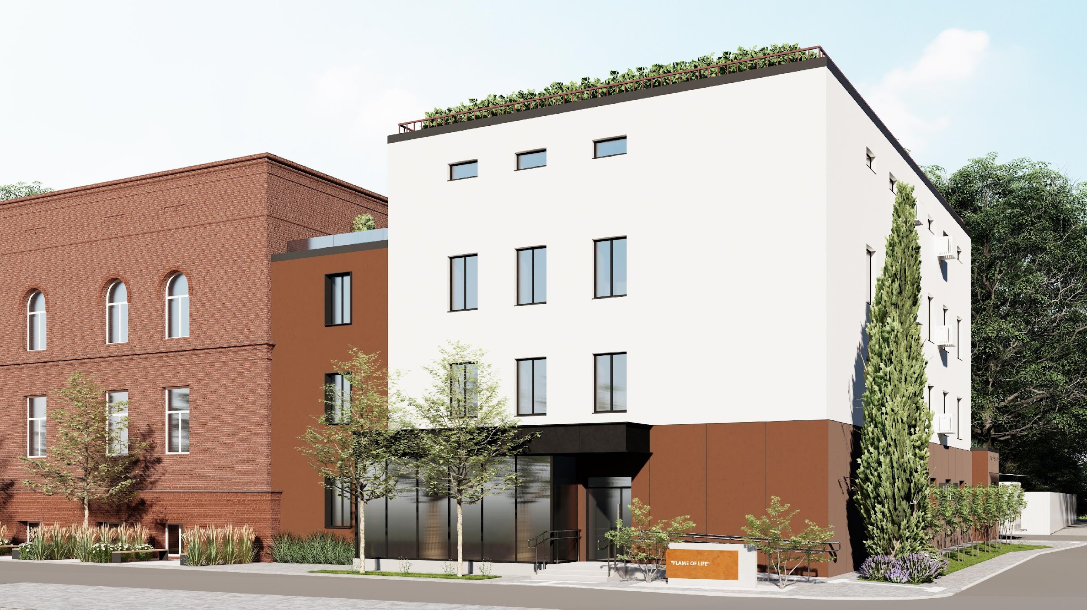
Burn Center “Sumy. Flame of Life“ will become a place for comprehensive support: medical, psychological, and social:
Saving lives and reducing disability
Modern equipment and methods allow rapid provision of care, increasing the chances of recovery
Reduction in complications and mortality from severe burns
Improved access to specialized care for residents of Sumy Region and neighboring areas
Shortened time to the start of treatment, which is critical for burn patients
Support for military personnel and victims of the war
The modern center will provide specialized conditions for treating young patients and psychological support for their families
Reconstructive and plastic surgeries will help patients avoid severe deformities and social isolation
Development of the region’s medical infrastructure, the center will serve as a hub for staff training, education, and implementation of modern technologies
Strengthening the vision of Sumy as a city with high-quality healthcare
Psychological and humanitarian support for society, as people feel that the state and community care about their safety and health

Slide 12
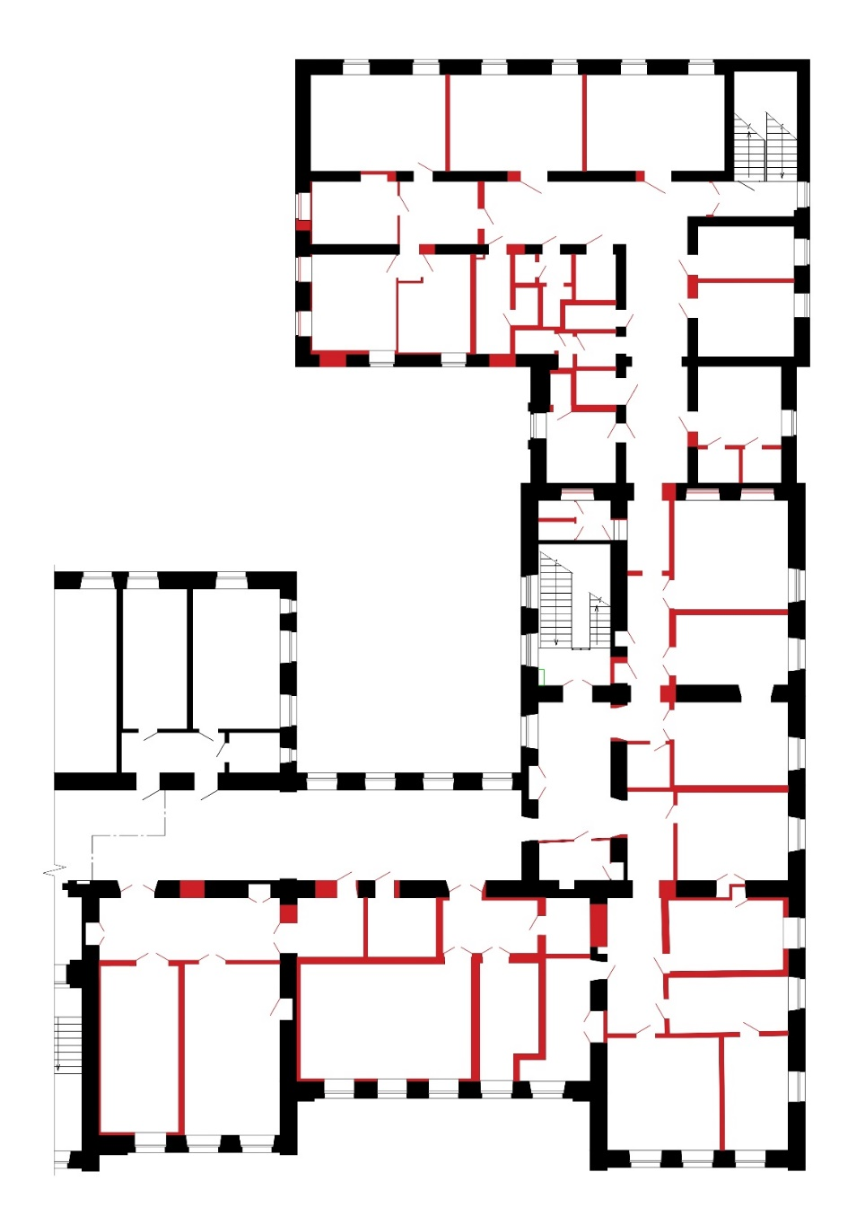
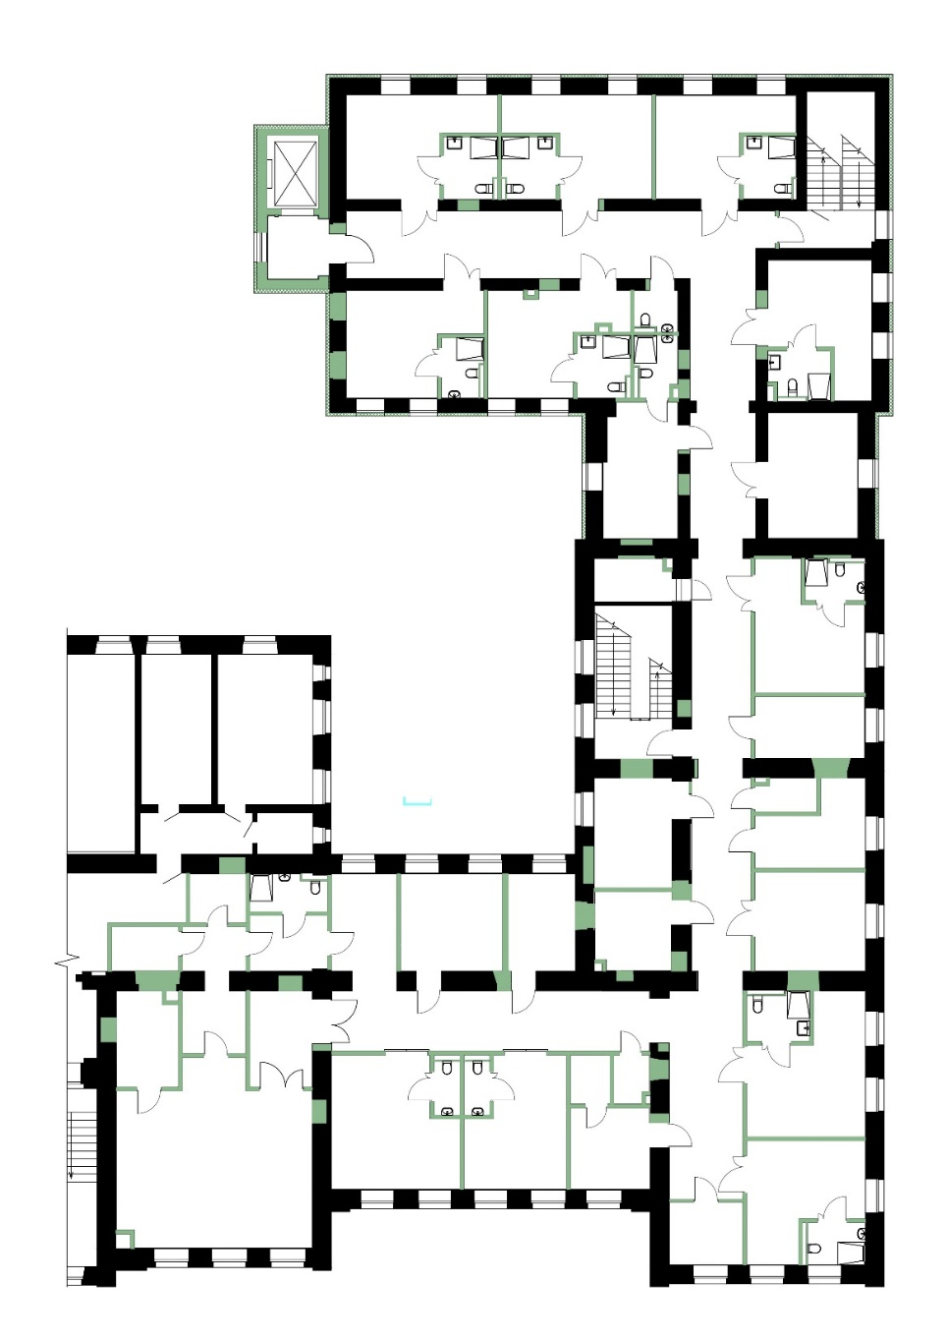
Before Replanning
After Replanning
The project provides for:
Thermal modernization of the building
Construction of a porch with a ramp
Extension of the elevator shaft
Replanning of premises, and finishing of walls, ceilings, and floors in accordance with modern requirements and standards
Replacement of damaged engineering networks with new ones
Creation of conditions for the future implementation and use of alternative energy systems (solar power plant with a capacity of up to 30 kW)

Slide 13
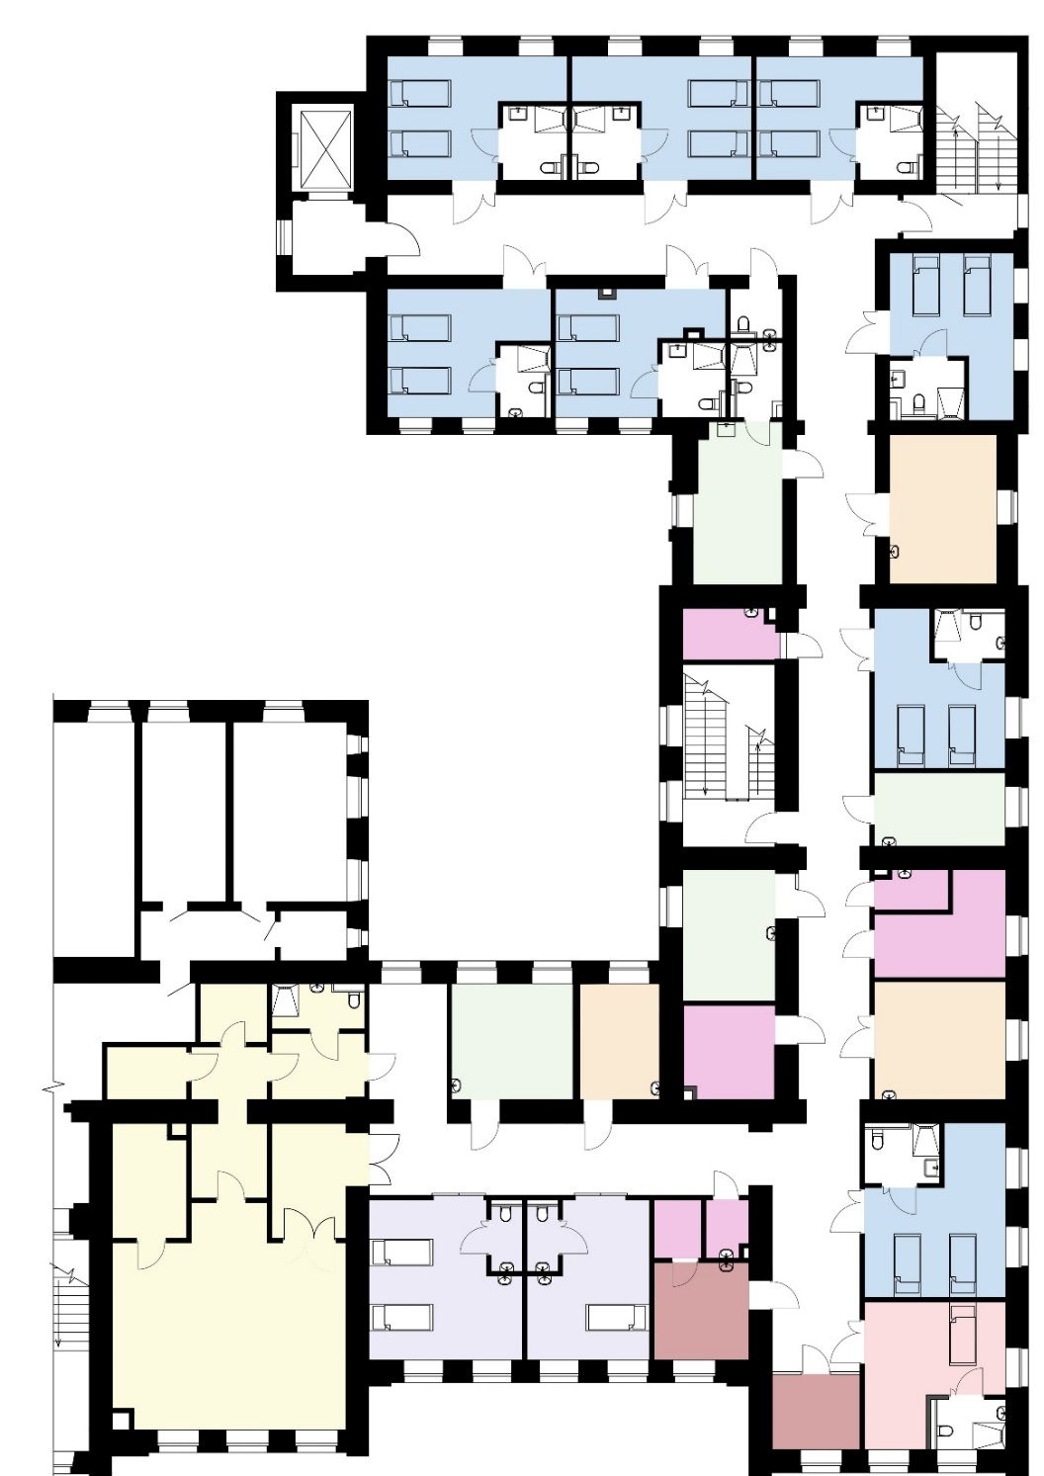
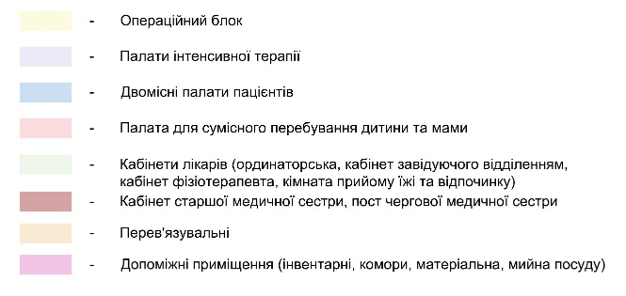
As a result of the major renovation, a convenient and functional layout has been designed, including the following rooms:
8 double wards, each with a universal restroom
2 intensive care wards with toilets (designed for 3 beds each)
operating unit with an operating room, preoperative room, sterilization room, washing room, and changing room with restroom for medical staff
doctors’ office
head of the department office
head nurse’s office
physiotherapist’s office
staff lounge
dressing room
dressing room for infectious patients
manipulations room
procedure room
storage room for supplies and medications
cleaning equipment room

Slide 14
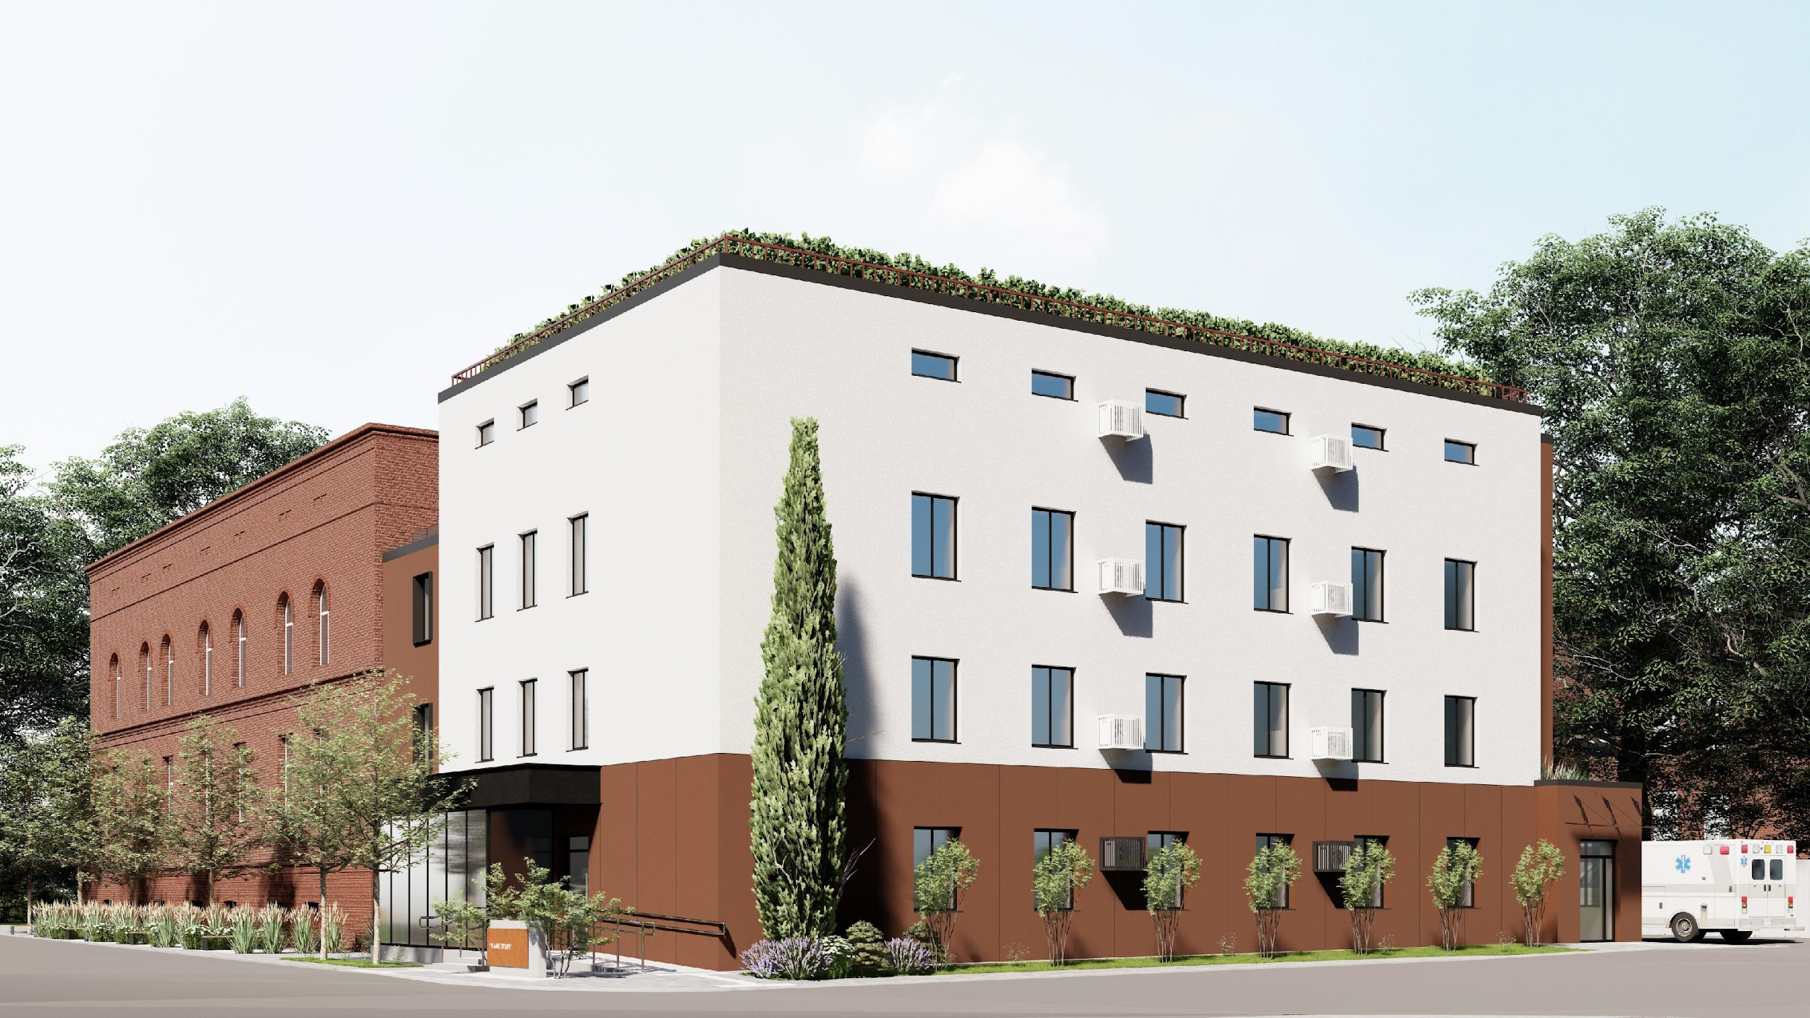
Design Proposal for the Building Facades

Slide 15
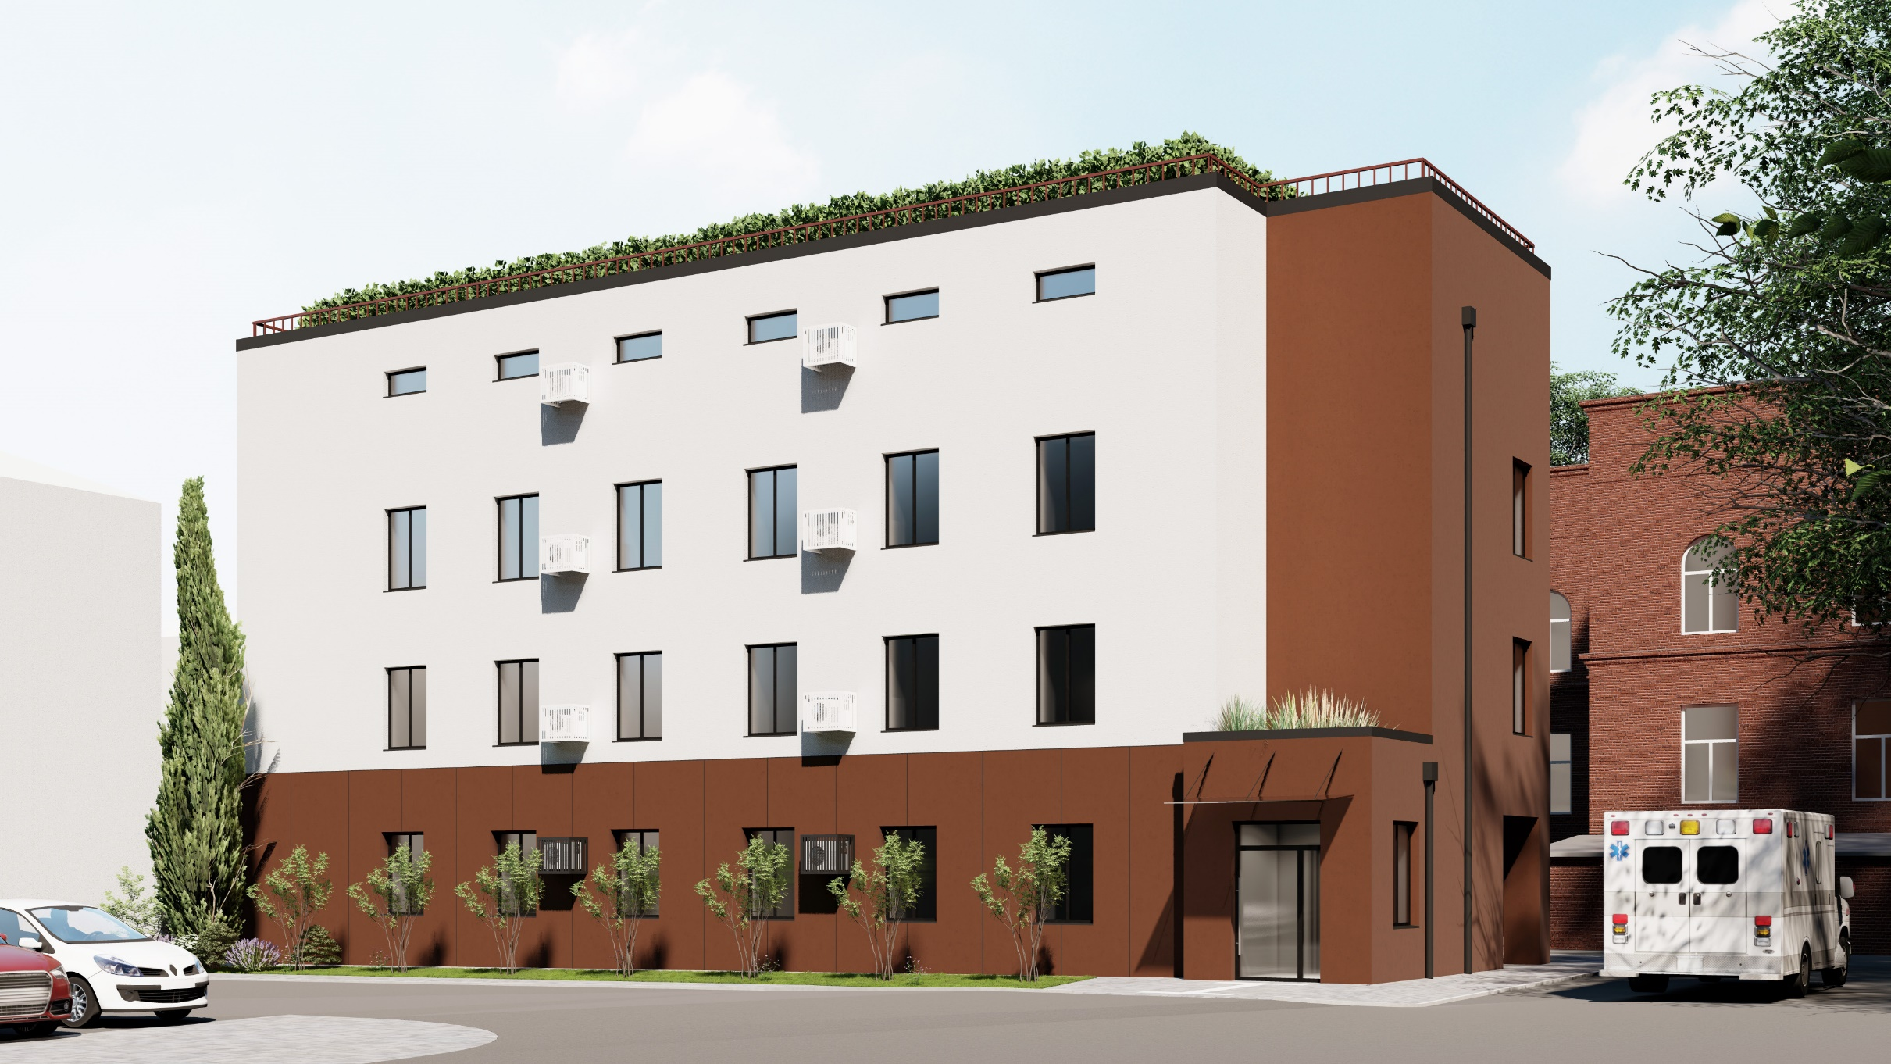
Design Proposal for the Building Facades

Slide 16
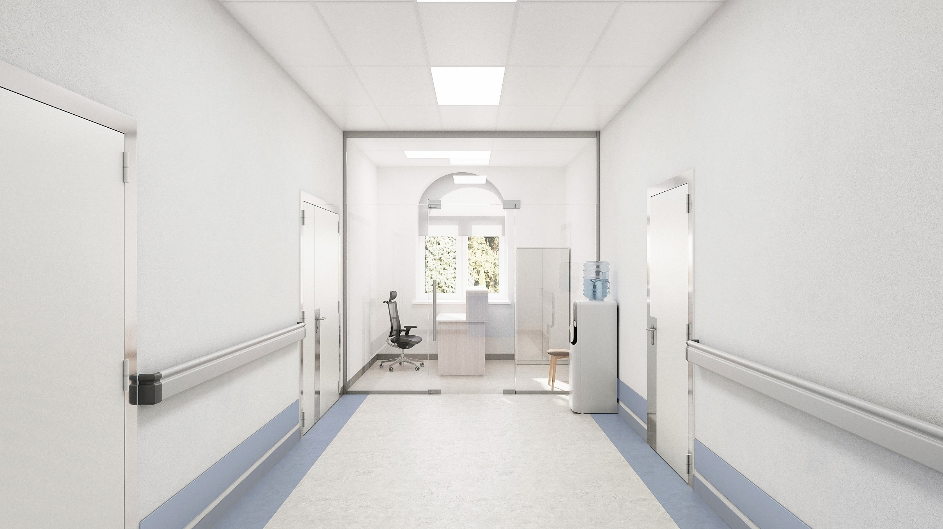
Nurse Station

Slide 17
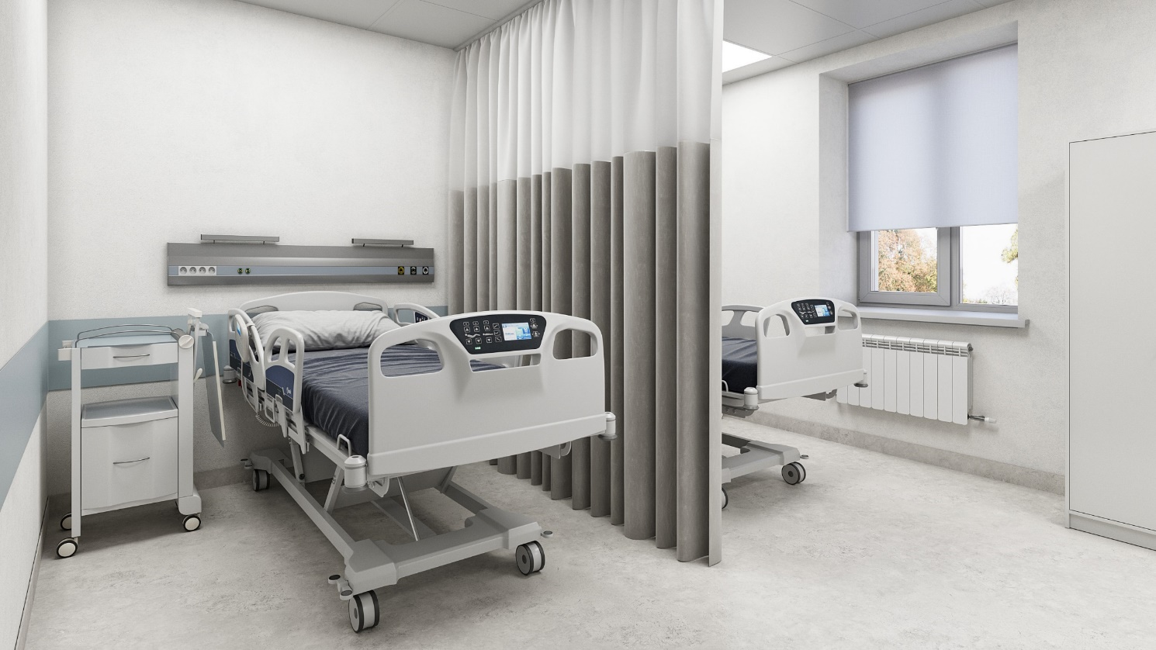
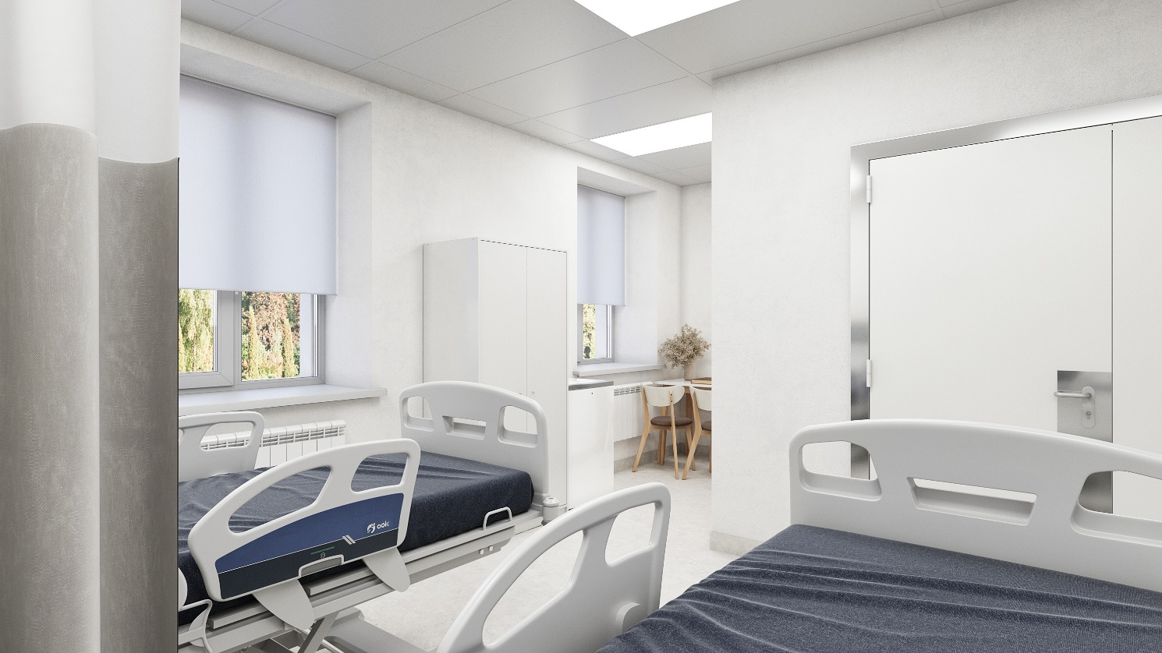
Two-Bed Patient Room

Slide 18
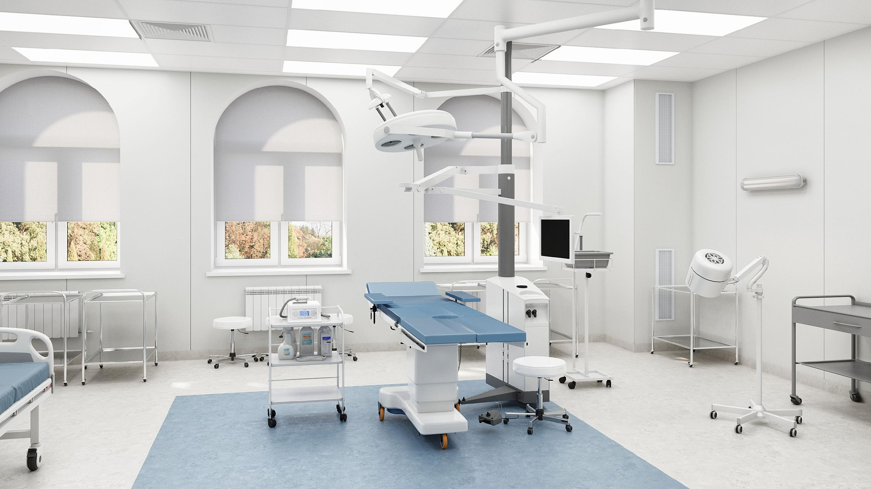
Operating Room

Slide 19
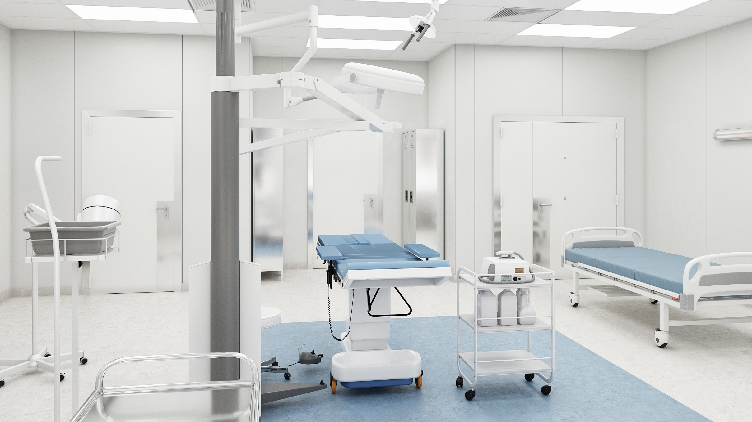
Operating Room

Slide 20
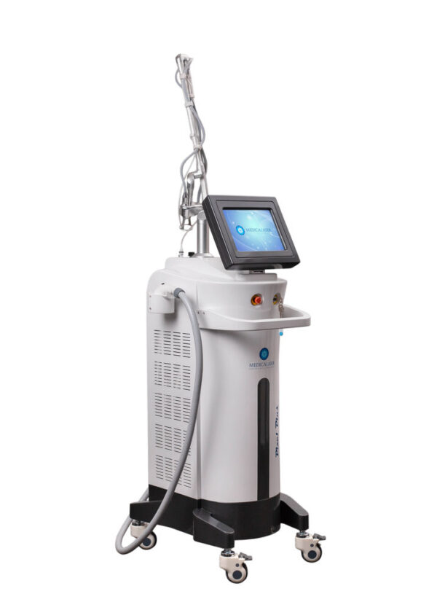
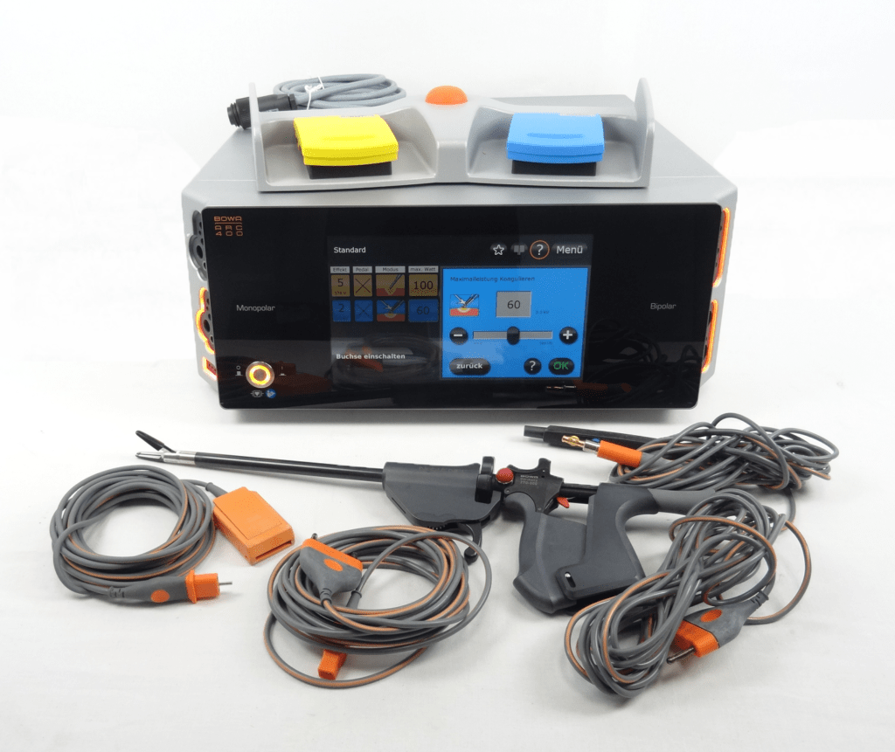
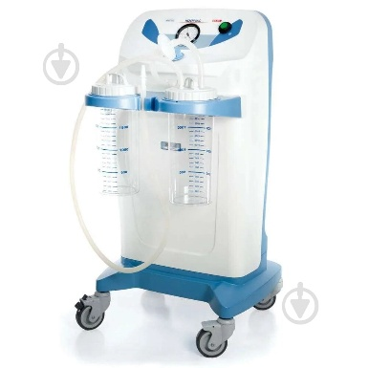
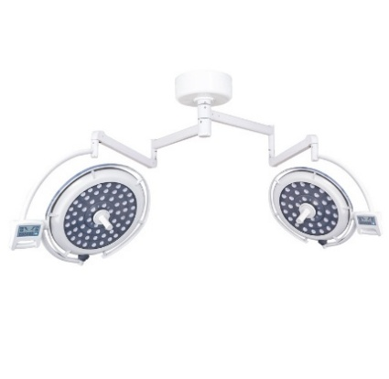
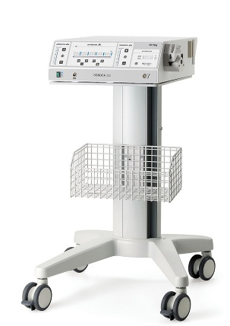
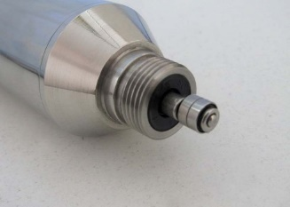
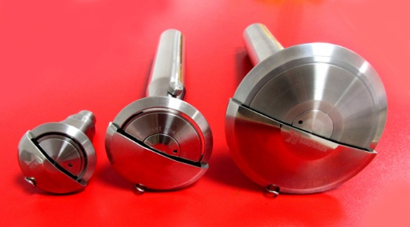
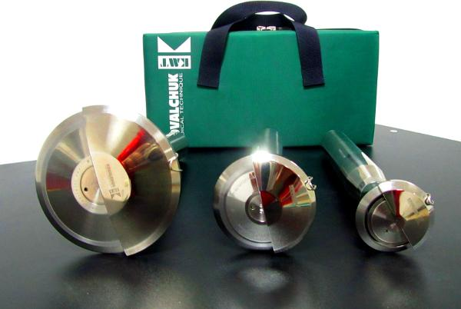
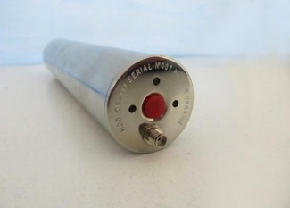
SURGICAL EQUIPMENT
Fractional CO2 laser Pixel Plus
Electrosurgical unit BOWA ARC 400
Medical suction unit NEW HOSPIVAC 350 BASIC 2
Shadowless operating lamp (double-dome)
Ultrasonic cavitator Sonoca 300
Linear electrodermatome with disposable cutting head DK-717.0.00
Disk electrodermatome DK 717.0.02
Perforator PMR-3 (perforation step 1:3)

Slide 21
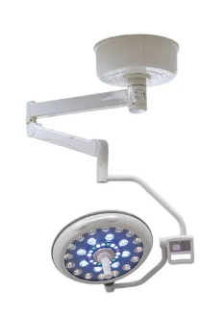
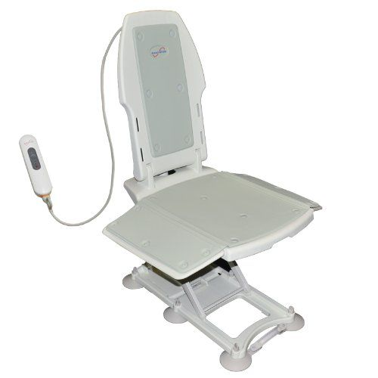
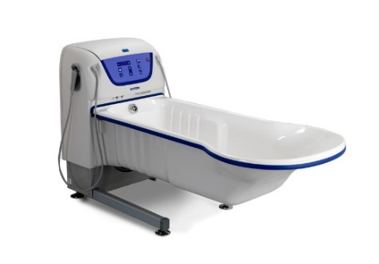
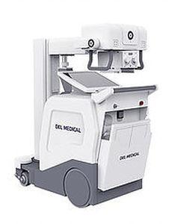
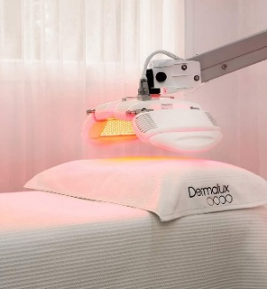
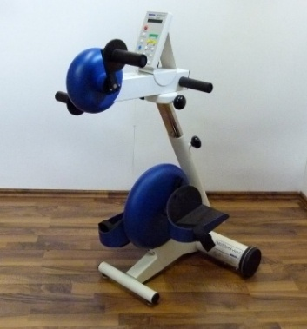


EQUIPMENT FOR THE DRESSING ROOM
Shadowless operating lamp (single-dome)
Electric medical bathtub Rhapsody
Adjustable bathtub lift
EQUIPMENT FOR PHYSIOTHERAPY, REHABILITATION AND OTHER
Universal LED DERMALUX Tri Wave device
Electric rotary trainer for upper and lower extremities
Mobile X-ray system
Specialized beds for patients (with burns) Soft 2 (for adults)
Specialized beds for patients (with burns) Soft 2 (for children)

Slide 22






BURN TREATHMENT ROOMS AND INTENSIVE CARE UNITS
Patient heating system 3M
Infusion solution heating complex
Lung ventilation device
Patient monitoring system
Hearls fluidized air care system
Mobile patient lift

Slide 23


The Burn Center will improve the quality and accessibility of specialized care for patients with burn injuries and create proper conditions for comprehensive treatment and rehabilitation of the affected people.
The reconstructed Center will become an important hub for saving lives, restoring health and working capacity, generating significant social and economic benefits for the entire Sumy region and neighboring areas.
We have set the goal of creating a modern Burn and Plastic Surgery Center that will provide medical care according to European standards.
The establishment of the Burn Center in Sumy is a strategically important project for the development of the region’s healthcare infrastructure.

Slide 27


Slide 31



Ihor Duzhyi, Academician of the Academy of Sciences of the Higher School of Ukraine, Doctor of Medical Sciences, Professor, Head of the Department of Surgery, Traumatology, Orthopedics, and Phthisiology, Honored Doctor of Ukraine, and Chairman of the Association of Surgeons of Sumy region

Slide 32




Project Team
Grechanichenko Mykola
Rudenko Alina
Lobanov Vasyl
Popova Yuliia
Director Private JSC “SUMSKYI PROMPROEKT”
Chief Project Architect
Head of the Architectural Department
Lead Project Architect
PhD in Architecture and Urban Planning
Junior Project Architect
9, Pryvokzalna square,
Sumy, Ukraine
40004
office.sumyproject@gmail.com
+380 50 407 2184

