Slide 1
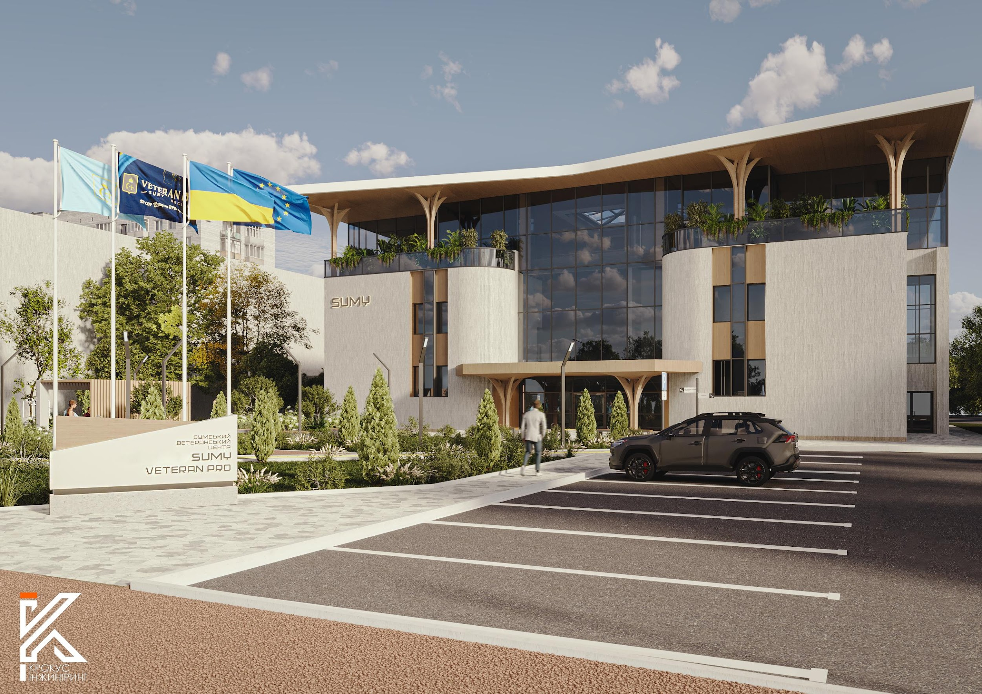

SUMY | VETERAN PRO
a space where resilience takes shape

Slide 2
Contents
Statistic Data: the Human Dimension (page 2)
Justification and Problem Statement (page 3)
Current Status and Achievements (page 4)
Where We Are Today and What We Already Have (page 5)
Reintegration Ecosystem (page 6)
Comprehensive Veteran Center (pages 7–8)
Mission and Tasks (page 9)
From Idea to Implementation (page 10)
Planning (pages 11–14)
The Project Proposes (page 15)
Future Building Design (pages 16–24)
First Floor (pages 25–32)
Second Floor (pages 33–42)
Third Floor (pages 43–44)
Expected Outcomes (page 45)
Letter of Support (page 46)
Project Group (page 48)

Slide 3

SUMY | VETERAN PRO
Justification and Problem Statement
62 252
up to 150 00
Statistical Data: the Human Dimension
veterans
family members of veterans
34(6)\84
Staff of the Regional Veteran Center (including those currently employed) / Number of support specialists in the region
up to 200 thousands
8 439
mobilized individuals in the region who will be granted veteran status
family members of the fallen

Slide 4
CONTINUOUS INCREASE IN THE NUMBER OF VETERANS
If the war were to end tomorrow, it is estimated that the number of veterans in Sumy Oblast would be approximately 120,000
GROWING AND DIVERSIFYING NEEDS, INCREASED DEMAND FOR SERVICES
SUMY | VETERAN PRO
Justification and Problem Statement
Social support, informational guidance, counseling and referral, physical and psychological rehabilitation, legal assistance, economic recovery and well-being, moral support = comprehensive support
LIMITED CAPACITY OF EXISTING INSTITUTIONS (OR THEIR COMPLETE ABSENCE)
Most institutions intended to provide services and support for veterans are neither inclusive nor accessible, and their number is insufficient
LACK OF CAPABLE HUMAN RESOURCES
An insufficient number of various specialists to meet the real needs and challenges faced by veterans; the lack of modern rehabilitation approaches reduces the effectiveness of support and complicates the process of veterans' return to active life

Slide 5
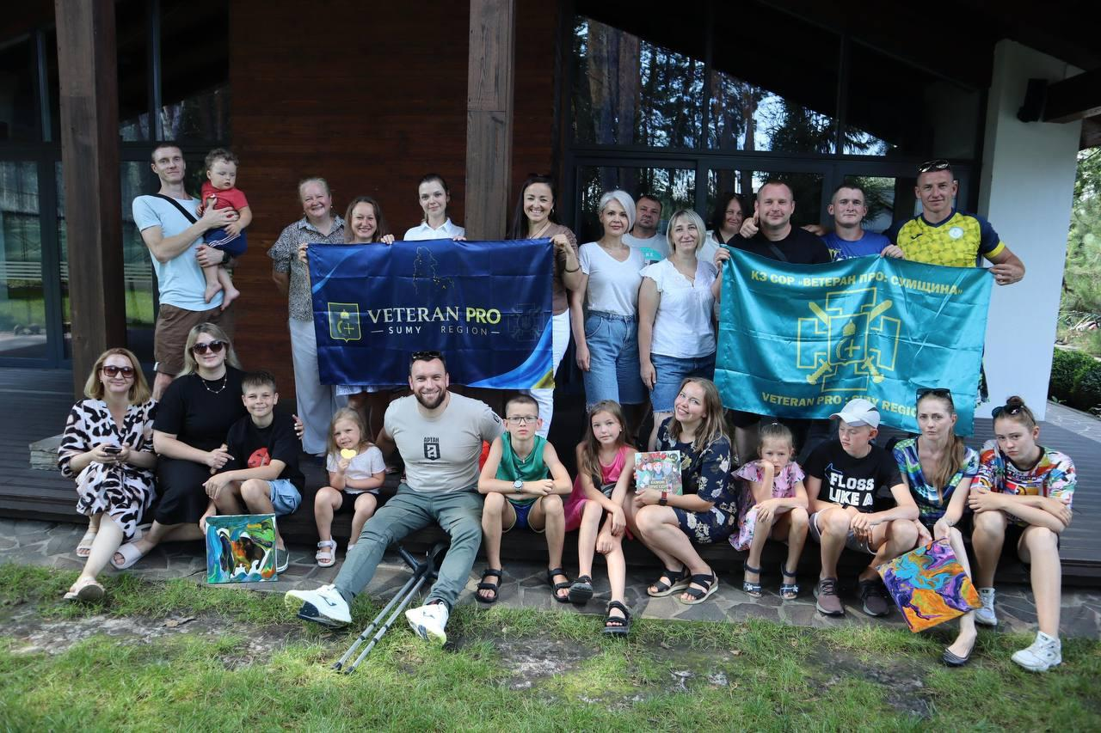
But we are not waiting for change with our hands down and hope lost. We have chosen the path of transforming ourselves and becoming the drivers of change around us, for us, together with us! Join us!
SUMY | VETERAN PRO
shaping a shared vision

Slide 6
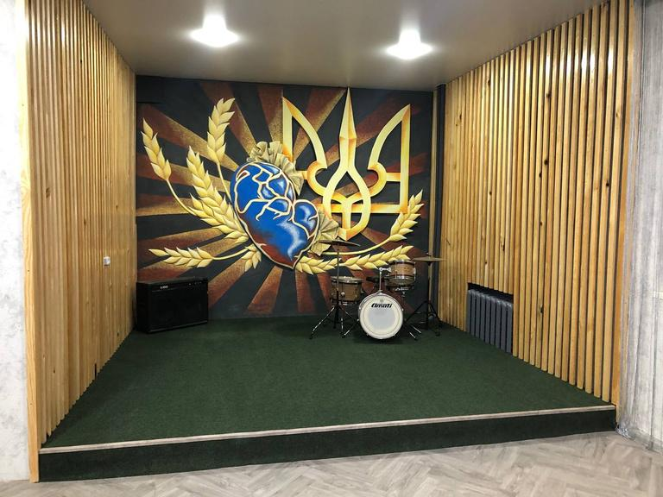
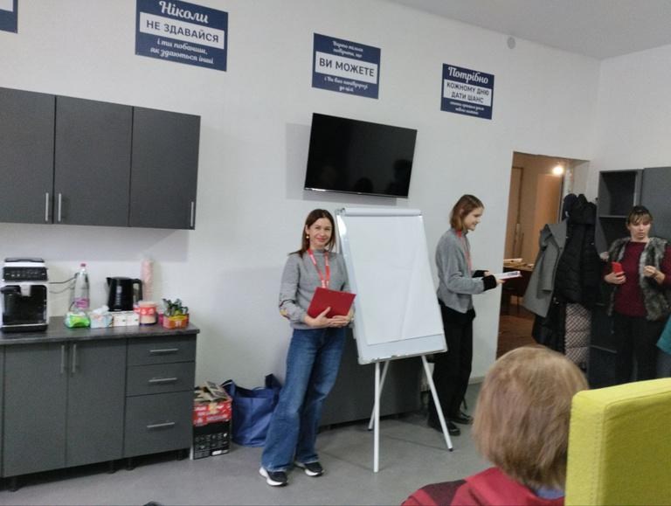
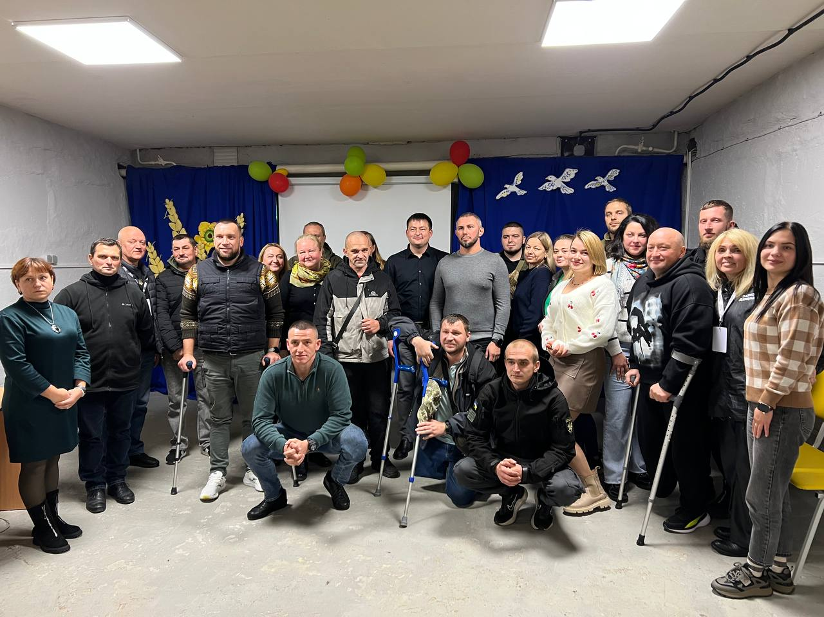
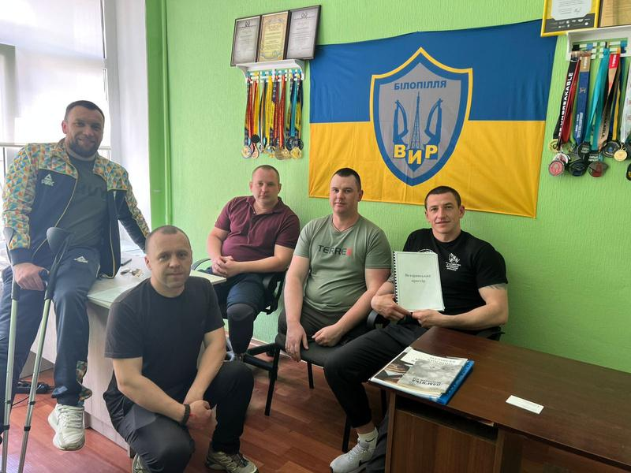
Where we are today and what we already have
  At the end of 2024, the Sumy Regional Council established the Regional Veteran Center “VETERAN PRO,” led by veterans themselves
  The veteran movement in Sumy region is receiving increasing support from local authorities, businesses, civil society, and international partners
  Thanks to cooperation with UNDP in Ukraine, the region has moved from implementing isolated initiatives to building a holistic ecosystem for veteran support and reintegration at the community level
  UNDP, as one of the key international partners, has provided both material assistance and support in strengthening the center’s institutional capacity
  A network of veteran spaces is gradually taking shape across the region, and projects are being implemented that respond to the real needs of veterans
  In 2025, with support from UNDP, the EU, and the Government of Denmark, the center is actively expanding its capacity
SUMY | VETERAN PRO
shaping a shared vision

Slide 7

Support Center
From informational to professional assistance
SUMY | VETERAN PRO
Together, it's not just help — it's a journey from pain to strength
The reintegration ecosystem is not about institutions. It's about interaction
An ecosystem is a space where a veteran receives support, finds community, and has the opportunity to grow and influence change.
A place where the experience of war is transformed into strength for a new life
Opportunity Provider
Adaptation, education, creativity, and leisure
A hub of community strength
A platform for uniting veterans and the community
A key ally
An environment of complete understanding and support
The voice of veterans
Protecting rights and shaping positive attitudes

Slide 8
SPACE
WHERE DO WE WANT TO BE?
The main goal is to create a unique space for veterans and their families — a place where they can receive psychological support, undergo rehabilitation, and reintegrate into society
The Sumy community and the region as a whole need more than just a veteran center functioning as a service office — they need a comprehensive hub: a space for support, trust, and growth.
The “peer-to-peer” principle should become the foundation of interaction, fostering an atmosphere of trust and mutual support
MODERN INFRASTRUCTURE
An essential component is the use of modern infrastructure. The key to effective recovery lies in cutting-edge technologies, innovative methods, and comfortable, functional spaces
UNITING THE COMMUNITY AND THE STATE
It’s not just about financial support, but about active involvement of local communities, volunteer organizations, and state institutions in the process of veterans’ rehabilitation and reintegration into society. This approach helps build trust, mutual understanding, and support among all participants.
POSITIVE IMAGE
Shaping a positive image of the veteran — as an active citizen, leader, and mentor — will contribute to the development of an open and supportive society
SUMY | VETERAN PRO
What lies at the heart of our idea

Slide 9
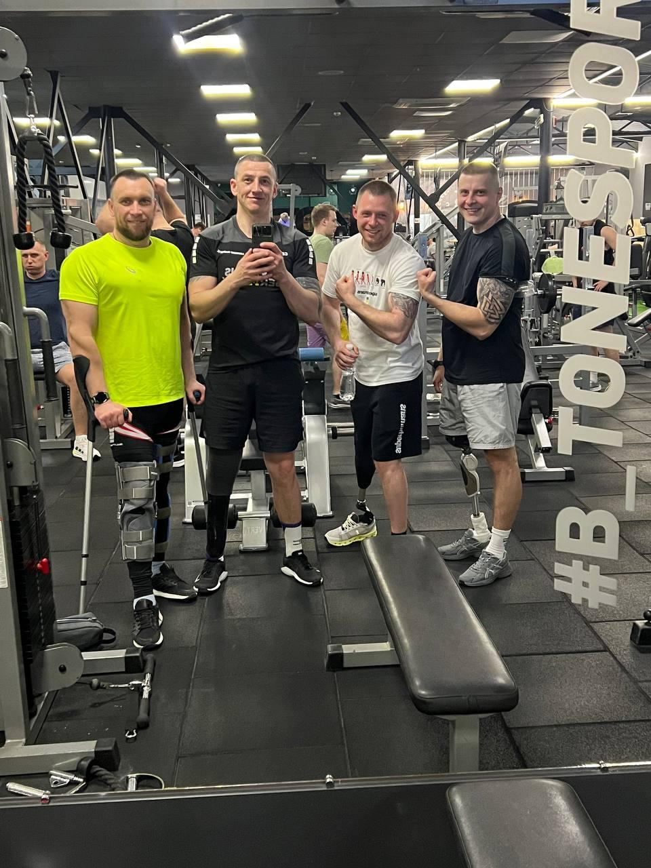
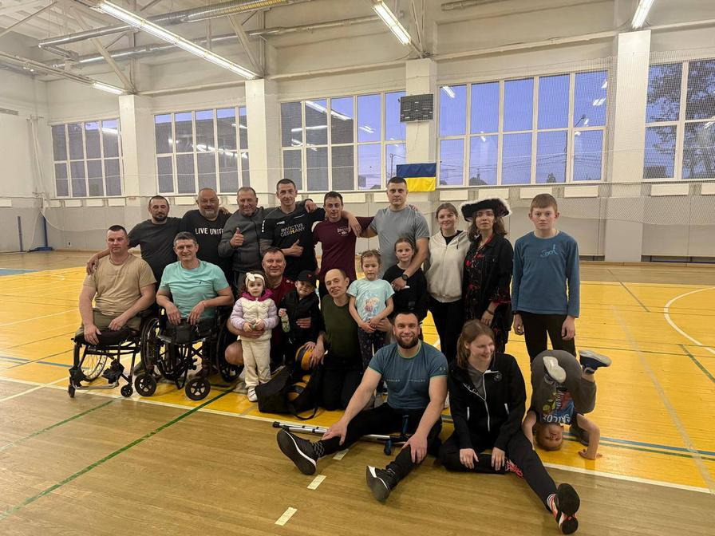
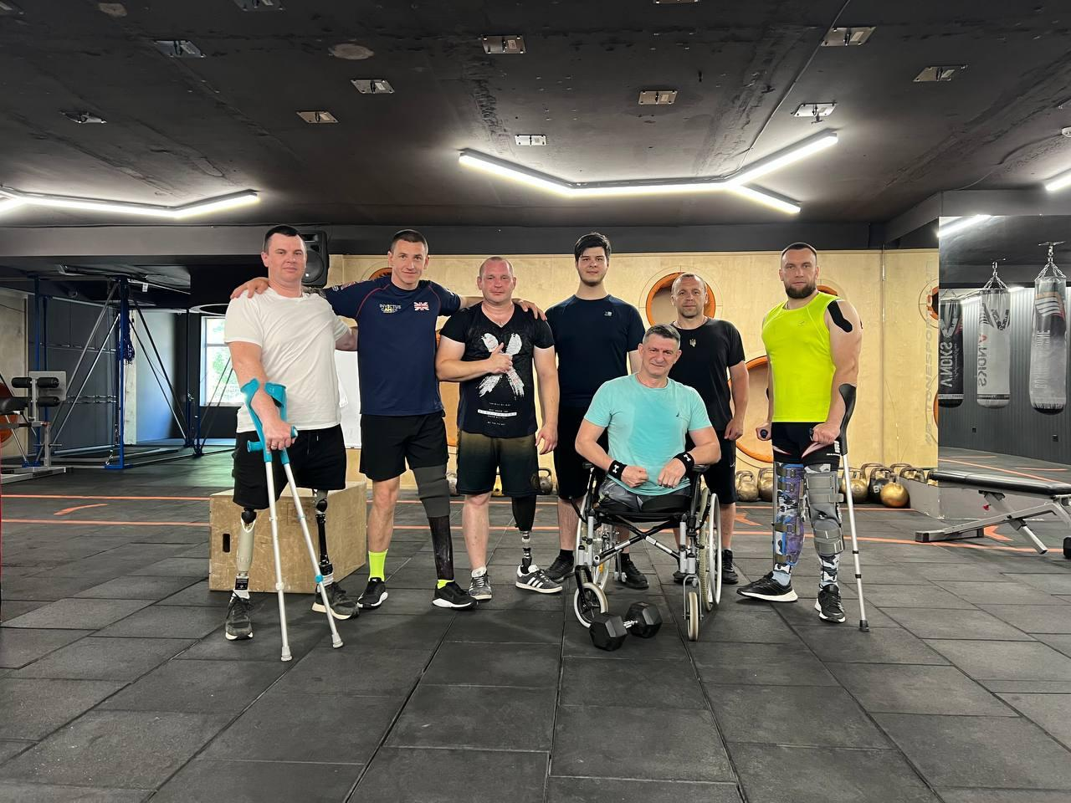
SUMY | VETERAN PRO
Space of Trust

Slide 10
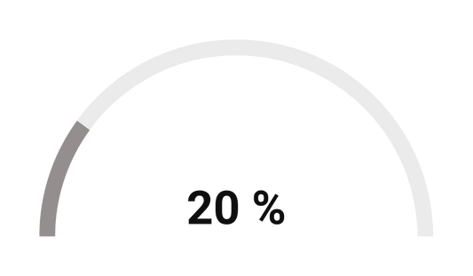
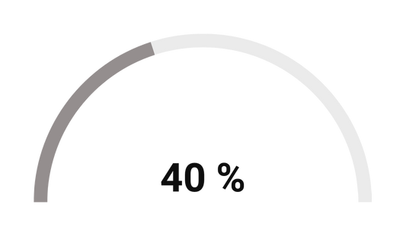
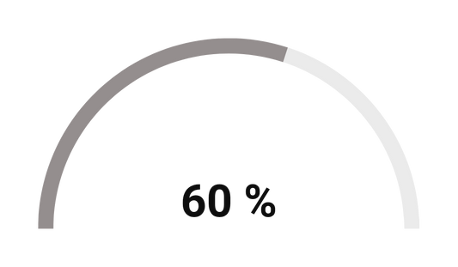
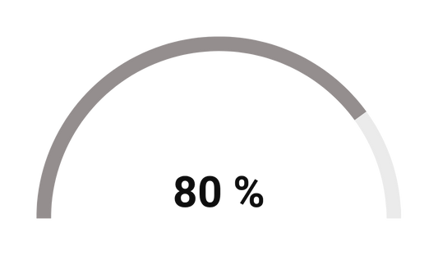
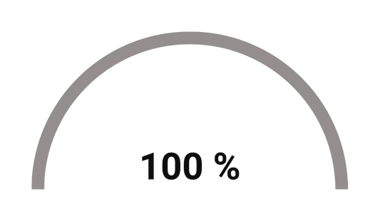
SUMY | VETERAN PRO
Our mission - is to create conditions for veterans’ self-realization, strengthen their families, and build an active, united community.
Tasks and Functions
INFORMATION, CONSULTATION, AND LEGAL SUPPORT
PSYCHO-SOCIAL SUPPORT
PHYSICAL AND SPORTS REHABILITATION
PROFESSIONAL ADAPTATION AND CAREER DEVELOPMENT. LEISURE AND CULTURE
PARTNERSHIP AND VOLUNTEER DEVELOPMENT

Slide 11
SUMY | VETERAN PRO
From Idea – Through Experience – To Implementation
  Currently, the creation of a veteran hub is being considered on the premises of a former swimming pool facility that belonged to an educational institution but has been unused and non-operational since 2020. The building will be officially transferred to the regional council and placed under the functional management of the Regional Veteran Center
  It is a two-story building that previously housed large and small swimming pools, along with appropriate sanitary and technical facilities. However, the potential of these existing spaces—once renovated and brought up to standards—allows for the development of functional, accessible areas to implement various tasks
  The building is in a residential district but has convenient transport connections. It sits within a recreational zone: near a city park, a river, and a stadium. Less than one kilometer away is Sumy state university’s Athletics Arena and a hotel-dormitory, which can serve as additional functional infrastructure

Slide 12
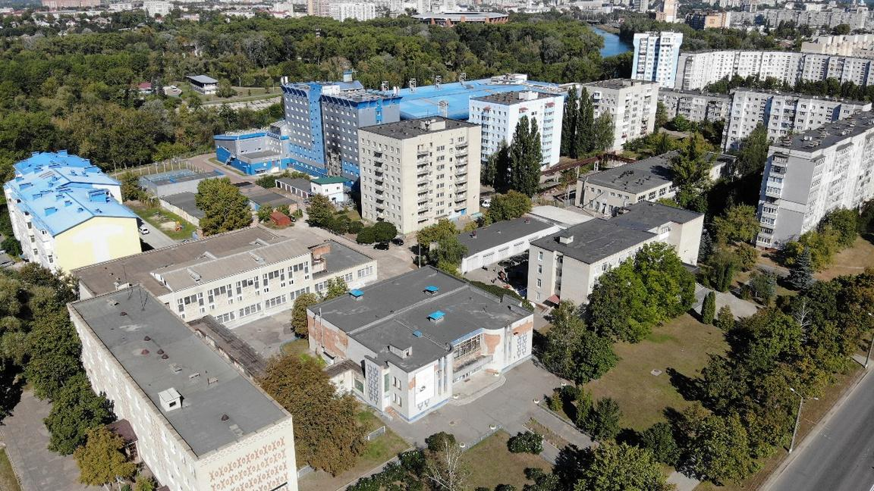
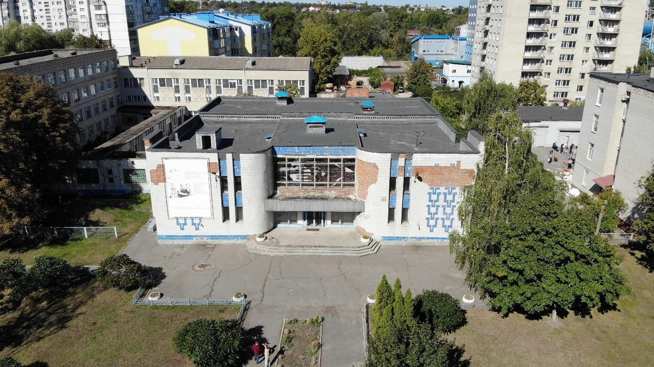

Slide 13
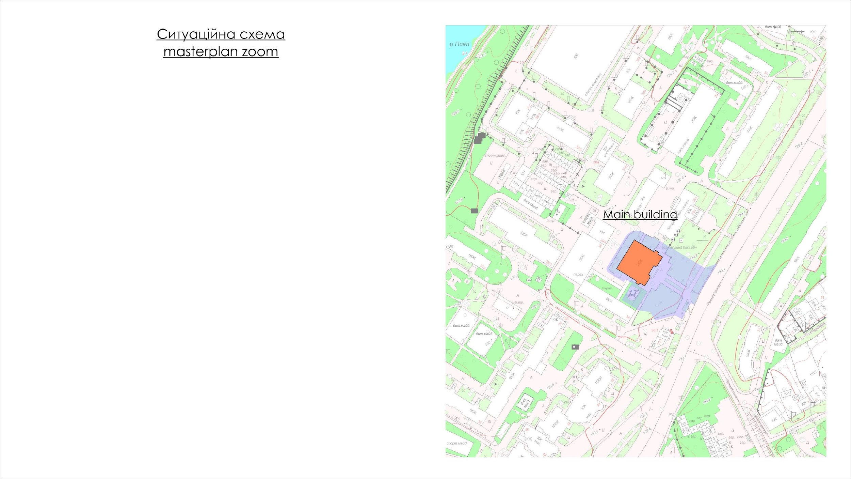
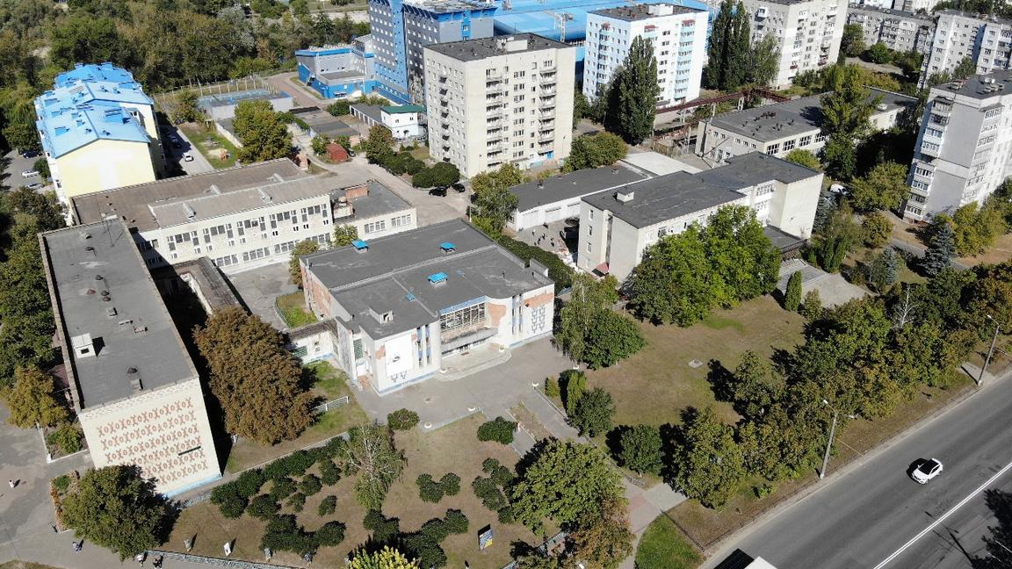

Slide 14
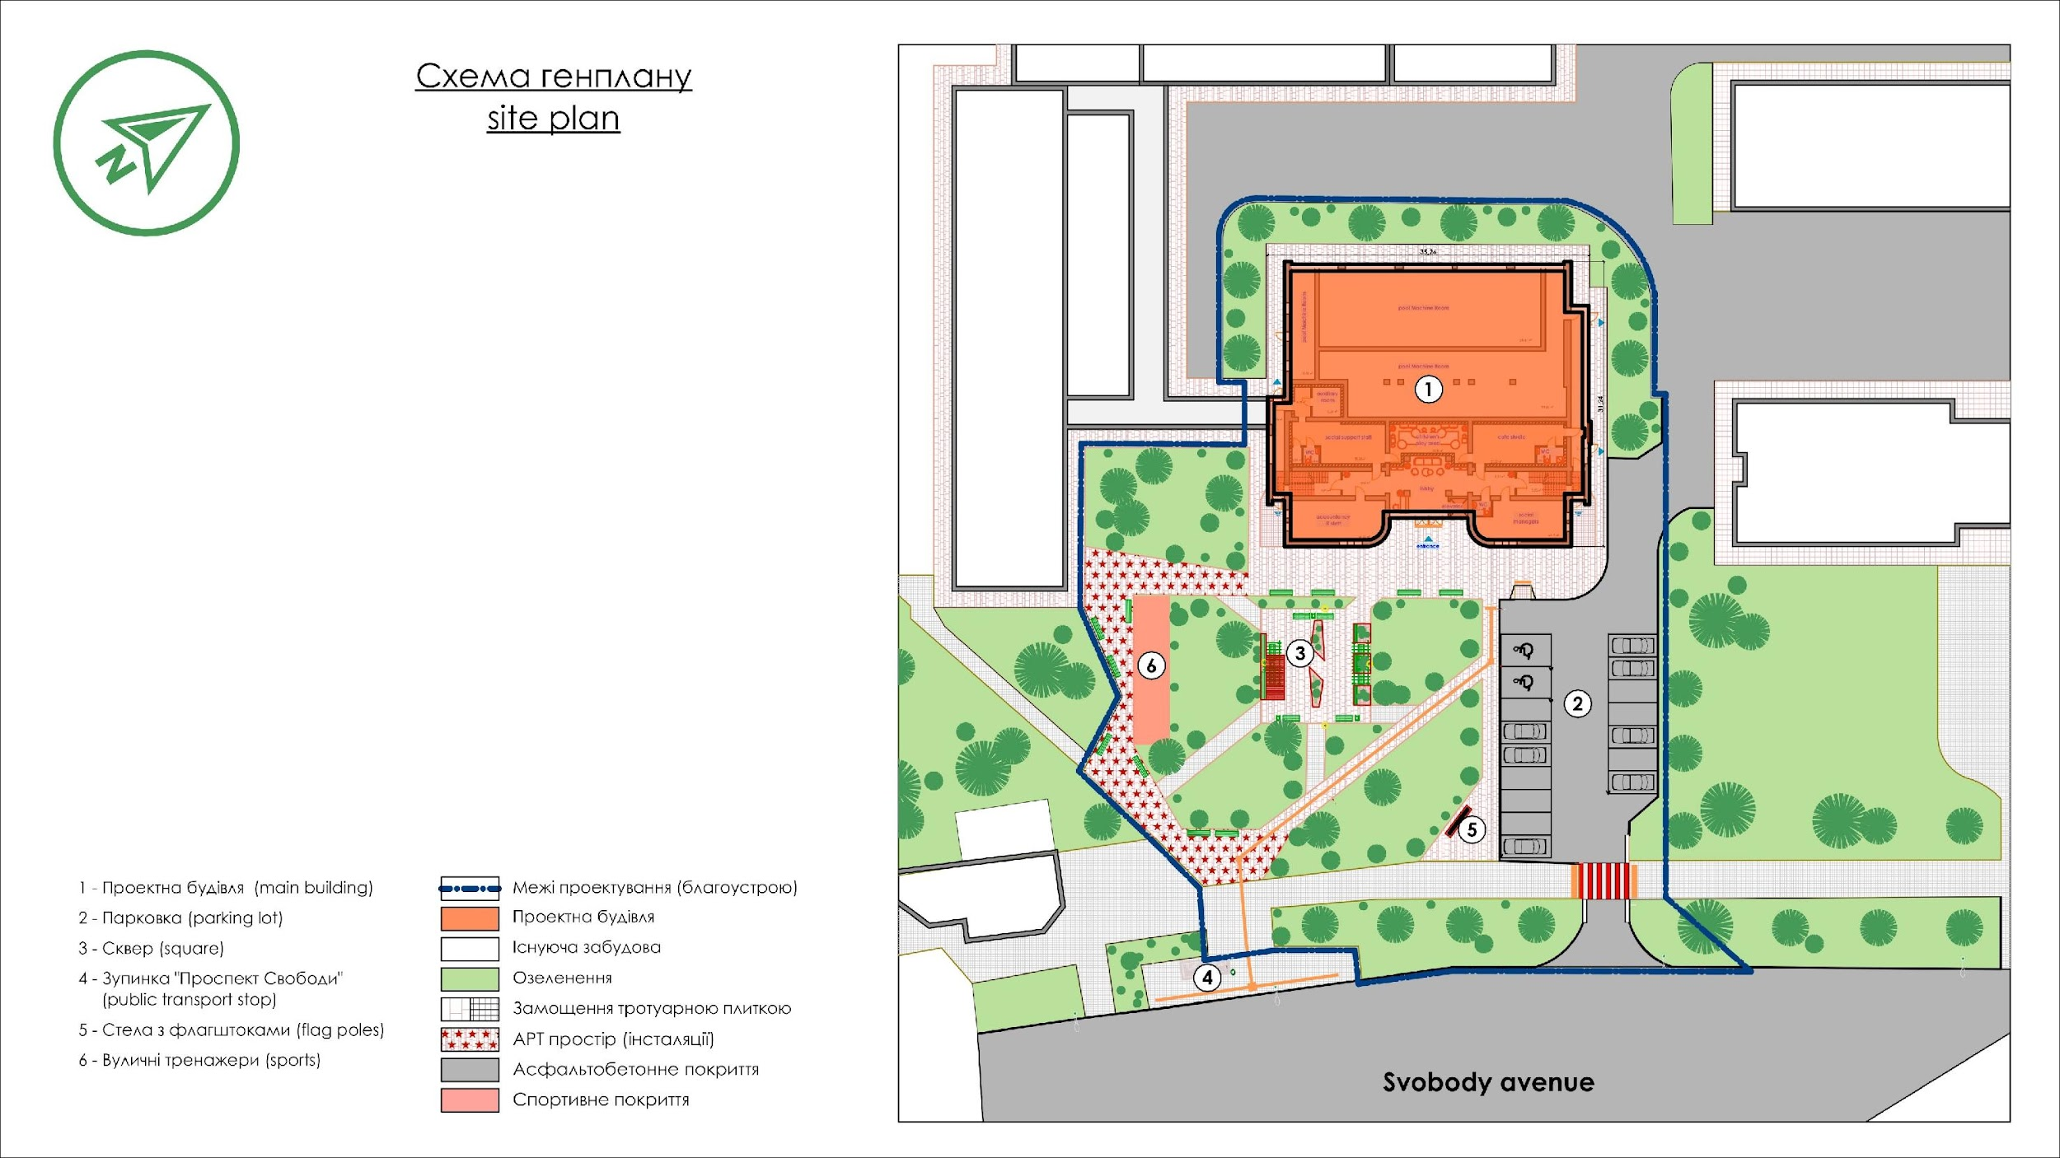
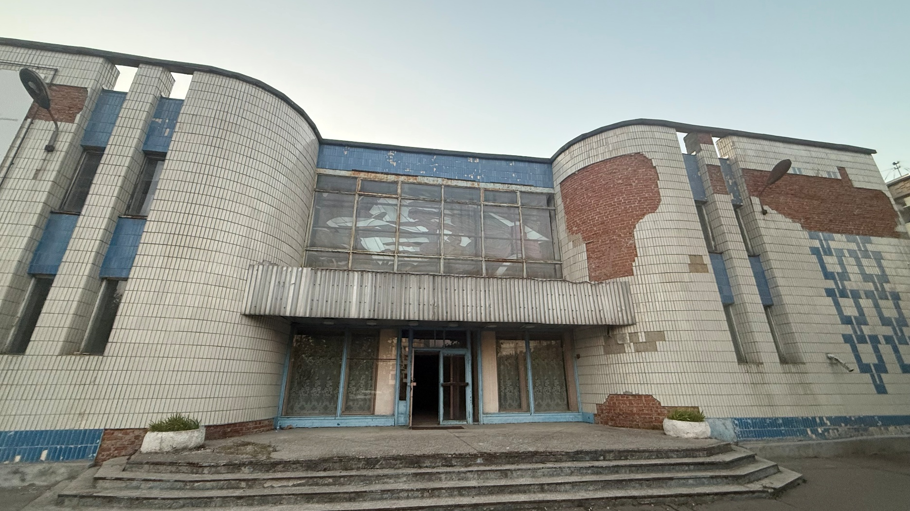

Slide 15
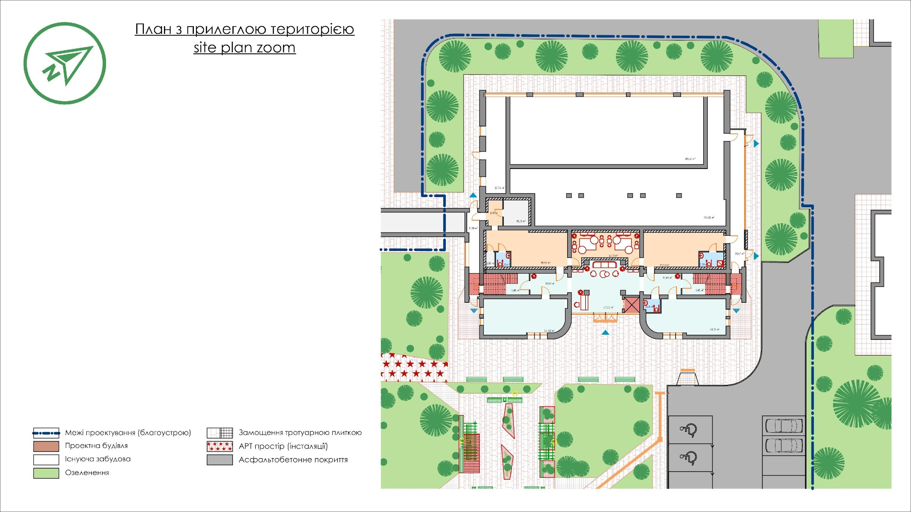


Slide 16
SUMY | VETERAN PRO
From Idea – Through Experience – To Implementation
The project proposes:
  Redevelopment and proper zoning of the surrounding area;
  Renovation and major refurbishment of the two existing floors;
  Additional construction of a third floor.
The building plan includes ramps, internal and external inclusive elevators, and fully meets accessibility standards and requirements. At the same time, its internal layout is highly flexible, allowing most spaces to be adapted to current needs.
In the future, the facility has the potential for expansion to include areas such as several rooms for temporary stays with overnight accommodation, showers, a kitchen, a media studio, a workshop, and more.
The site plan provides for an inclusive, accessible entrance, a driveway and parking area, a green zone that could feature an art alley and a relaxation area, and further away—an inclusive sports ground.

Slide 18
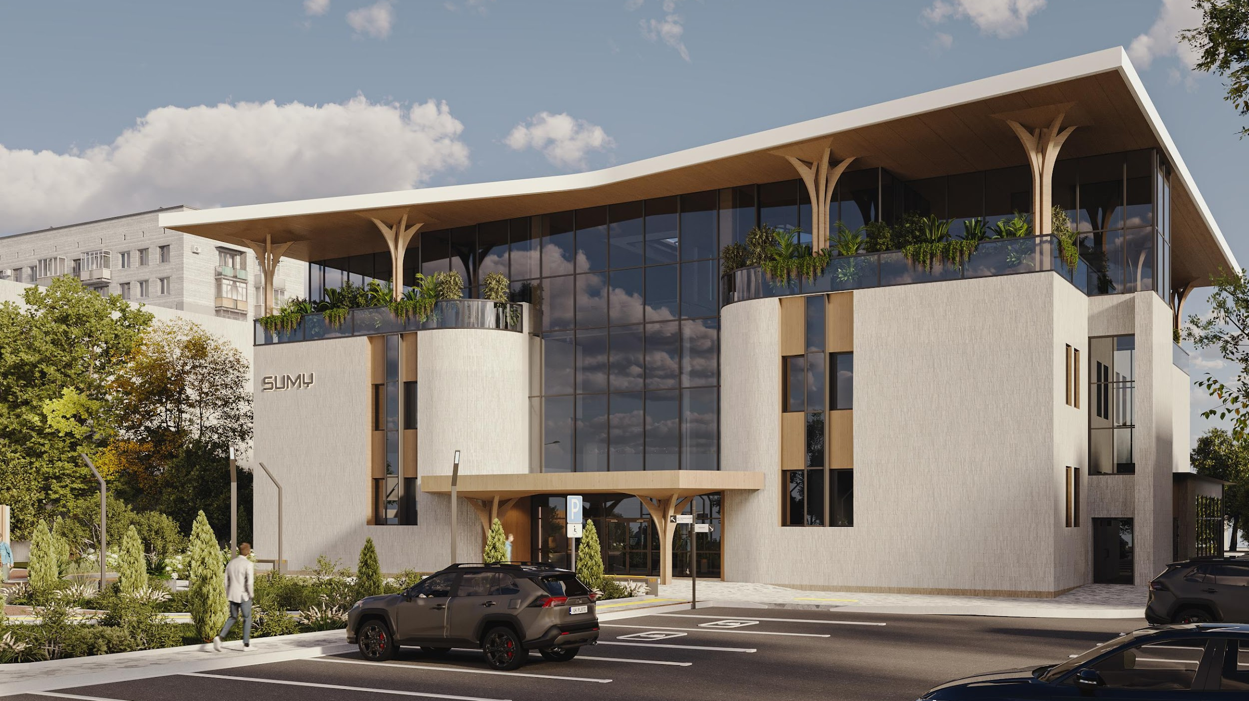

Slide 19
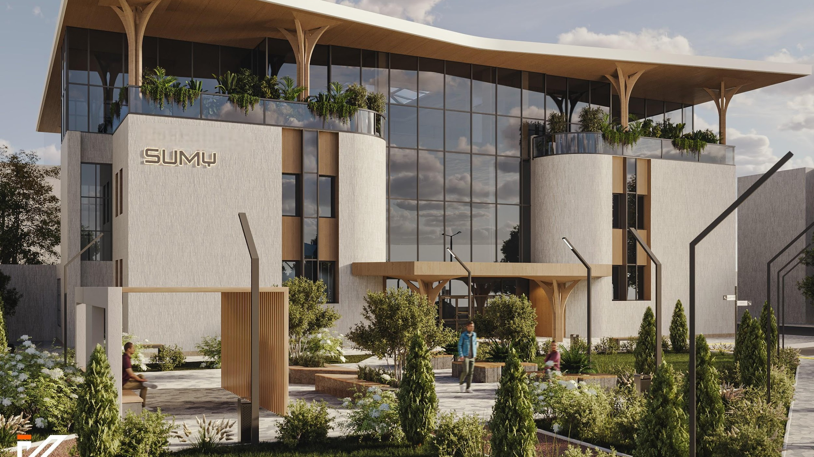

Slide 20
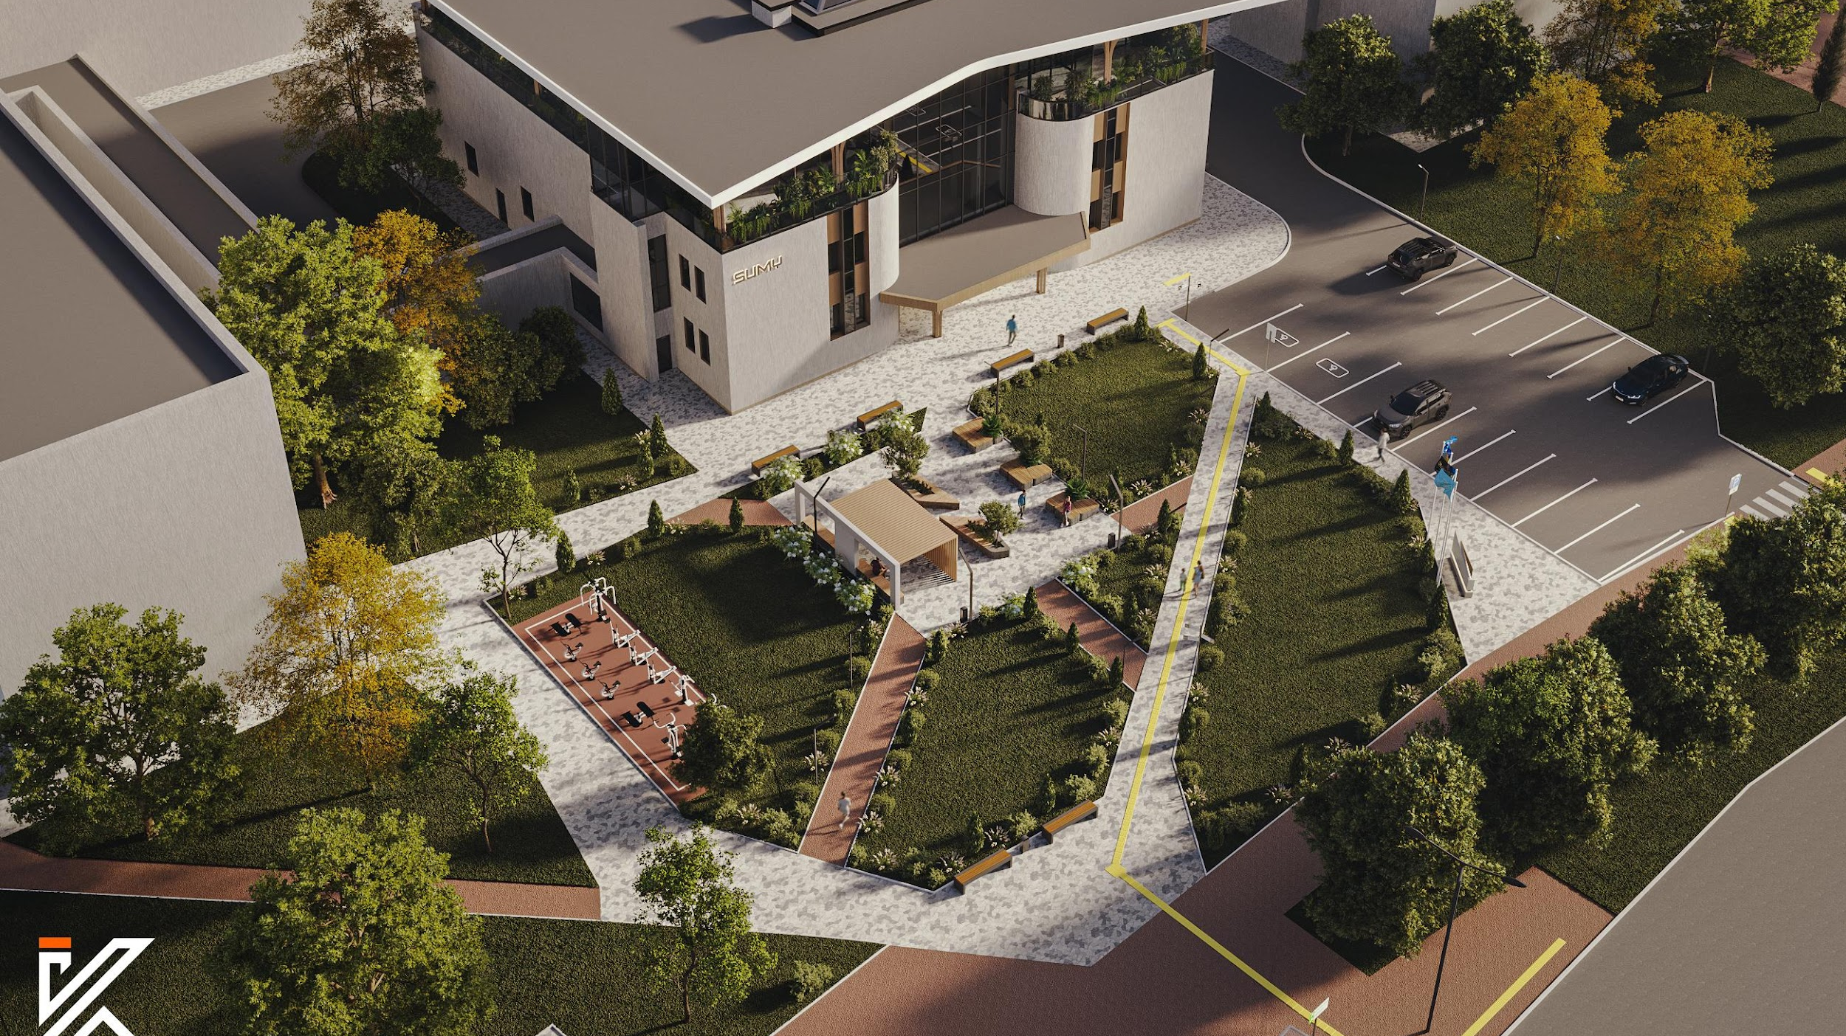

Slide 21
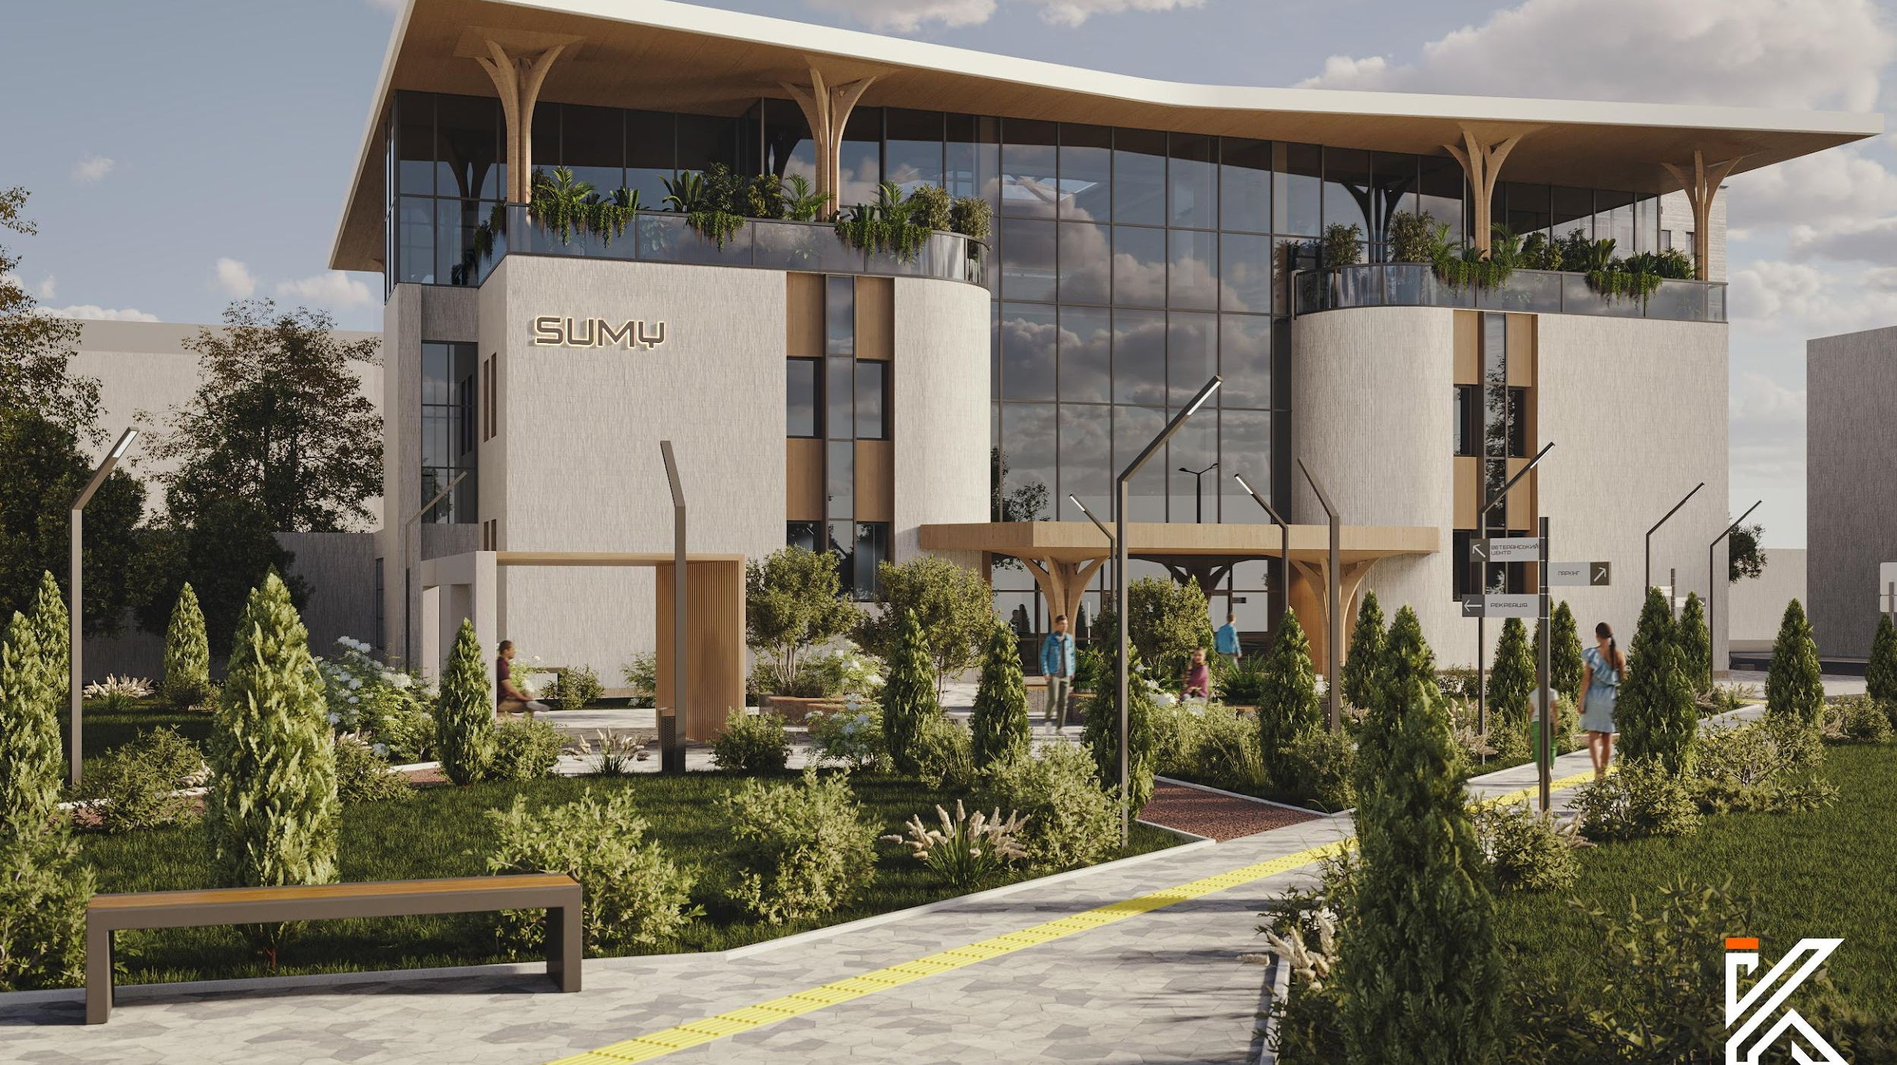

Slide 22
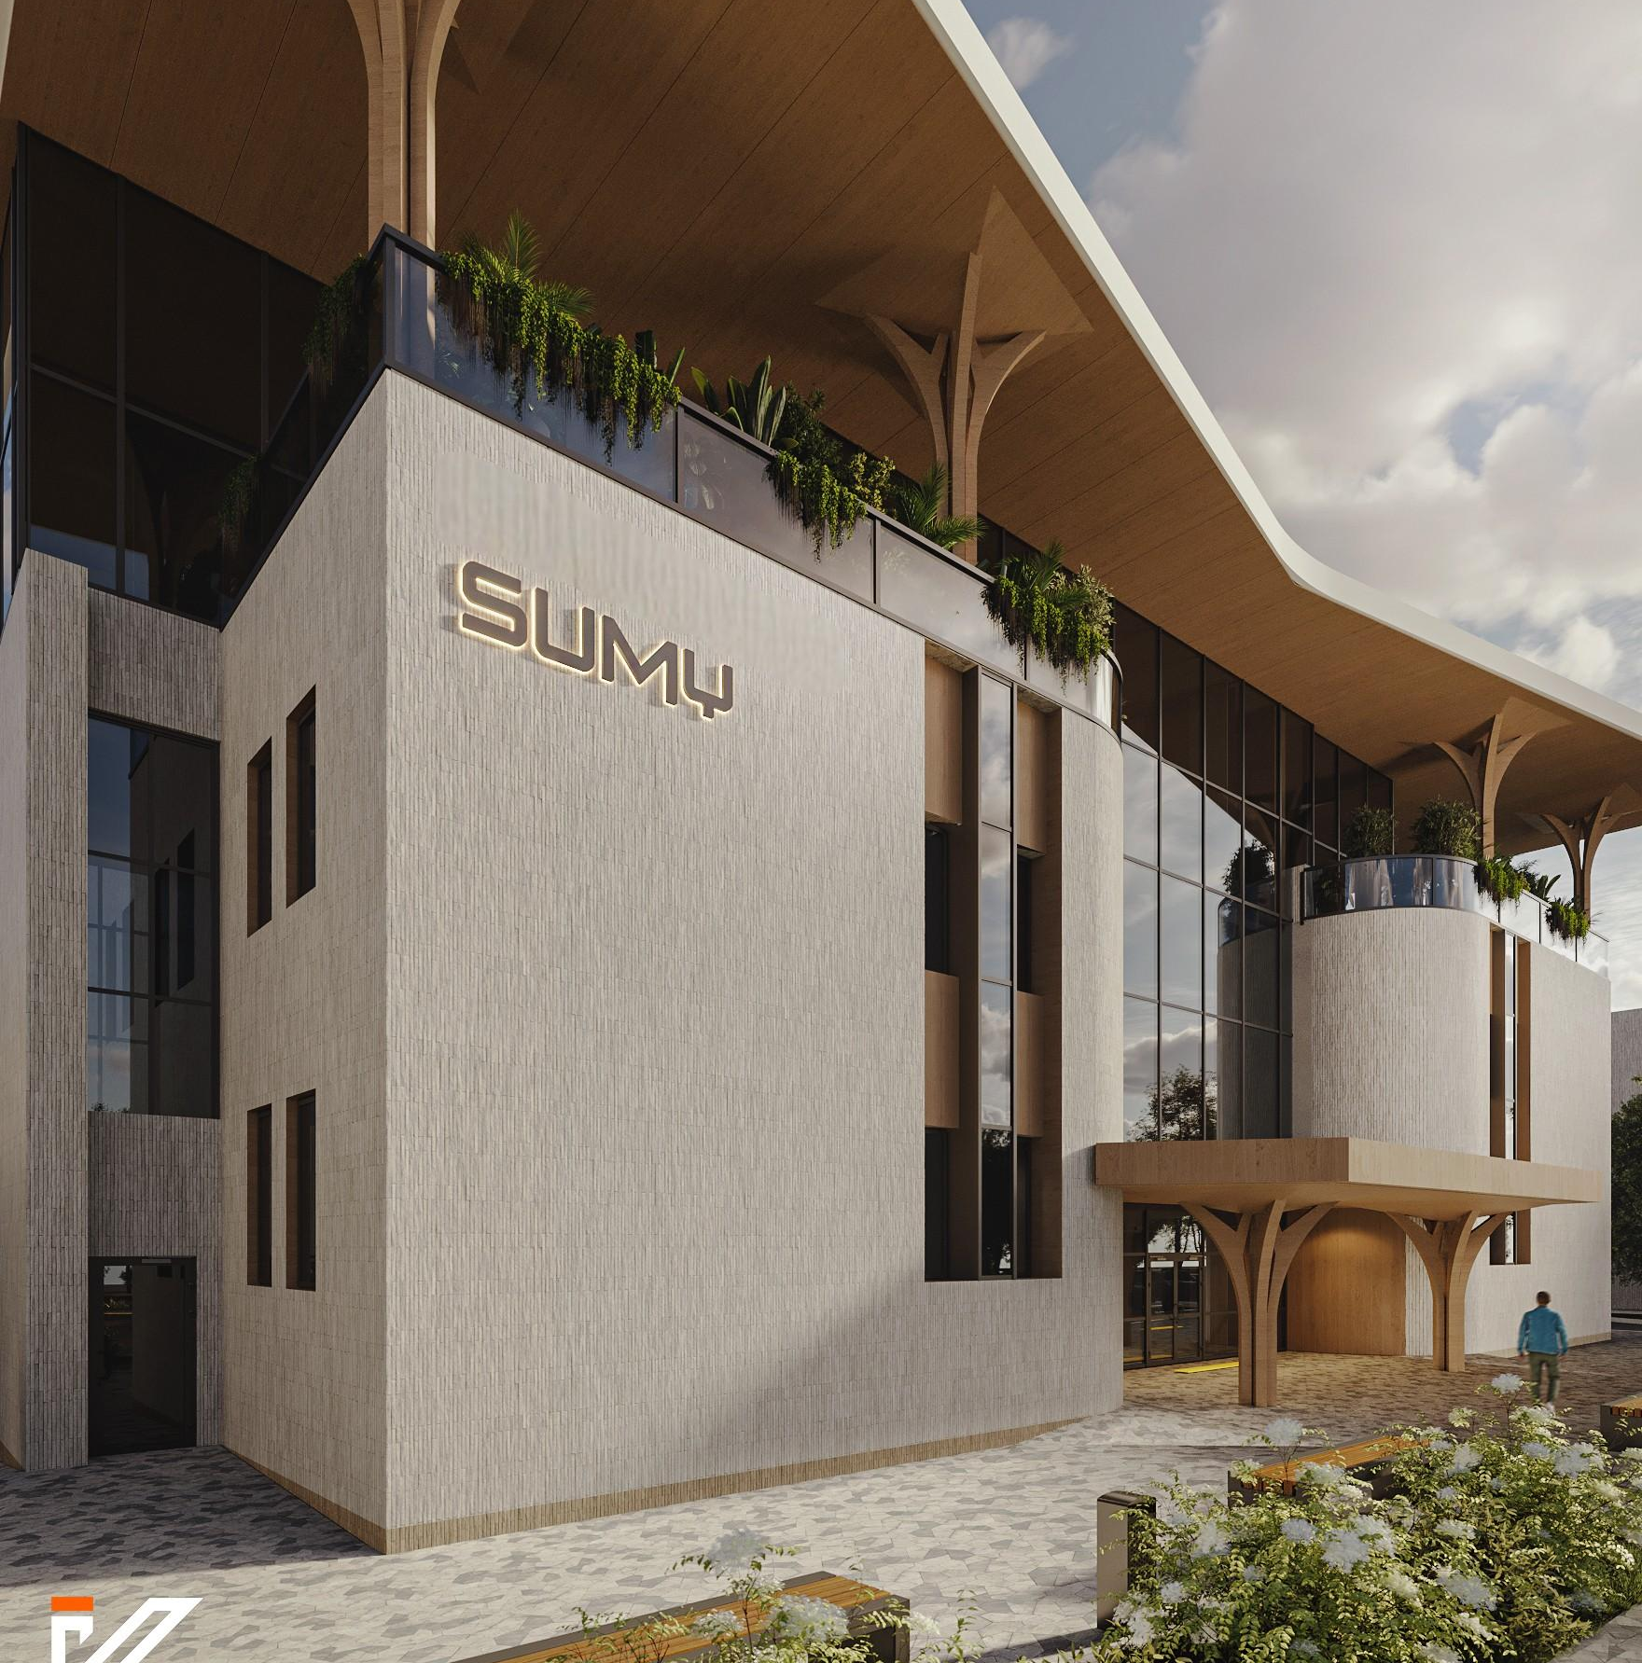
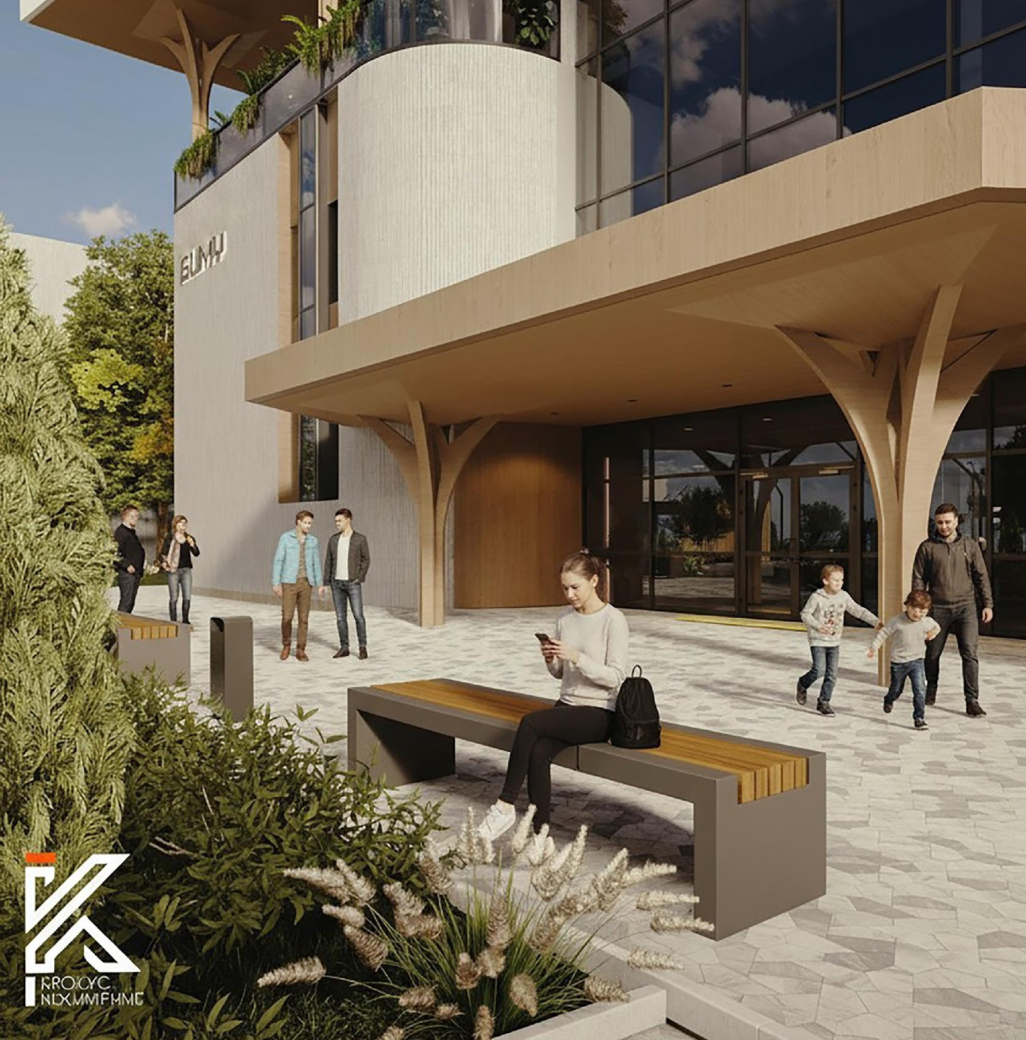

Slide 23
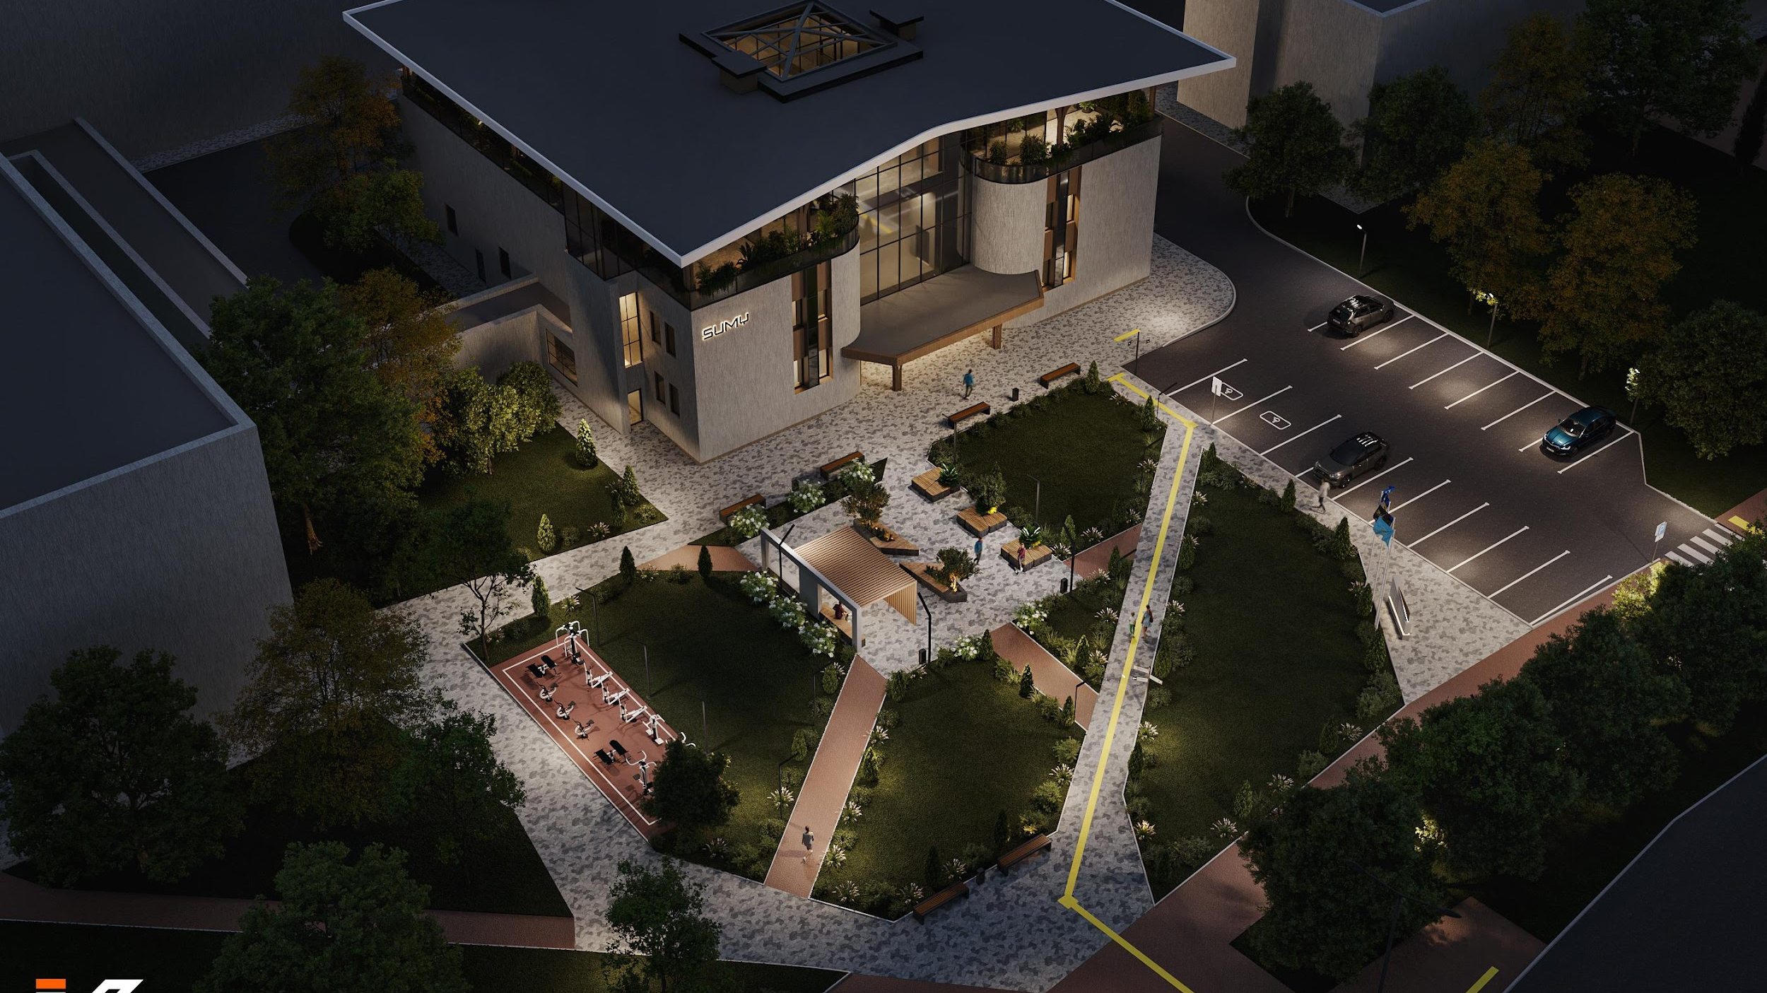

Slide 24
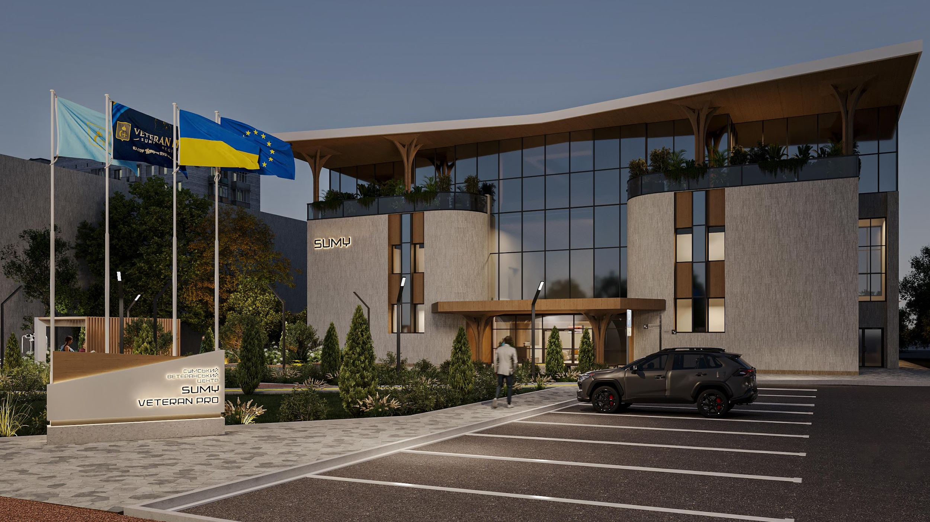

Slide 25
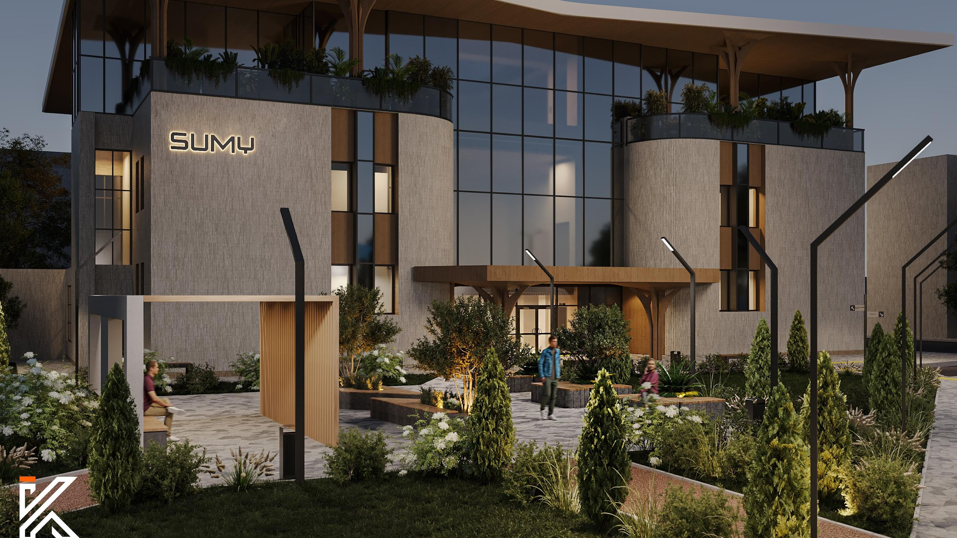

Slide 26
SUMY | VETERAN PRO
From Idea – Through Experience – To Implementation
First Floor
The central area and the left wing serve as the information, consultation, and administrative sections. Here, specialists from the administrative team and veteran support professionals work directly with visitors.
The right wing features a café-studio where veterans can gather over coffee or tea, socialize in an informal setting, and spend time with fellow service members. The café also includes a cozy, private area for more intimate conversations when needed.
This floor also includes a children’s zone where visitors can leave their kids or spend time with them while waiting.
The floor is equipped with sanitary facilities, including accessible restrooms, as well as technical rooms and storage areas.

Slide 27
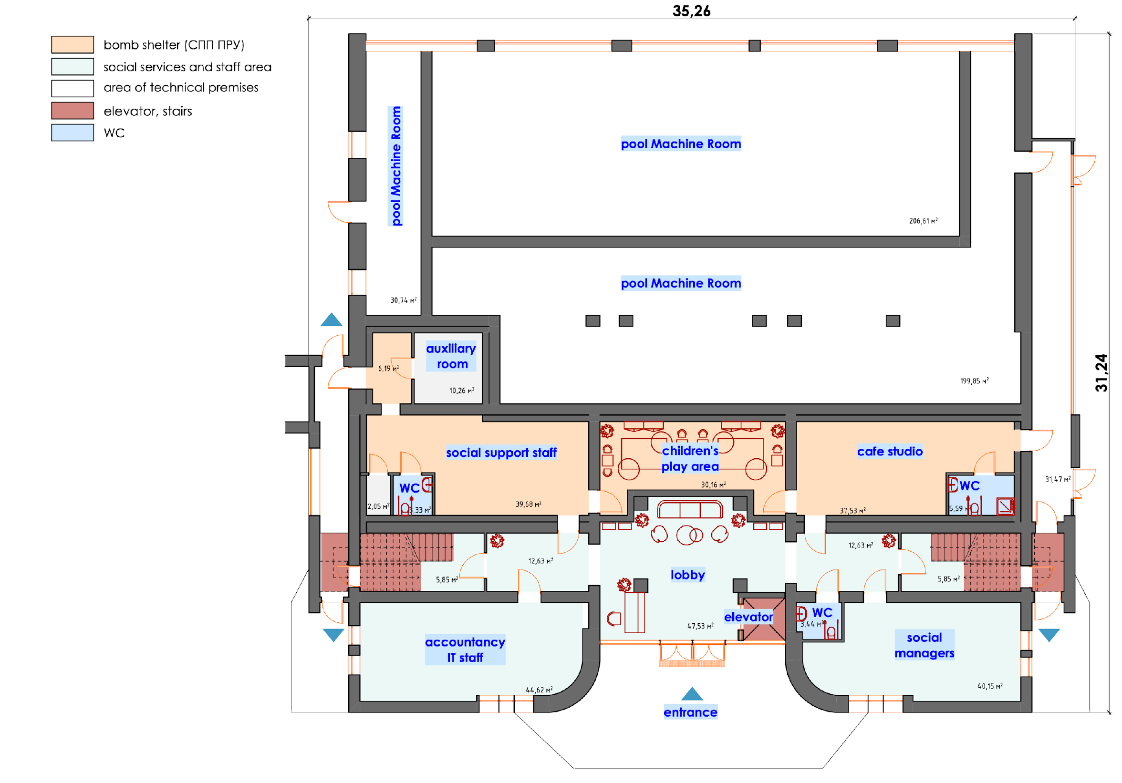

First Floor

Slide 28
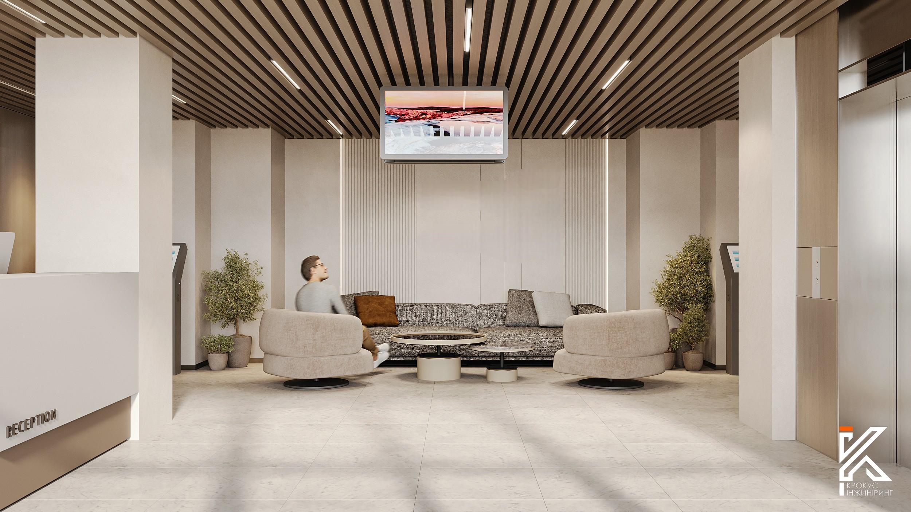

Slide 29
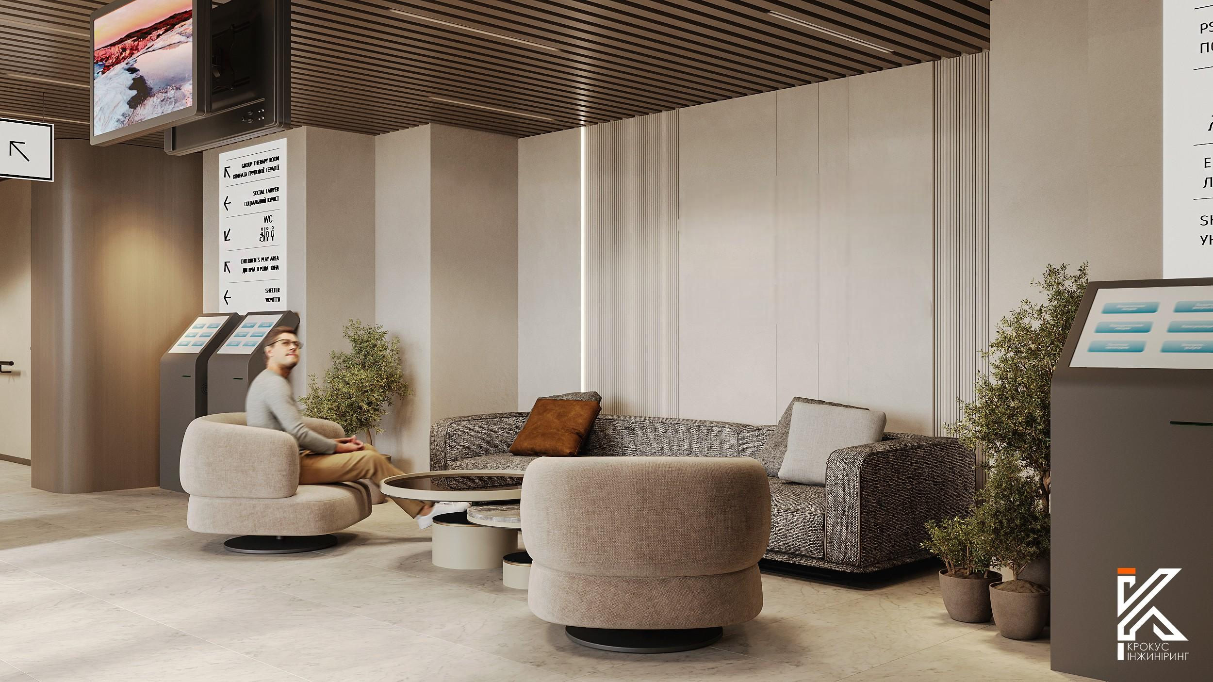

Slide 30
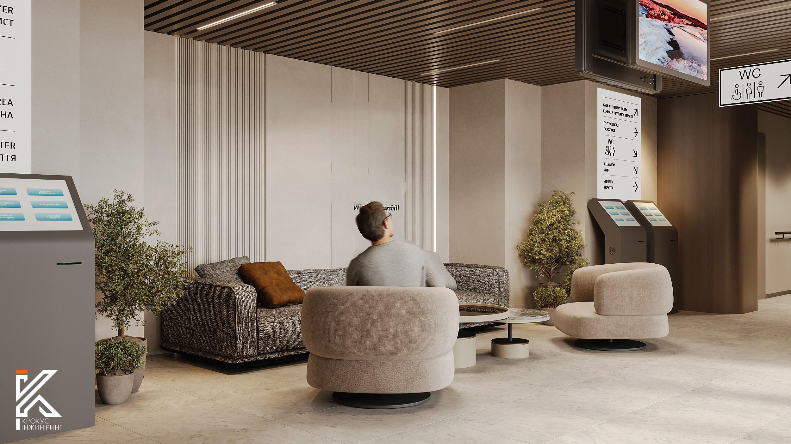

Slide 31
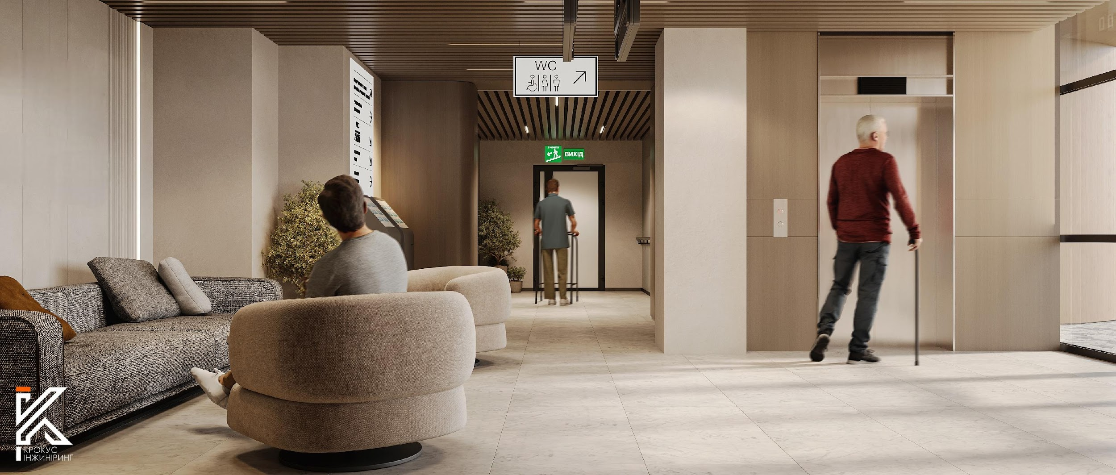

Slide 32
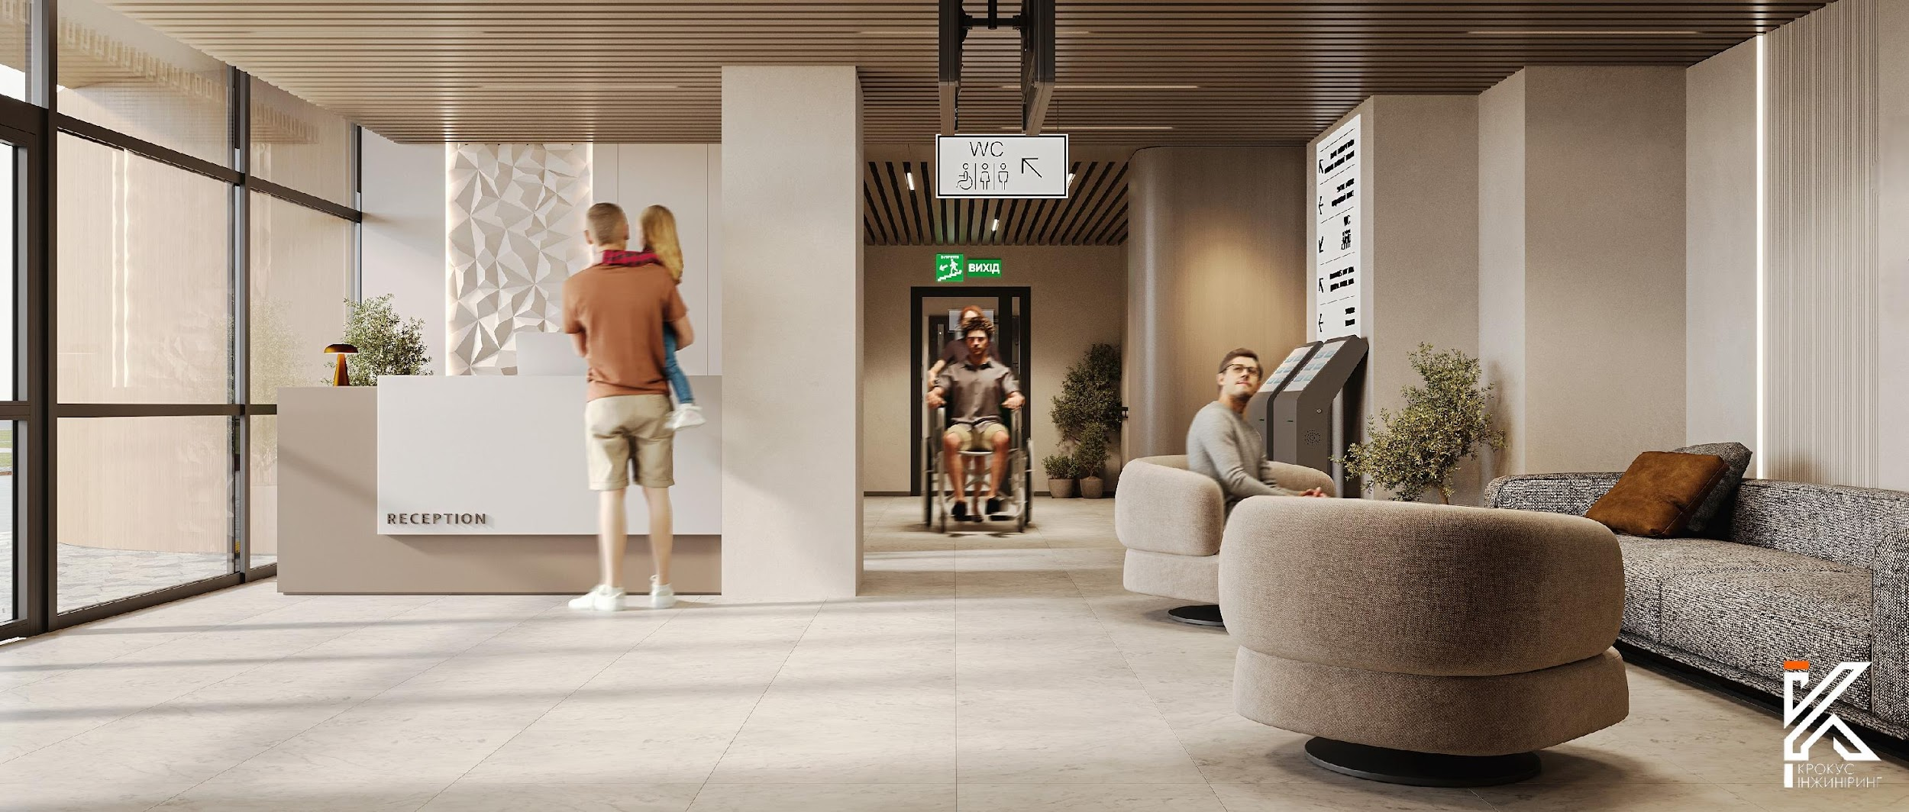

Slide 33
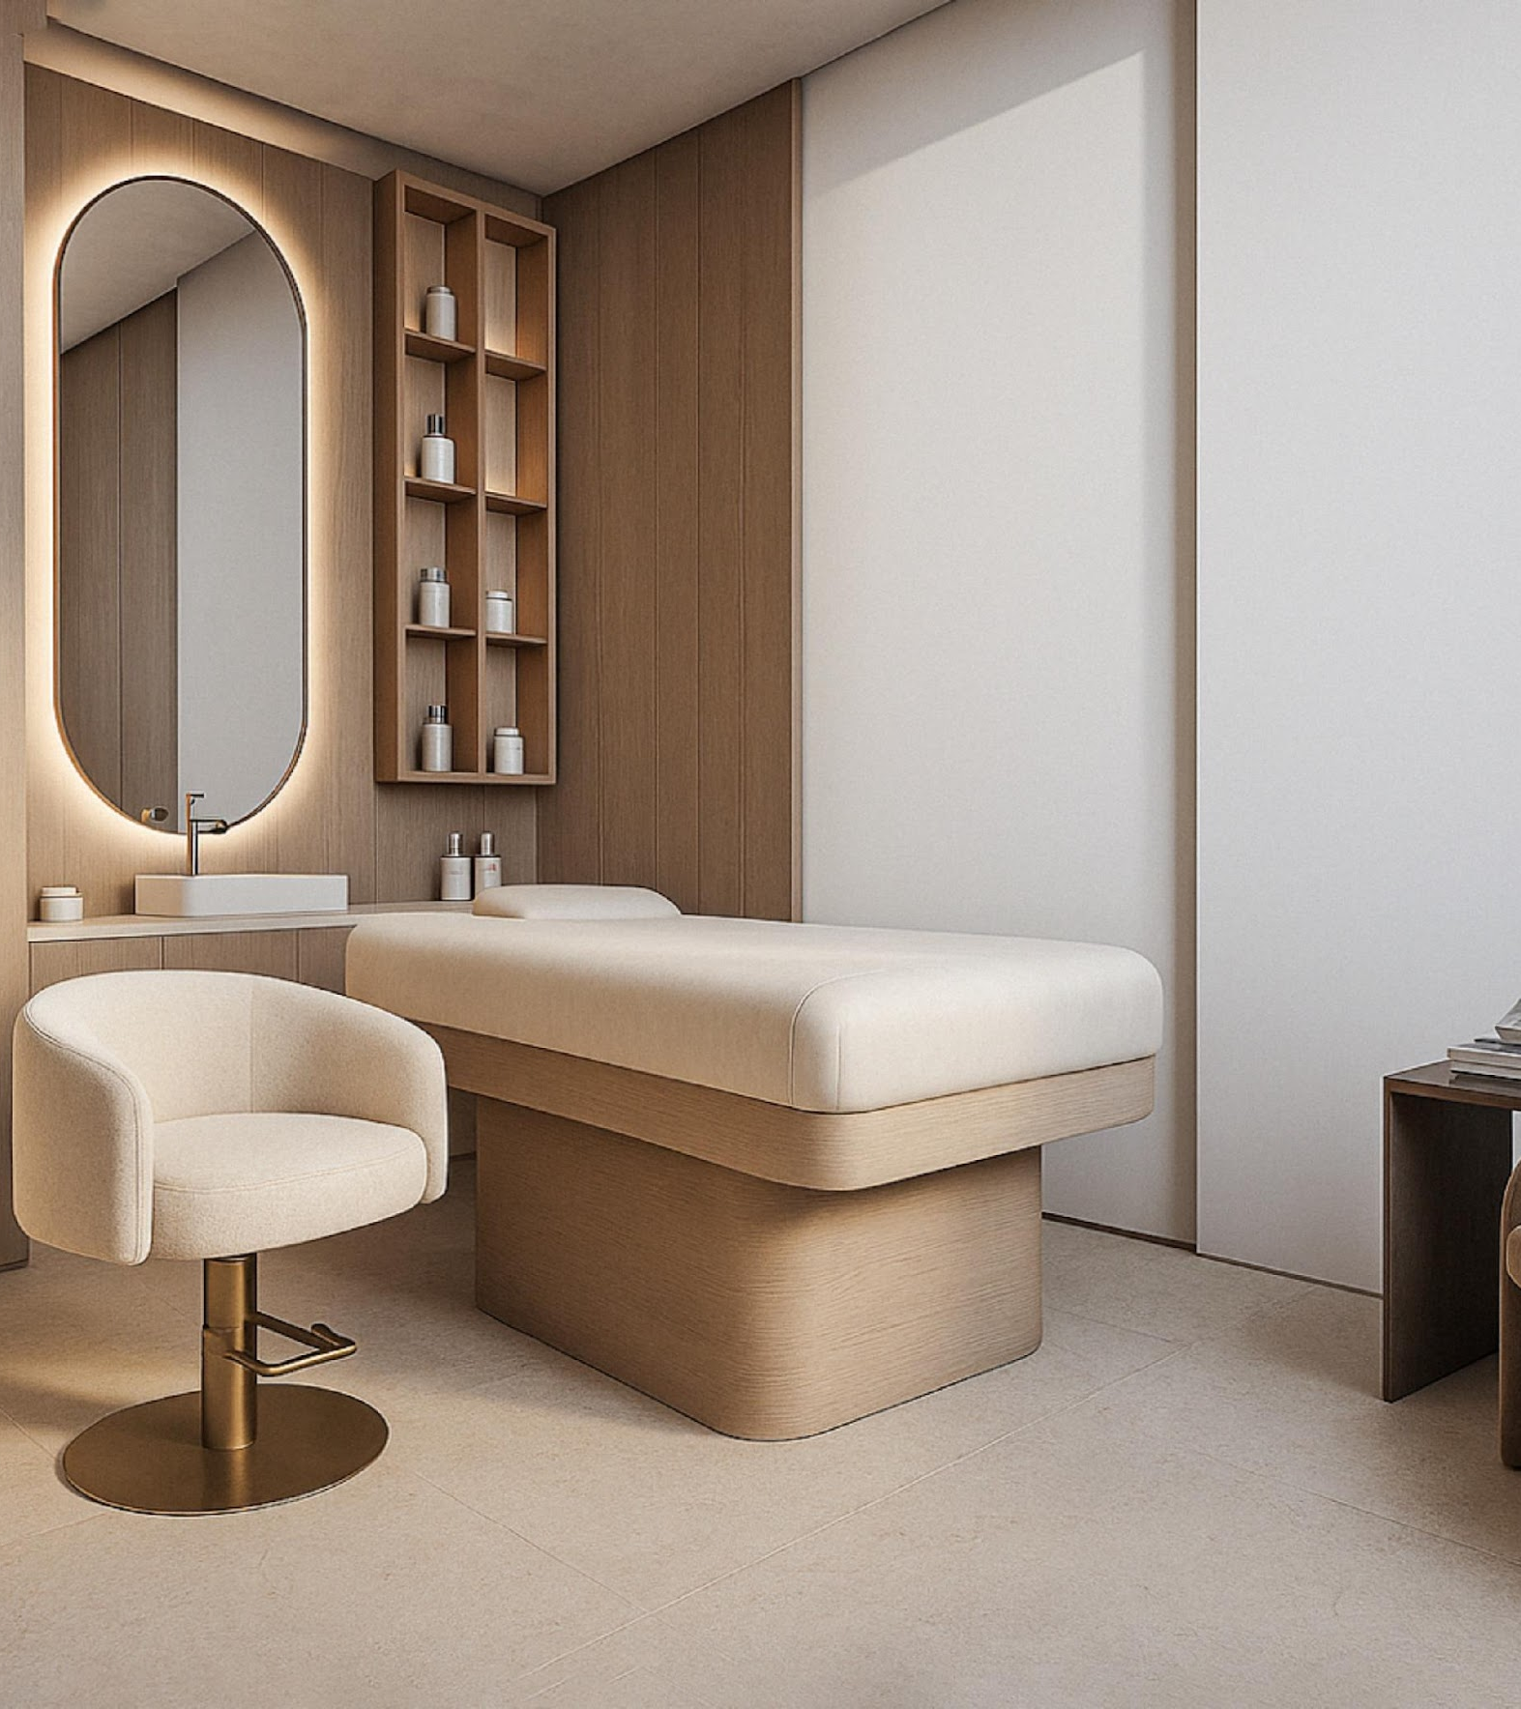
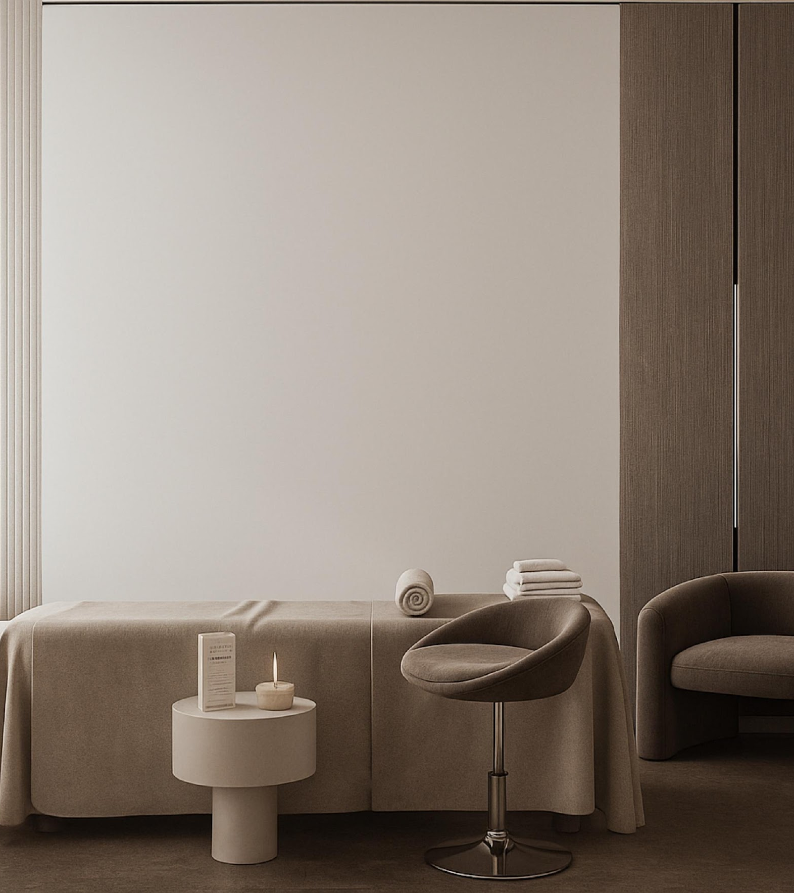

Slide 34
SUMY | VETERAN PRO
From Idea – Through Experience – To Implementation
Second Floor
This area is a location for adaptive sports. It includes:
  A large inclusive swimming pool with changing rooms, showers, and sanitary facilities
  A massage room
  Offices for specialists—trainers, rehabilitation experts, and adaptive sports instructors
  A gym
  A multifunctional sports hall
Although the multifunctional hall is not professional-sized, its flexibility allows for a wide range of adaptive sports for veterans with various disabilities (including amputations), such as:
  Table tennis
  Boccia
  Adaptive archery (12 meters)
  Darts
  Chess and checkers
  Para-jiu-jitsu
  Arm wrestling
  Powerlifting
  Stretching, aerobics, and dance practices

Slide 35
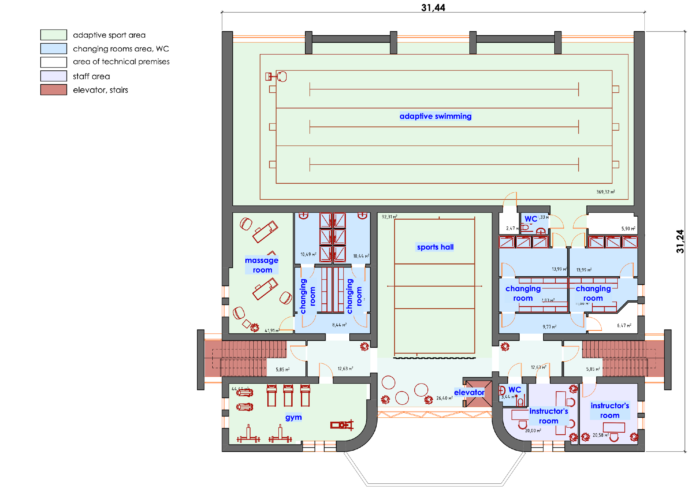
Second Floor

Slide 36
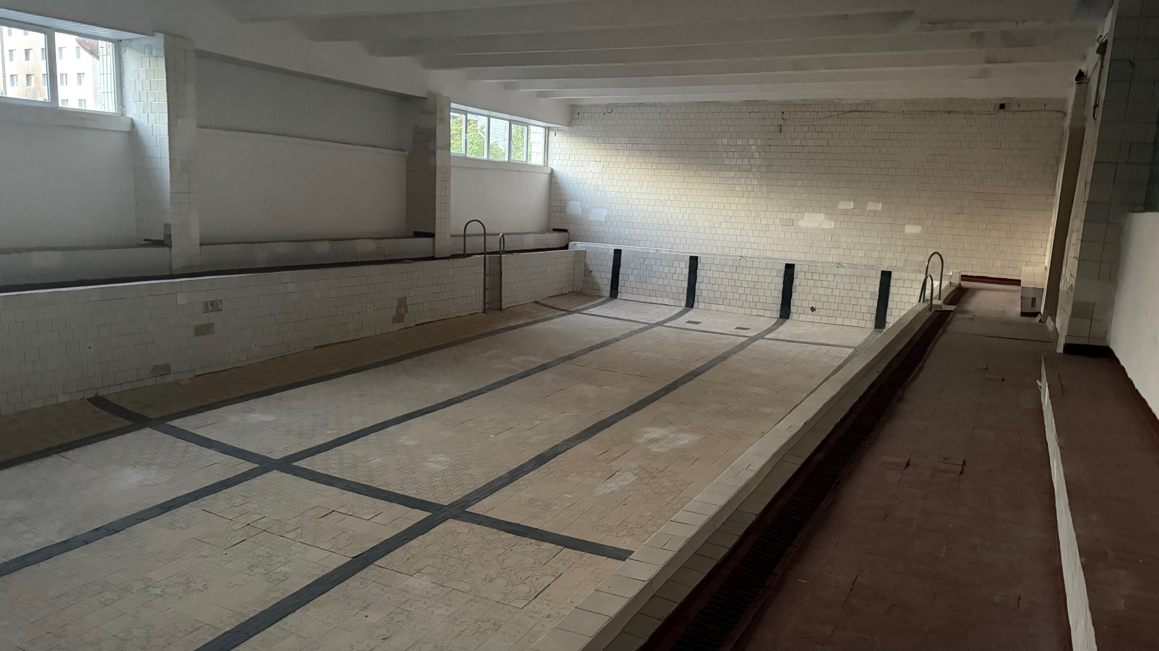
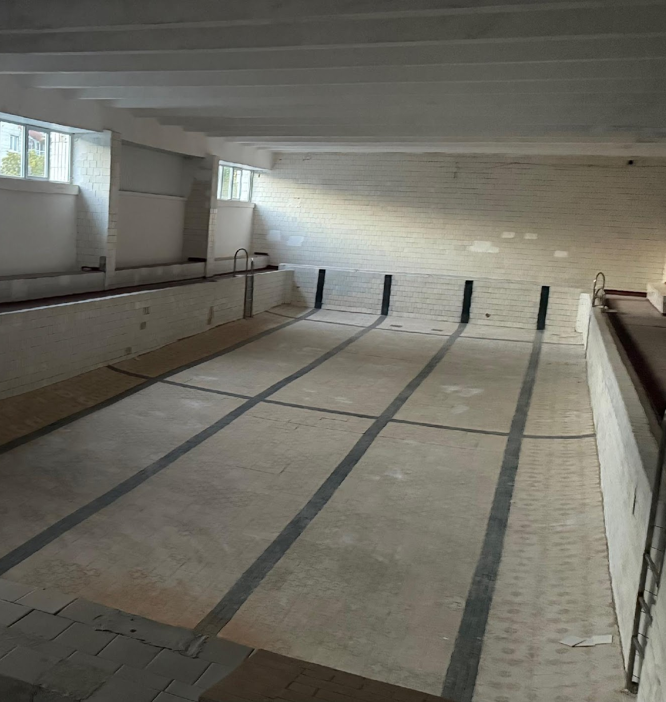
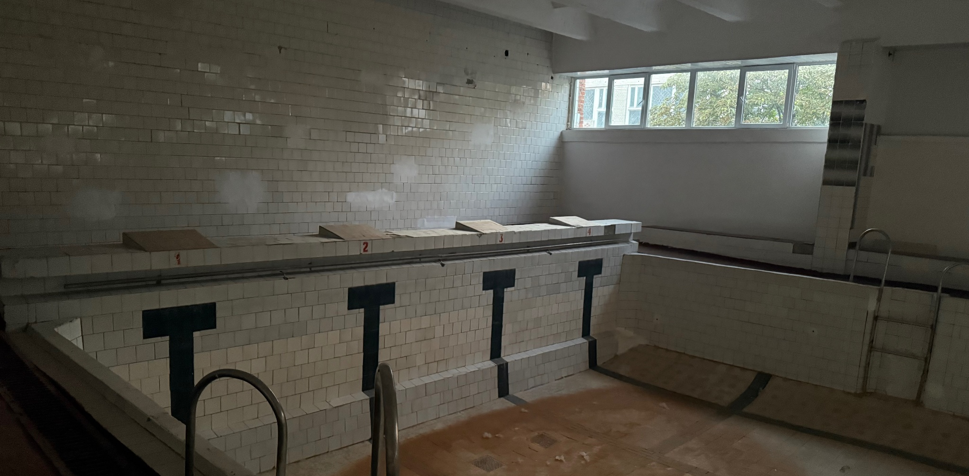

Slide 37
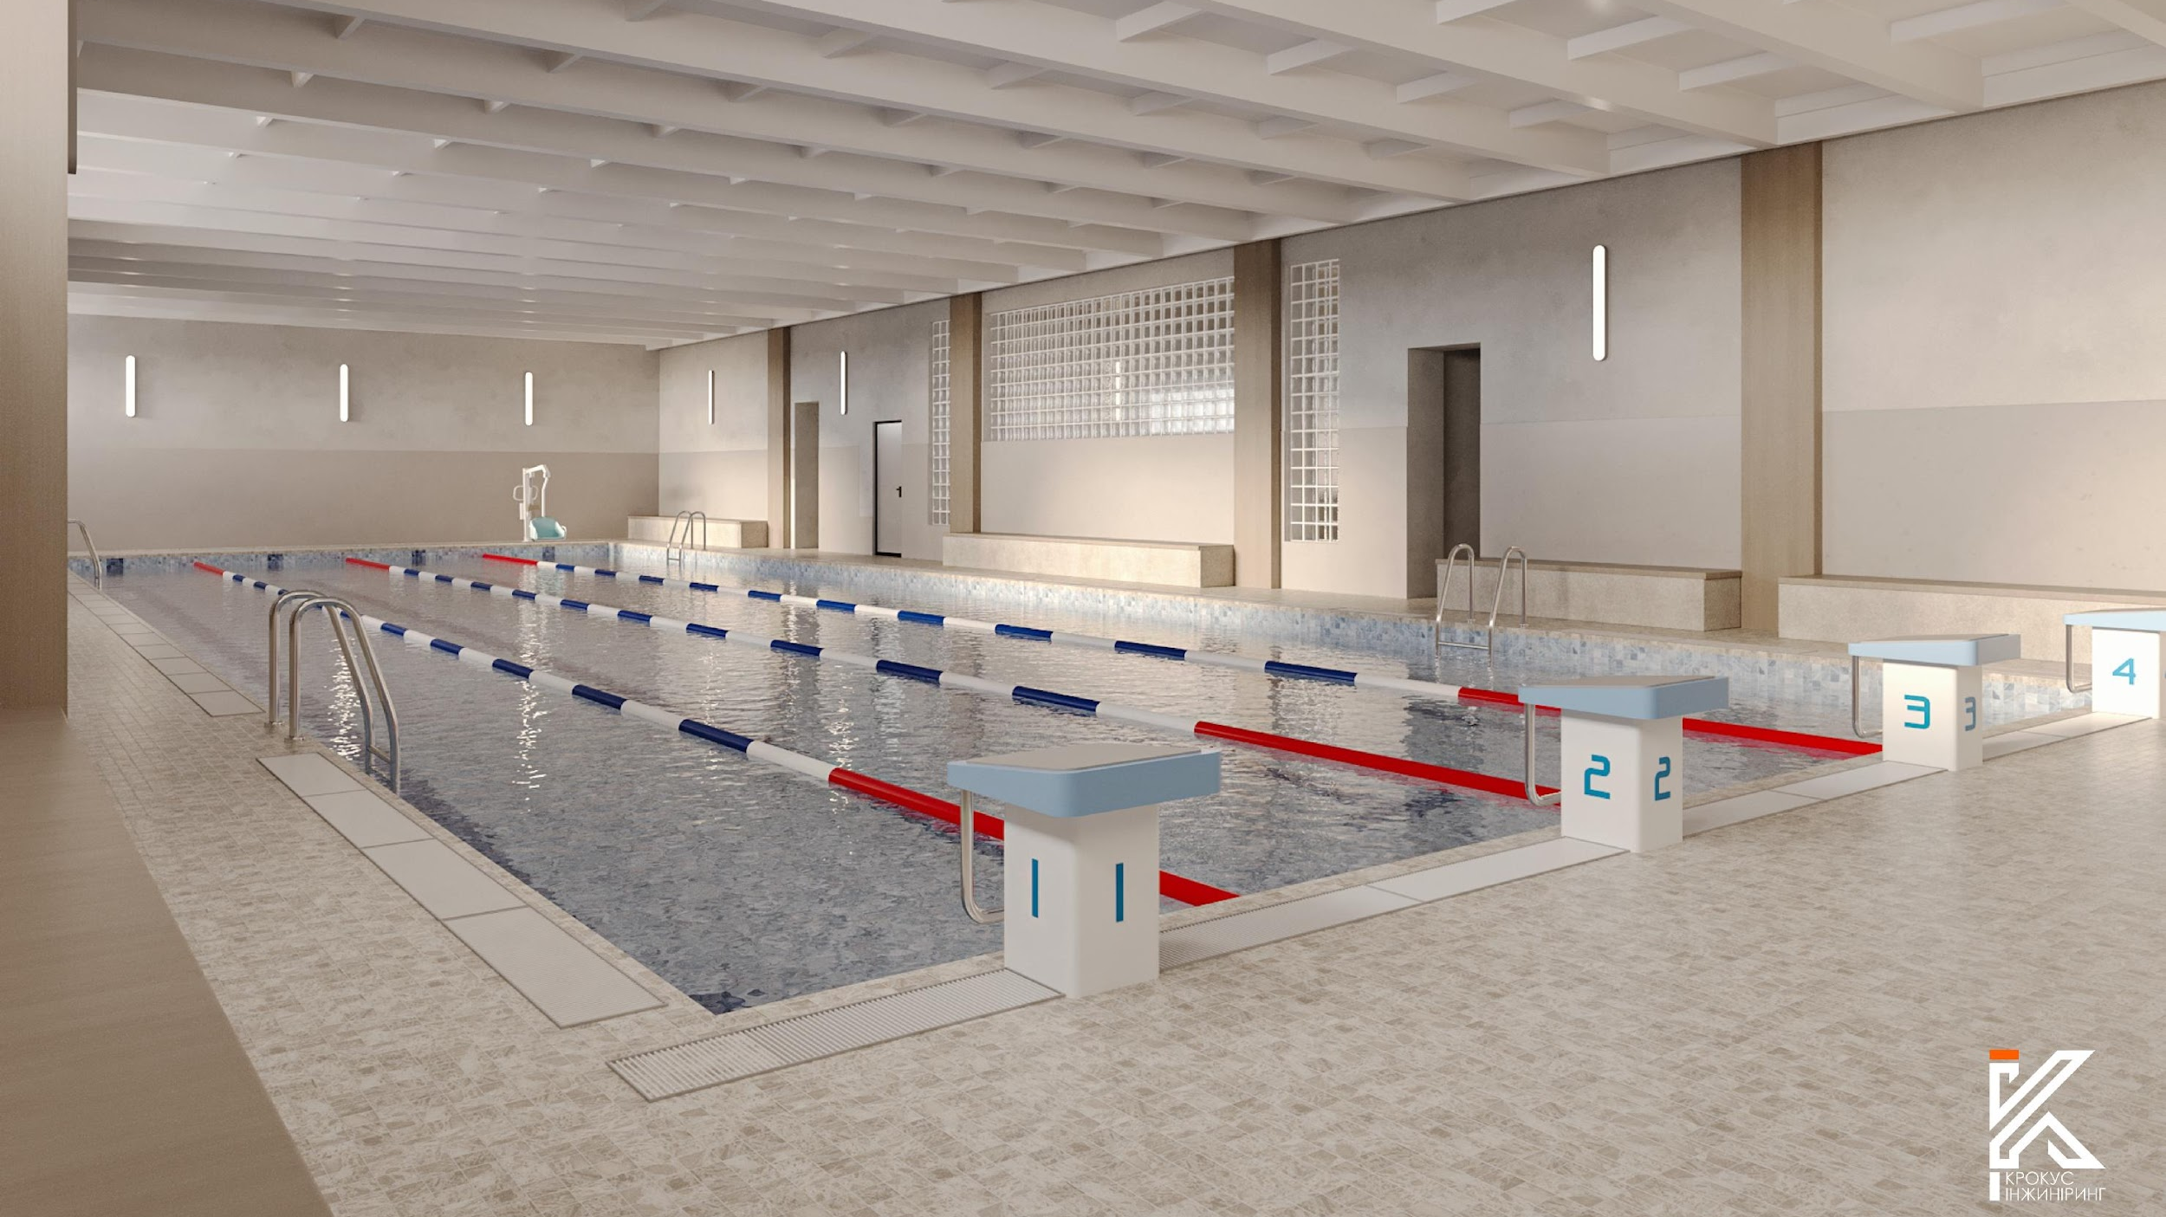

Slide 38
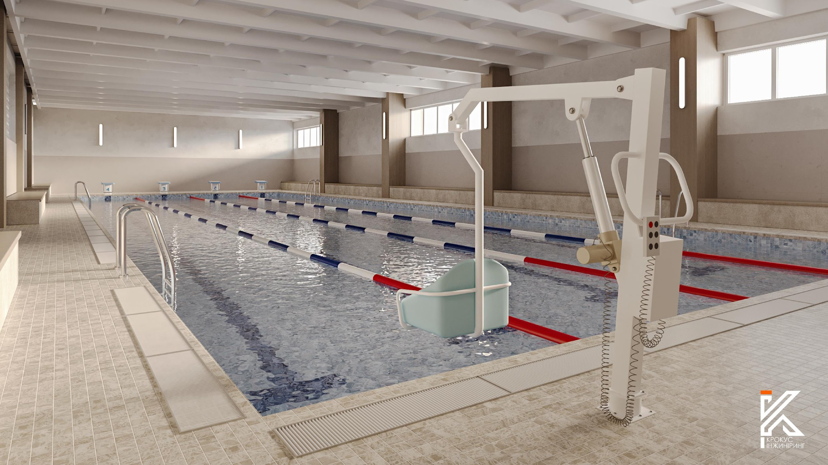

Slide 39
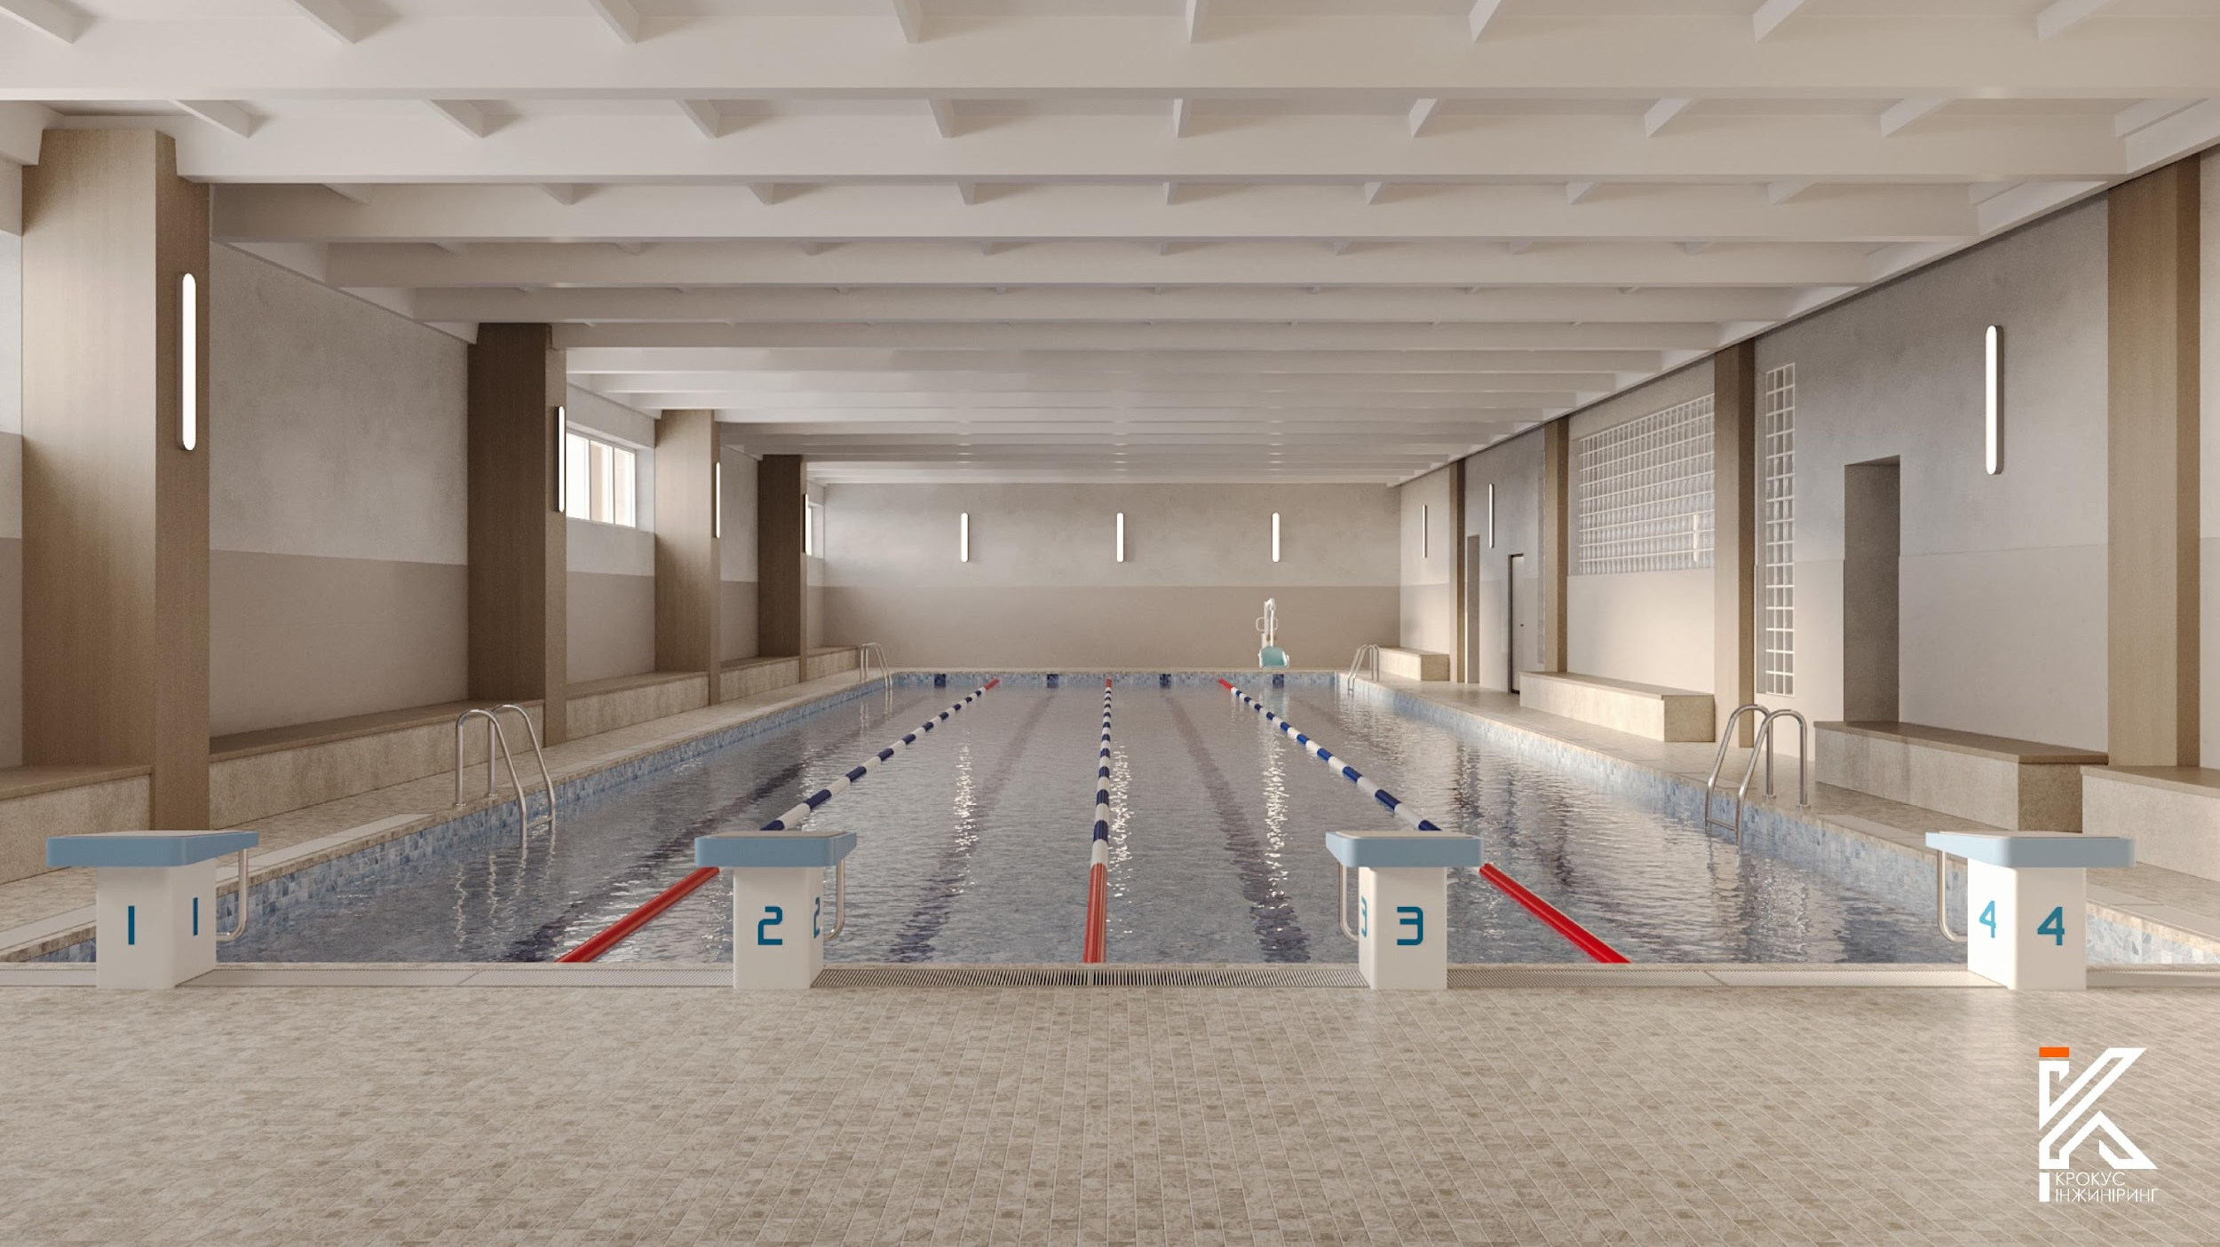

Slide 40
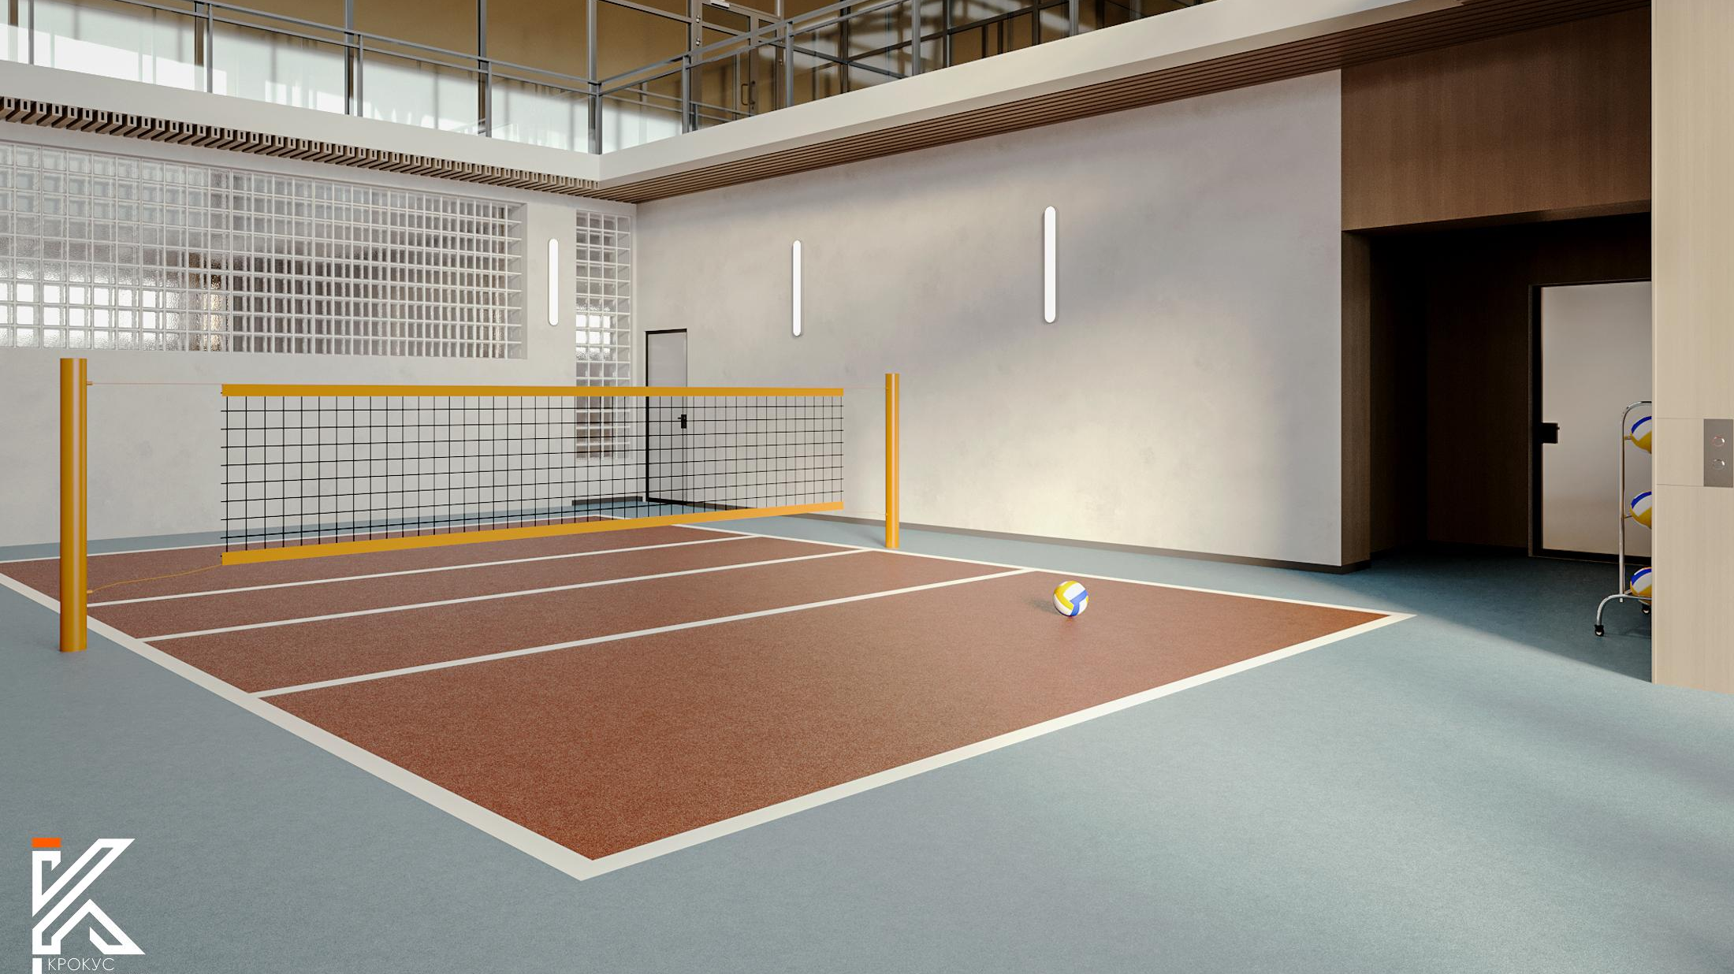

Slide 41
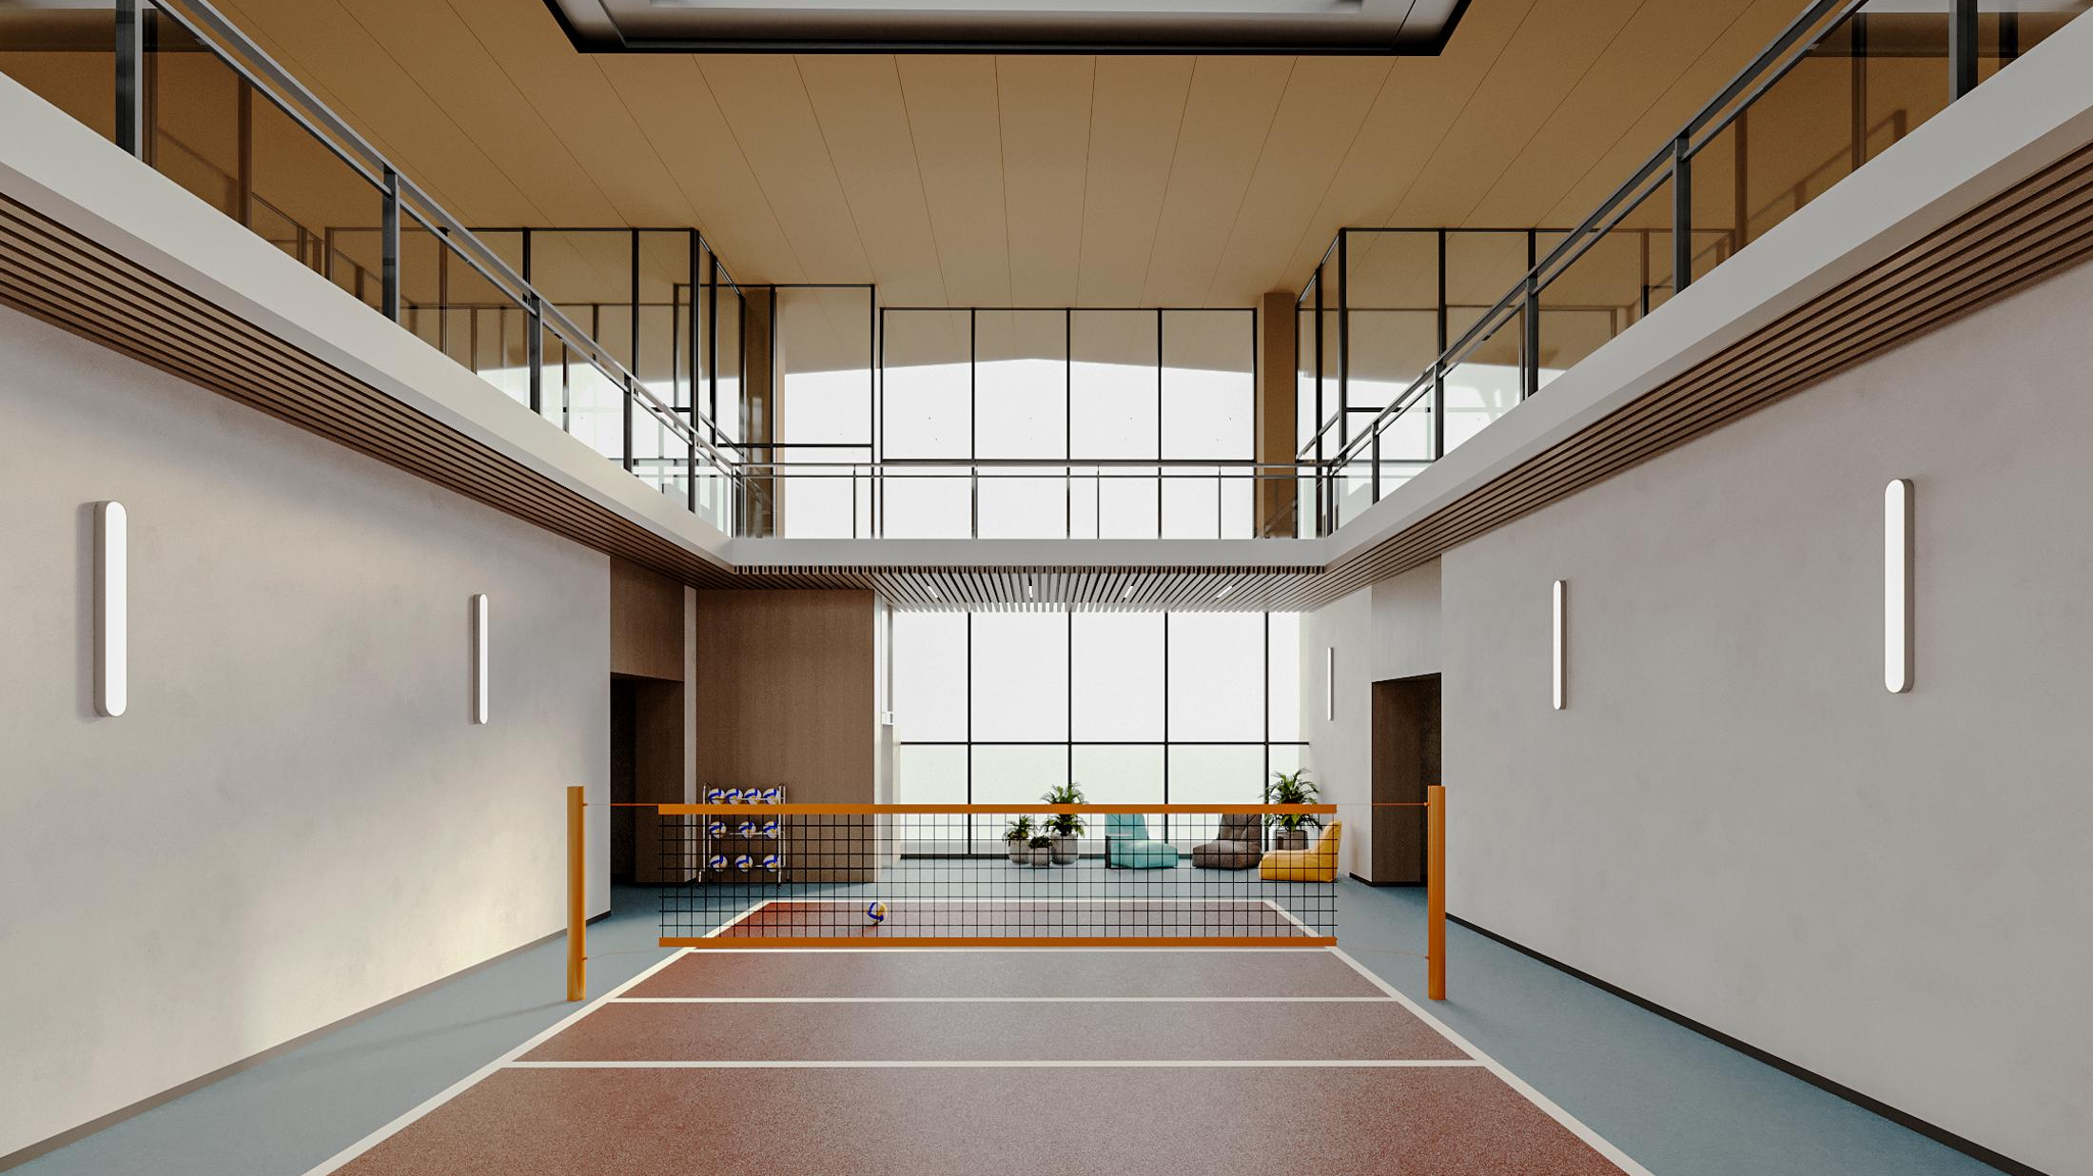

Slide 42
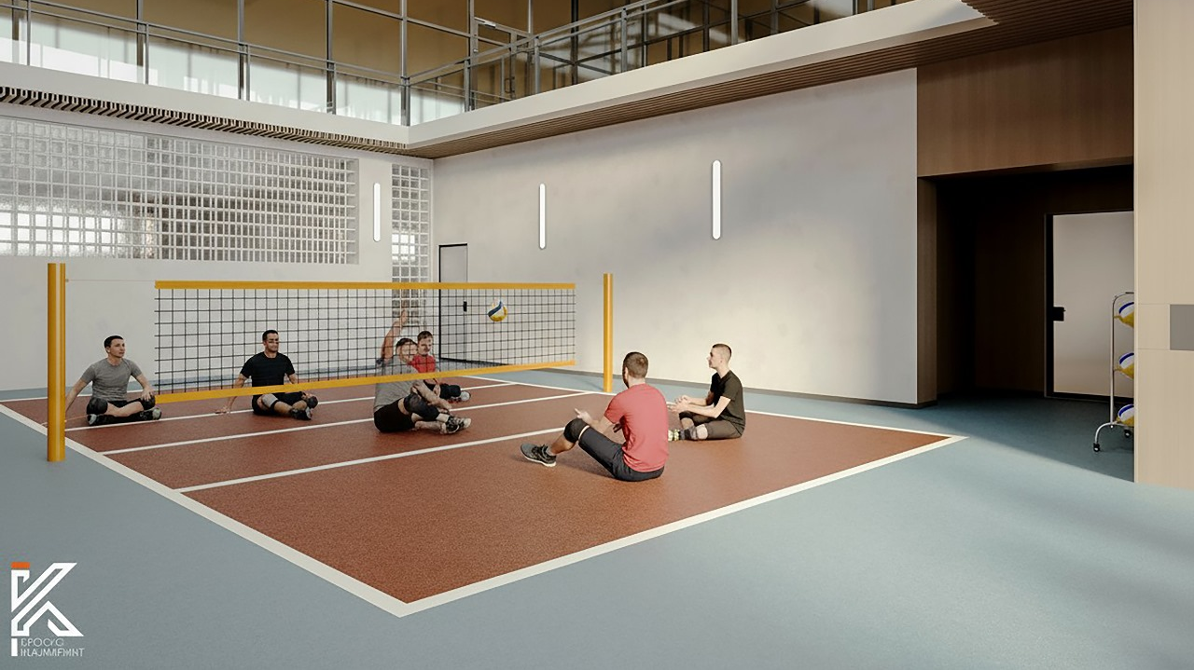

Slide 43
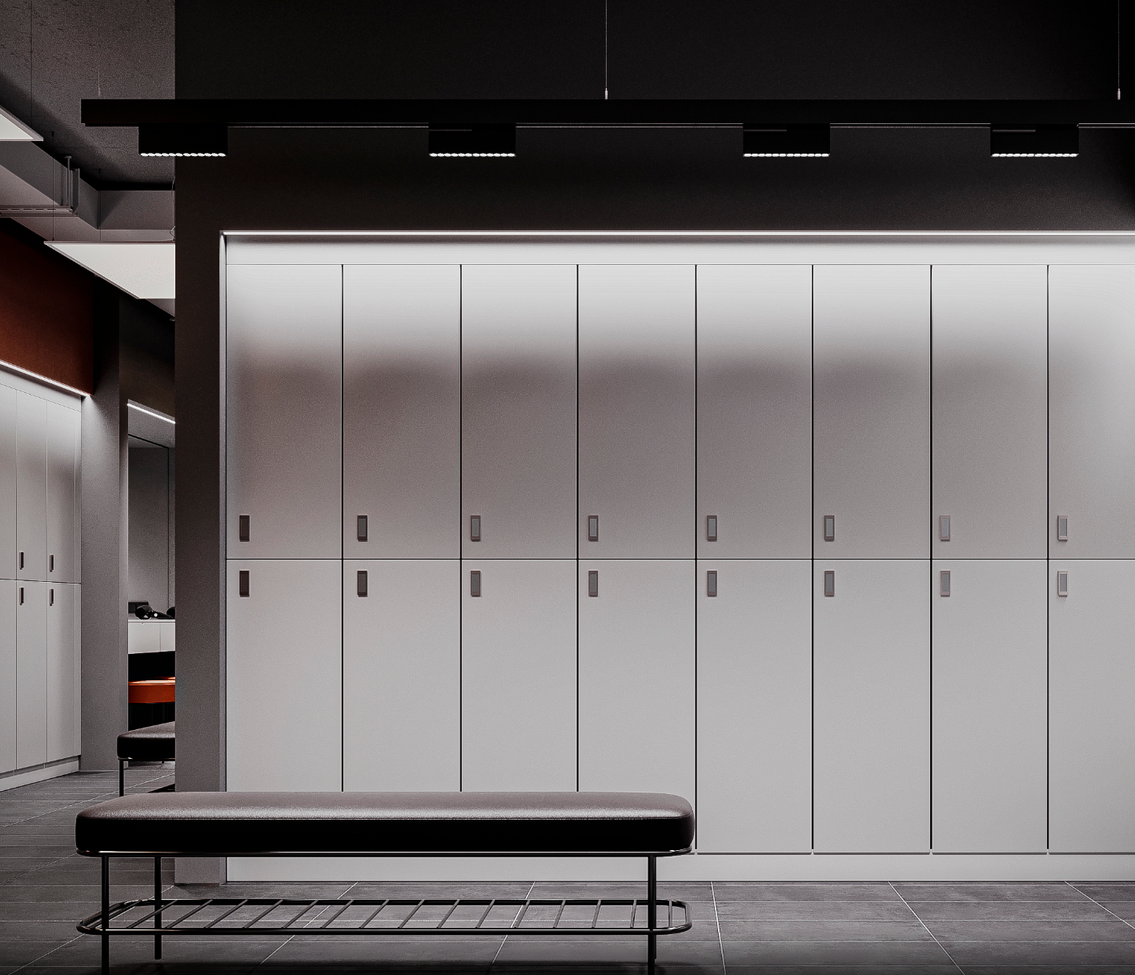
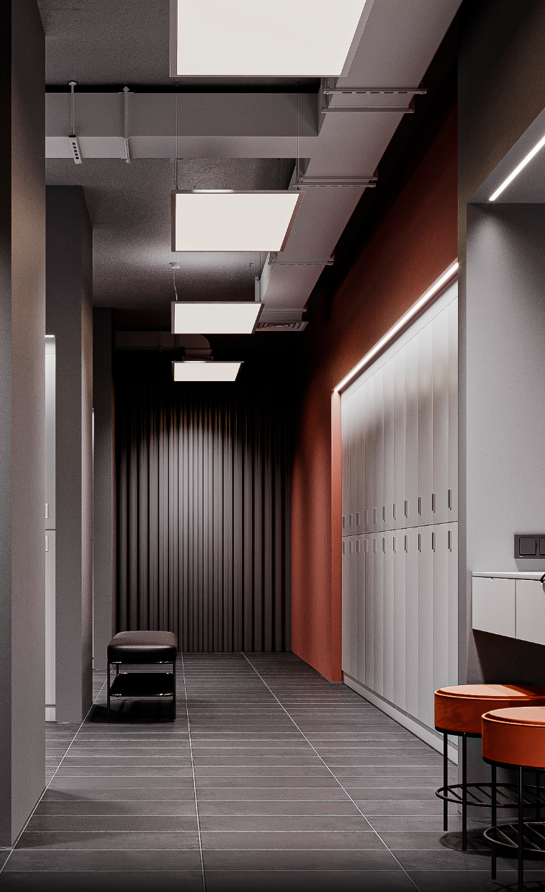

Slide 44
SUMY | VETERAN PRO
From Idea – Through Experience – To Implementation
Third Floor
This level is designed as a space for mental health, creative expression, personal development, learning, and communication. It will also partially house the center’s administrative offices.
It will include:
  Two rooms for individual sessions with psychologists
  A room for group counseling and art therapy activities (including painting and pottery workshops)
  A VR zone (for e-sports and VR therapy)
  Offices for administrative staff and specialists
  A modular conference hall that can be adapted as a training venue, a creative performance space (concerts, plays, acoustic sessions), or used for large events (capacity: 100 people)
The third floor is designed as an atrium, creating additional open space, providing more natural light, and enhancing comfort.
Terraces along the perimeter will serve as informal, psychologically supportive spaces for communication or solitude.

Slide 45

Third Floor

Slide 46
IMPROVING THE QUALITY OF LIFE FOR VETERANS AND THEIR FAMILIES
Comprehensive support promotes both physical and psychological recovery, facilitates social adaptation, and helps reduce isolation. Families also receive assistance, which contributes to their overall well-being
SOCIAL COHESION
Building a veteran community and fostering partnerships strengthens social connections, encourages mutual support, and promotes the development of civic initiatives. Ultimately, it helps shape a veteran-oriented society
SUMY | VETERAN PRO
Expected Outcomes and Community Benefits
ECONOMIC BENEFIT
Supporting veteran entrepreneurship, retraining, and job creation for specialists — such as psychologists, lawyers, and trainers — stimulates employment, attracts investment, and fosters the development of small businesses
REGIONAL ATTRACTIVENESS AND INTERNATIONAL PARTNERSHIP
Attracting grants and partners enhances financial stability and strengthens Sumy’s image as a region that supports its defenders. Collaboration with donors and international organizations enables the implementation of best practices, expands opportunities for veterans, and raises the region’s credibility
A POSITIVE PUBLIC IMAGE OF VETERANS
Promoting veterans’ experience and leadership helps break down stereotypes, fosters respect within society, and inspires young people to take an active civic stance
"Resilience and the European future of Sumy region"

Slide 47

SUMY | VETERAN PRO
we are supported by
"Resilience and the European future of Sumy region"
30.10.2025

Slide 48


SERHII KOZNIENKO
VETERAN, DEPUTY DIRECTOR OF THE REGIONAL VETERAN SUPPORT CENTER
"I have no right to give up. I know that my example motivates my comrades and inspires hope. We won’t be able to save everyone. But if we manage to bring even one veteran back to life, it’s worth fighting for”
SUMY | VETERAN PRO
a space where life continues
SUMY: VETERAN PRO
A space where resilience takes shape. It’s a place where the experience of war transforms into action, leadership, and support
"Resilience and the European future of Sumy region"
30.10.2025

Slide 49


SUMY | VETERAN PRO
Thank you for your attention!
Project group
Andriana Kostenko
Doctor of Political Sciences, Professor, Head of the Department of Psychology, Political Science and Sociocultural Technologies of Sumy State University
Phone: +380 50 974 11 49
e-mail: kostenkopr@ukrnet

Slide 50


"Resilience and the European future of Sumy region"
Sumy | Veteran PRO
30.10.2025
The MAN TGE Crewliner has 11 passenger seats in the cabin on fixed seats, 2 seats for passengers in wheelchairs for people with special needs
The wheelchairs included in the vehicle, Solero Light 9.072, are leading representatives of multifunctional chairs for people with special needs and allow you to adjust the chair in terms of depth, headrest height, leg position, tilt, etc. They allow you to transport a person up to 130 kg
Each wheelchair is attached to the floor rail system using a special AMF Bruns Protektor 2.0 (H 450 504 LV) retaining system
The lift for lifting people with special needs in wheelchairs at the back of the MAN TGE Crewliner also has handling features. The lift has a maximum lifting capacity of 350 kg. It is very convenient to control the elevator from your phone by downloading the Braunability Remote application

Slide 51





Sumy | Veteran PRO
"Resilience and the European future of Sumy region"
30.10.2025

